Slide 1
Experiential Learning
Continuing Airworthiness Management

Slide 2
Topics
What systems are we thinking of..
Process of conversion from AMO to Part M and Part 145
Organizational transformation and challenges
Airworthiness Renewal
How do we tackle it
What else we can do?

Slide 3
Systems
What Systems Should We Create?
Part 145
Part M
Tech
Fleet
Plan
Work
$
Ctrl
Regulations
Commercial

Slide 4
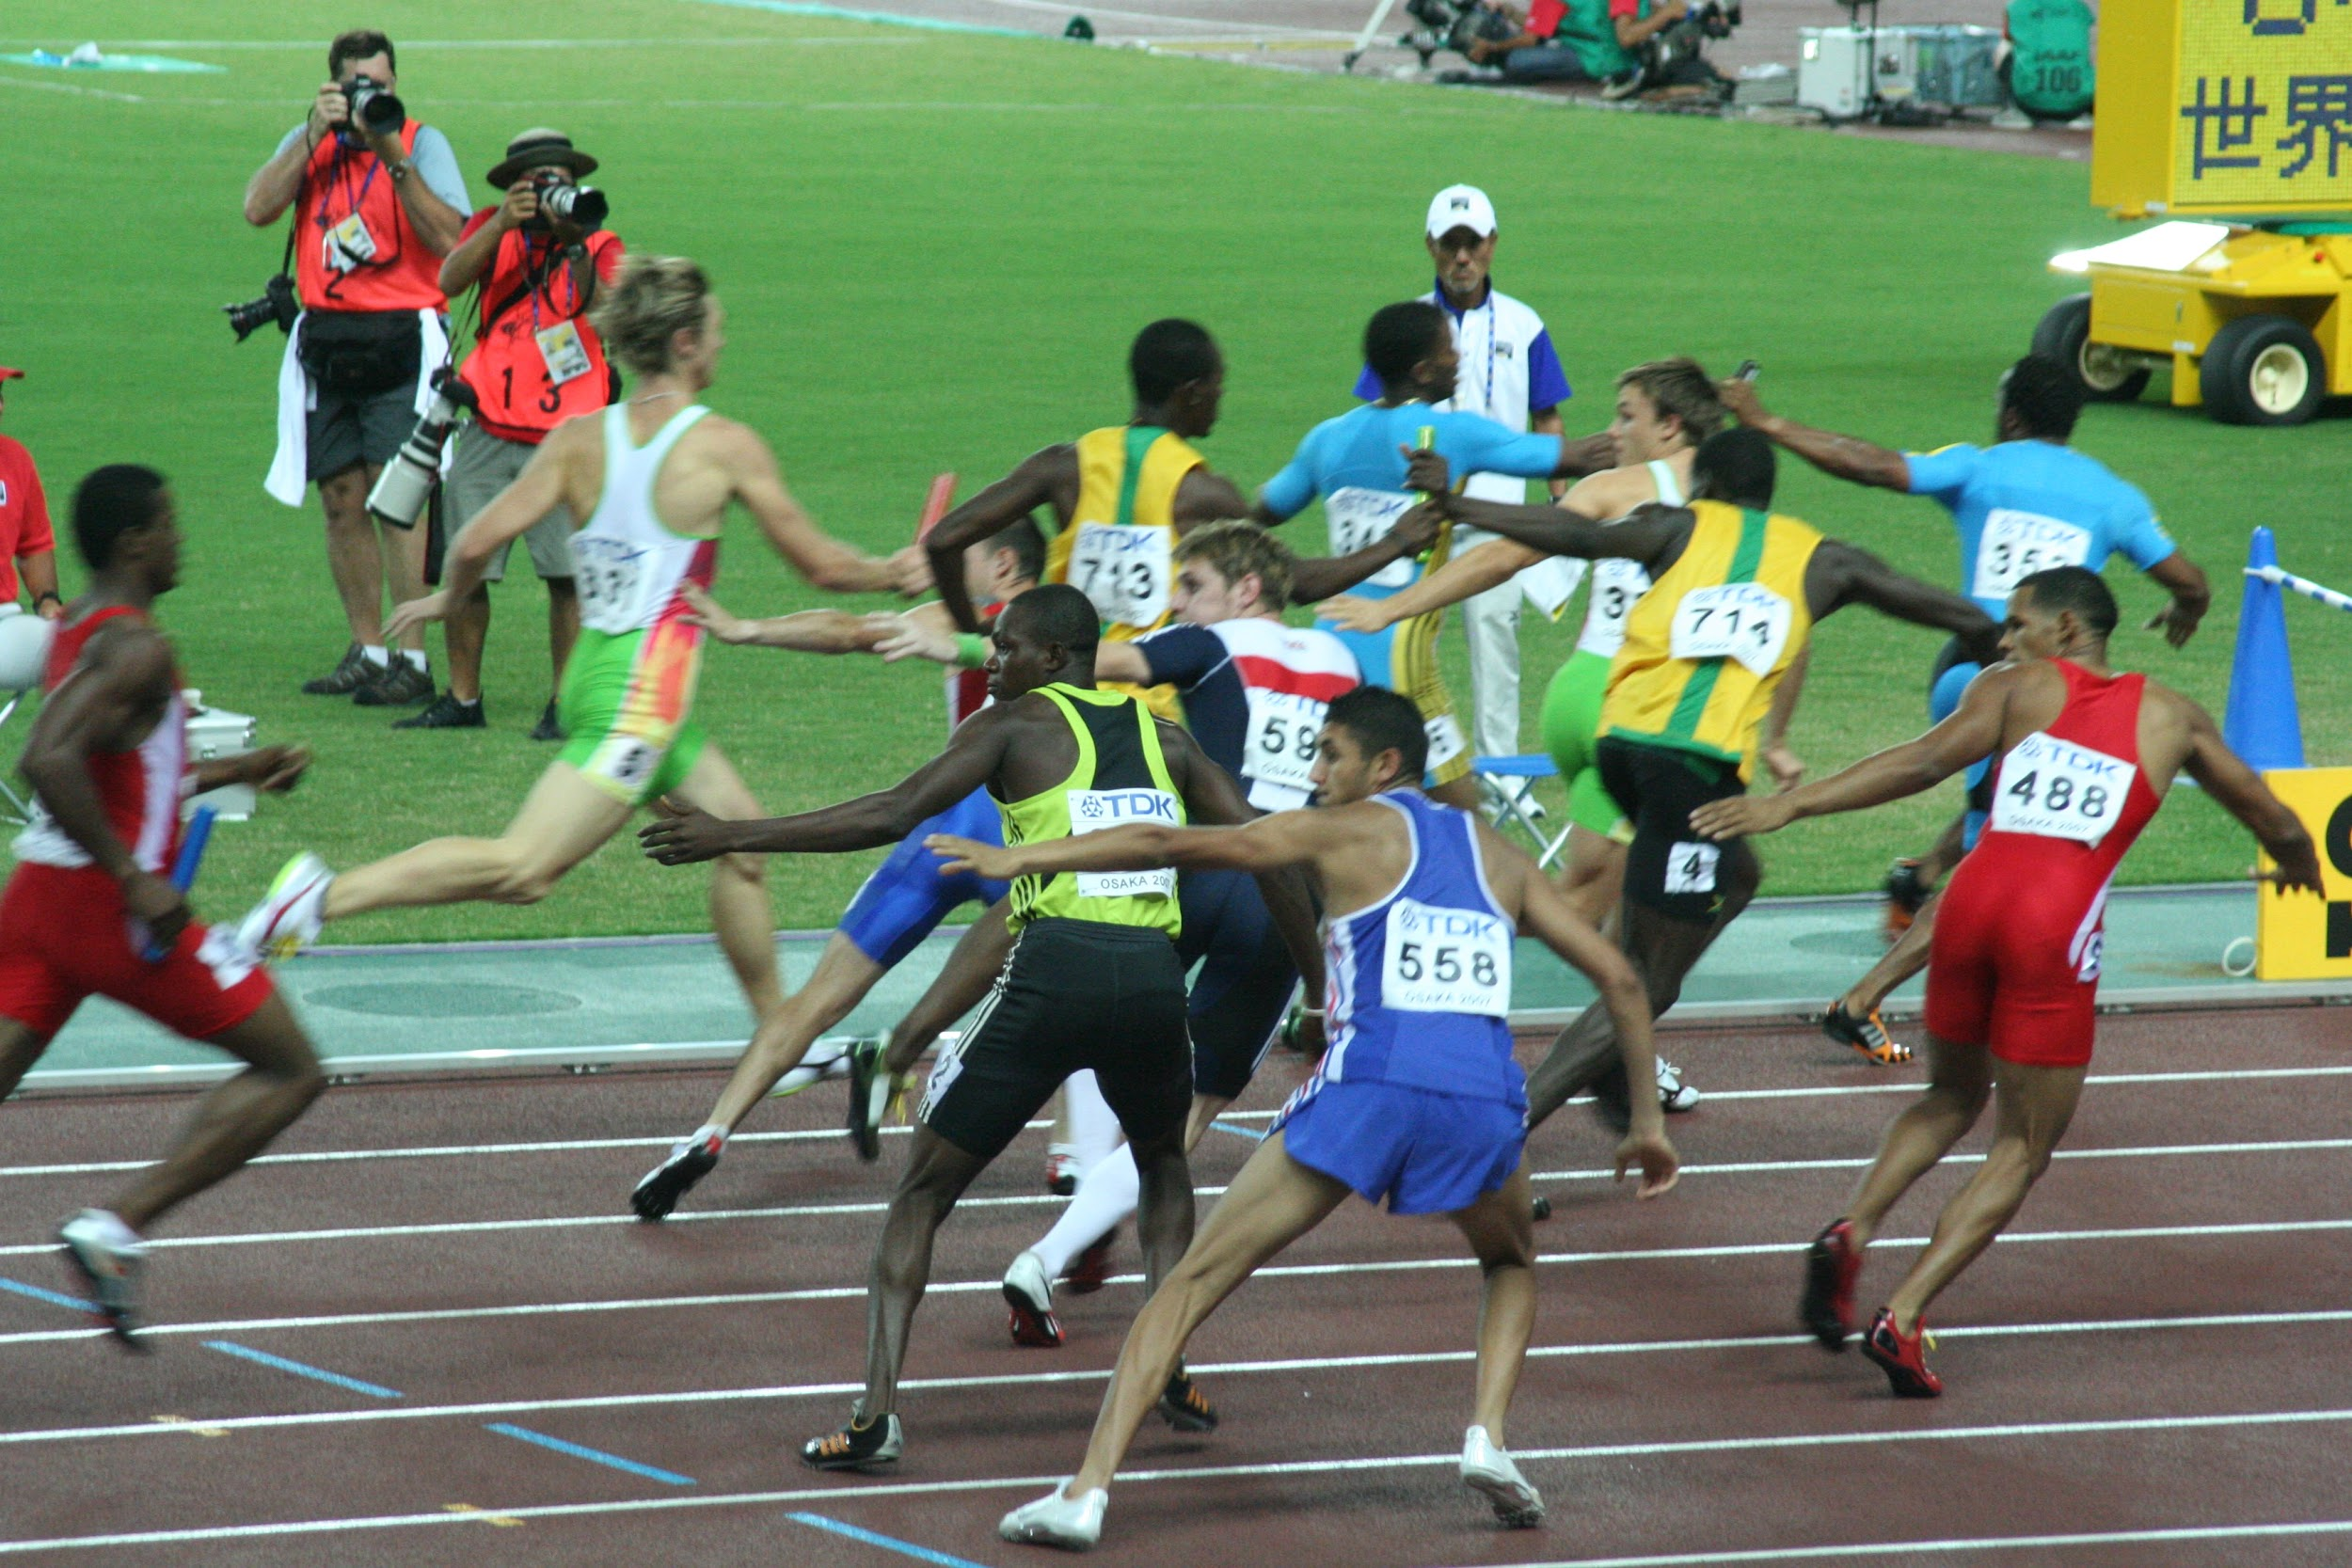
Conversion Process
Weekly meetings
Current operators experience
Current rules
Trainings
Manuals cocreation
MOC/Audits
Certification
Nominated holders
Compensation

Slide 5
Transformation
Partitioning the AMO and convert into Part M and Part 145
Part 145s
(inhouse, MROs)
AMO
Part M

Slide 6
From the Airworthiness Renewal Lesson Learns
Quality vs Airworthiness - how to segregate these findings (example - Lion case)
Mindset change - Does people attitude/mindset change?
Synchronization between Part M and Part 145s - Dissimilar size and pressure
Errors and mistakes - Punish on the very first time, make no mistake!

Slide 7
What We Experienced (uncovered) and We Obliged
Nominated holder is selected by the accountable manager
Understanding of the meaning of “sufficient” knowledge of continuing airworthiness as per para 9.8 of AN 6102 For example..
9.8 - All persons referred to in paragraphs 9.3, 9.4 and 9.5 of this Notice shall be able to show sufficient knowledge, background and appropriate experience related to aircraft continuing airworthiness to the satisfaction of the Director General.
Timeline for getting approvals, do we hang our organization for some period?
Poison pen emails...
EASA Part M and local authority Part M
Experience building thru partnerships

Slide 8
How Should We Tackle It? What Should We Exploit?
Academic studies; we need more and more independent and analytical academic papers for creating dynamics of rules and policy.
Feedback loop to correct our misunderstandings; this should be a continuous improvement
Measure the effectiveness of any implementations. Where is the indicator?
Building competencies thru practical training, coaching and seminars
Mutual respect; all ready rules is meant to regulate. Hence we should not create more rules in order to regulate.
Building trusts among stakeholders
Communications - do we really communicate well?

Slide 9
What Else We Can Explore?
Digital technology
Blockchain for supporting operations during multiple AOGs.
Prediction for managing interruptions
Text mining for chronic defect
Bayesian for chronic defect/troubleshooting
Platform for collaborative management OEM+airlines+shops
Big data for visualization looking for opportunities
2. Organizational Transformation - get more signal than noises
3. Augmented decision making - get more tools than manpower

