Slide 1
Looking From A Different Perspectives
One ASEAN Regulatory
If you want to understand something well, try to explain it simply.

Slide 2
Agenda
Why do we have to look from a different point of view?
Threat from the north
Wall in the middle east
Inherent issues within ASEAN geography
What are already in place?
What else we can do jointly?
How do we start?

Slide 3
Why are we looking from a different point of view?
“I have learned that two people can look at the exact same thing and see something totally different”.
begin
end

Slide 4
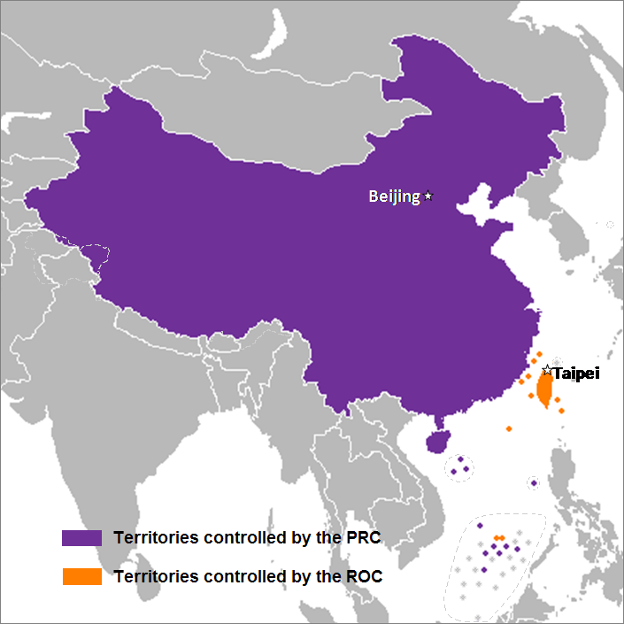
Swarming Flights from the North
What happen when there are more flights from China to ASEAN in the future?
What happen when China impose new rules after rules in order for us to fly freely into China?
What happen when (airports) slot time in China is getting less and lesser?
What happen when ASEAN open it skies?

Slide 5
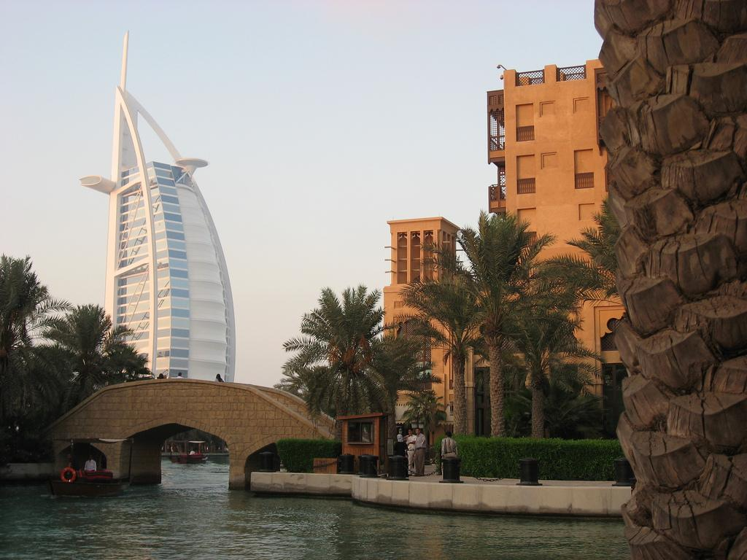
The stumbling wall in the middle east
Can we beat the middle east airlines in order to fly to overfly to Europe today and be profitable?
Can we be protected from the threat by hugh middle east airlines encroaching into our market segment/catchment area?
Can we insulate ourselves from the middle eastern airlines doing network/code sharing with few giant Chinese airlines?

Slide 6
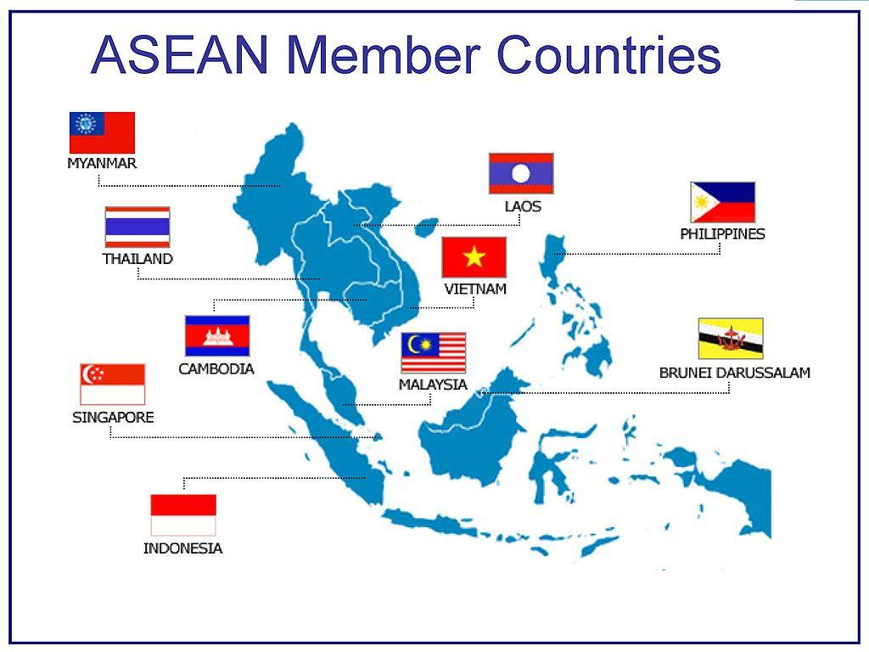
Inherent geographical disadvantages
Having more water than land - is it an advantage to the airlines industry?
Size of land area are small but population are dense, is this good for regulations?
In the middle of ring of fire, affected by climate
Language barrier and cultural diversity
History of colonialism, historically some at war
Fewer big metro cities

Slide 7
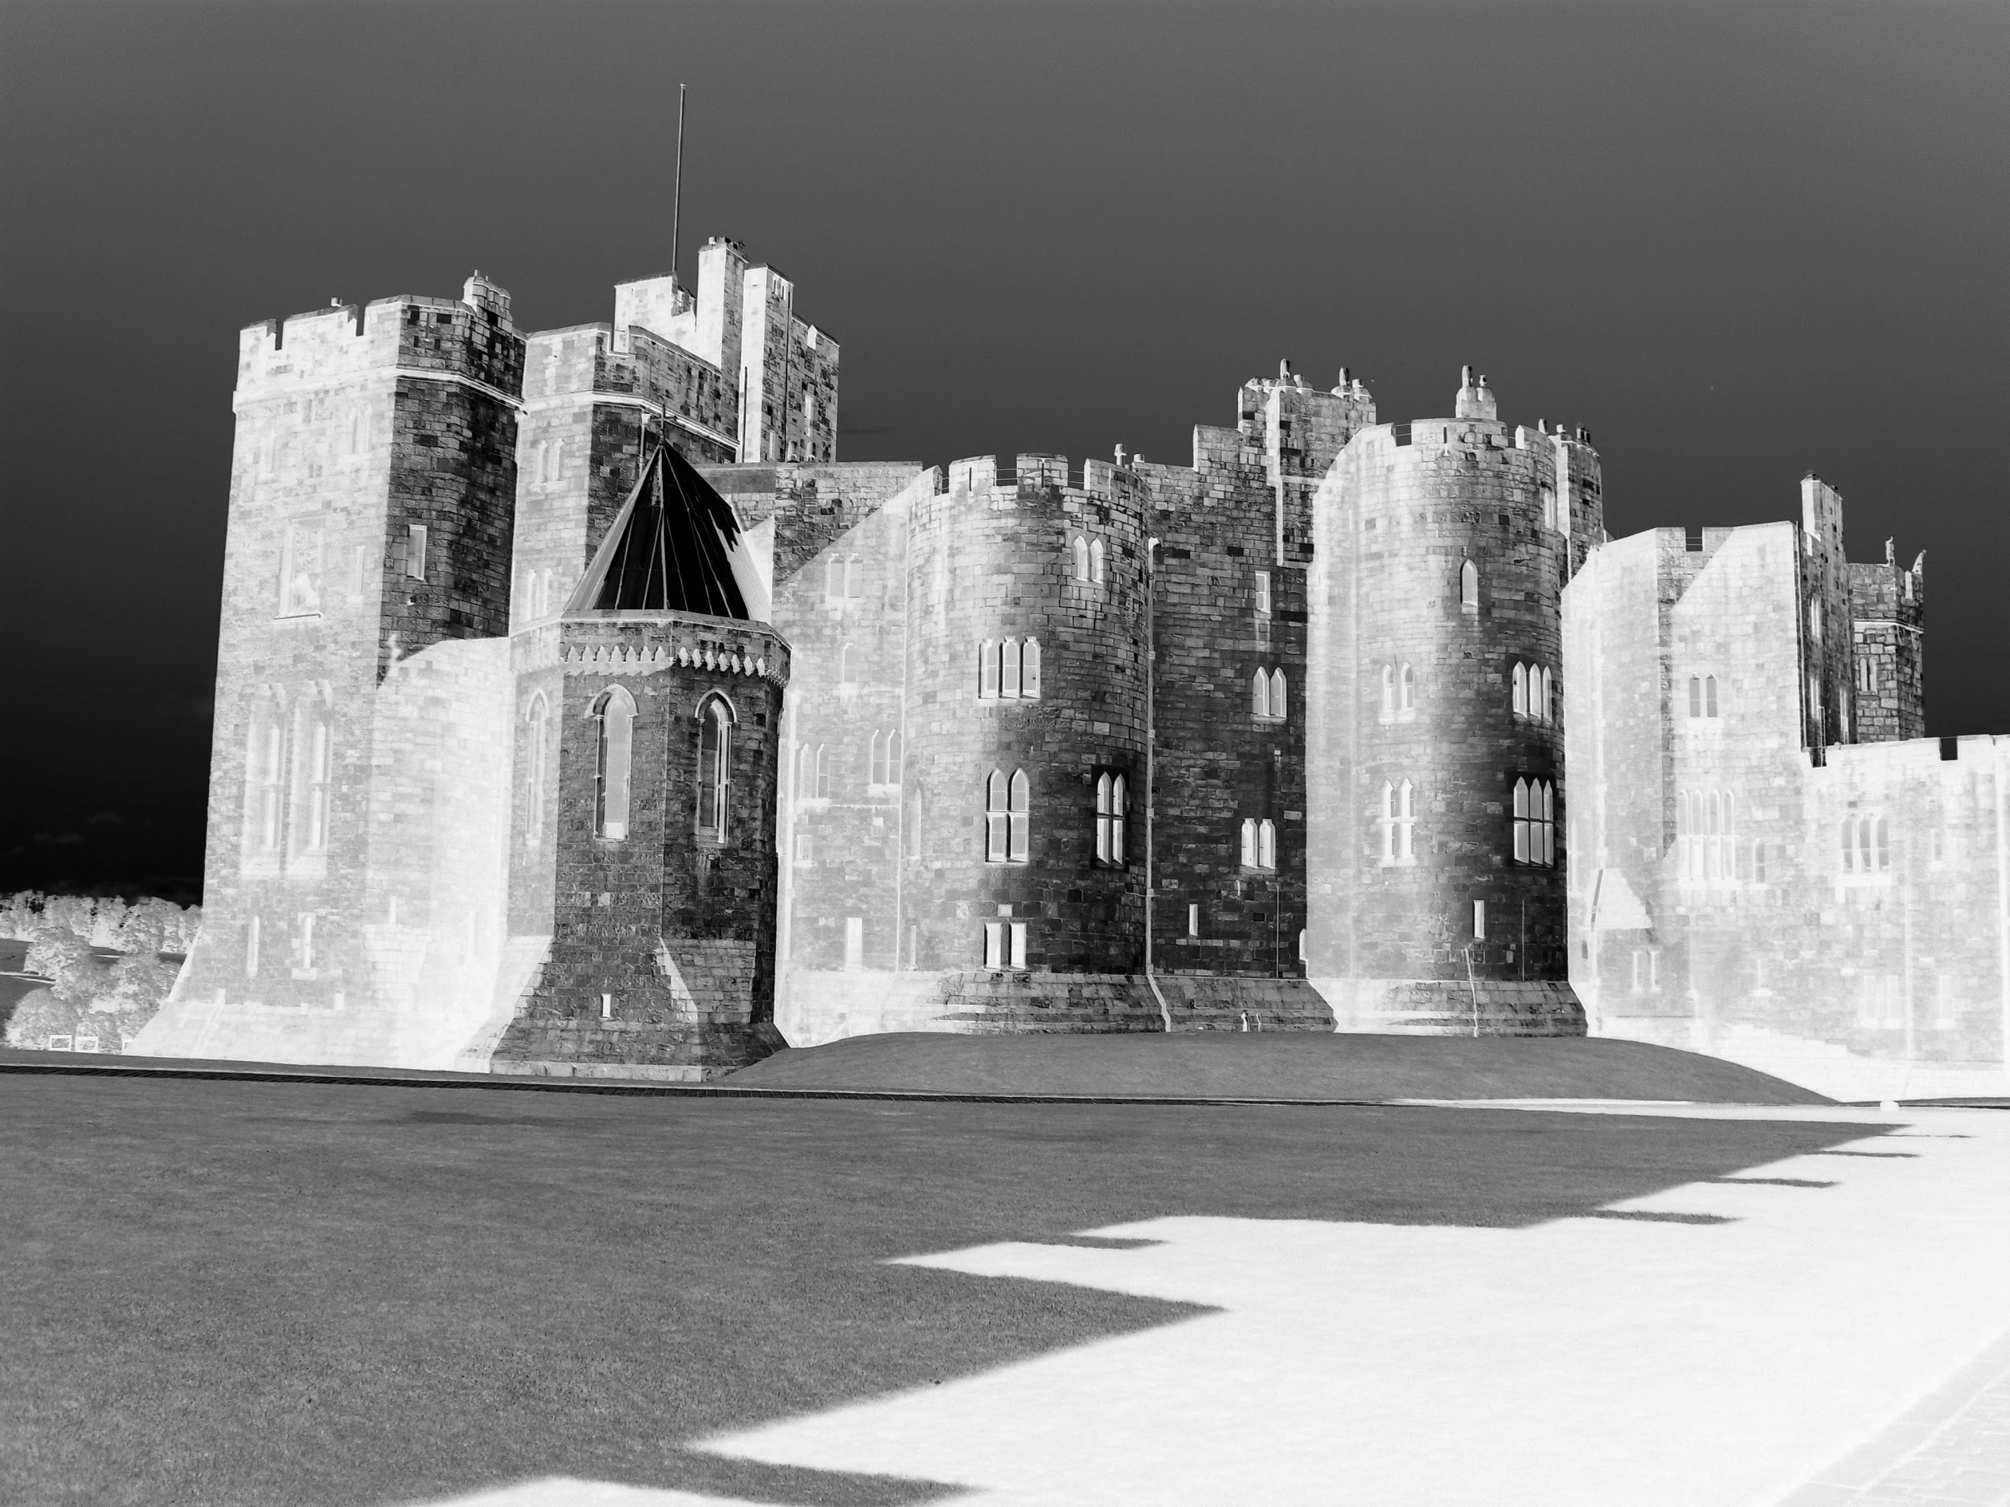
We need to build castle together!
ASEAN Regulation
1
=

Slide 8
What is already in place?
ASAM
SEARIF, authority club where meeting were to set directions for Part M by country..
ICAO Office in Bangkok, recently there was a First Meeting of ASEAN Regulators
EASA Office teaming up with COSCAP to “assist” the enforcement
Established local authorities, under ICAO governance
Safety investigation
SMS

Slide 9
What areas to explore, where to exploit?
Oversight, enforcement
Associations
Leaderships
Job market growth
Universities and colleges
Exploit EASA/ASEAN Authorities Agreement
Exploit personnel licensing interASEAN recognition
Exploit Design Organization Approval recognition
Exploit Part M standardization
Exploit 83 Bis
UAV rules
Ministerial
Regulators
Universities/Colleges

Slide 10
Where do we start?
“Start Up Organization” for ASEAN regulatory agency.
Endorsement by ASEAN ministries
Small facility to house “management and operations”
Enforcement
Technology
Facility
Organize
Endorsement
Enforcement
Platform Technology

