Slide 1

AIR ACCIDENT INVESTIGATION BUREAU (AAIB) MALAYSIA
BIRO SIASATAN KEMALANGAN UDARA (BSKU)
AIR ACCIDENT INVESTIGATION BUREAU ROLE AND RESPONSIBILITY
Presenter
Capt. Dato’ Yahaya Abdul Rahman
(Chief Inspector of AAIB)
20th December 2018

Slide 2
BACKGROUND
DCA was responsible for Air Accident Investigation prior to 2013
The Chief Inspector of Air Accident was appointed by Minister of Transport;
BG Omar bin Saman
Capt Abdul Shukur Abdul Aziz
En Idrus Abdul Rahman
ICAO Annex 13, Paragraph 3.2 on independence of investigation;
A state shall establish an accident investigation authority that is independent from State aviation authorities and other entities that could interfere with the conduct or objectivity of the investigation.
AAIB/BSKU was formed under MOT in March 2013 and headed by;
En Yusof Ahmad ( October 2013 until April 2016)
Capt Dato Yahaya Abdul Rahman ( From 16 April 2016 to date )

Slide 3
SCOPE OF PRESENTATION
Legislation and Procedures
Definition Accident/Incident
Role and Function of AAIB
MOT/ AAIB Organisation Chart
Handling of Major Accident
Investigation Phases
Occurrence Reporting
Safety Data
Identified Hazards
Safety promotions
ICAO Audit / Chalenges

Slide 4

AAIB LEGISLATION AND PROCEDURES
Civil Aviation Act 1969
Civil Aviation Regulations 2016
(Reg. 183-188)
Minister of Transport Directives
(ICAO Annex 13)
Air Accident Investigation Policy and Procedure Manual
Aviation Safety Circular

Slide 5
DEFINITIONACCIDENT
ACCIDENT
An occurrence associated with the operation of an aircraft which takes place between the time any person boards the aircraft with the intention of flight until such time as all such persons have disembarked, in which:
A person is fatally or seriously injured
a) being in the aircraft
b) direct contact with any part of the aircraft
c) direct exposure to jet blast
The aircraft sustains damage or structual failure
The aircraft is missing or is completely inaccessible

Slide 6
DEFINITION OF INCIDENT/SERIOUS INCIDENT
INCIDENT
An occurrence, other than an accident, associate with the operation of an aircraft which affects or could affect the safety of operation.
SERIOUS INCIDENT
An incident involving circumstances indicating that an accident nearly occurred
Near collision
Controlled flight into terrain only marginally avoided
Aborted take off on closed or engaged runway
Take off from closed or engaged runway
Landing or attempted landings on a closed or engaged runway
Flight crew incapacitant
Fuel quantity requiring the declaration of an emergency by pilot
And more, the list is not exhaustive

Slide 7
ROLES AND FUNCTIONS OF AAIB
Carry out an independent accident and serious incident investigation to prevent future occurrence and not to apportion blame and liability
To identify immediate underlying systemic causes, hazards, errors or deficiency of an accident and recommend appropriate safety action
Determine the facts, conditions and circumstances pertaining to the survival or non- survival of the occupants and recommendation for improvement
Properly planned and managed accident investigation program in accordance with international SARP.
The final report as the official conclusion of the investigation. The investigation can be reopened if new evidence become available.

Slide 8
MOT ORGANISATION CHART
MENTERI PENGANGKUTAN
BIRO SIASATAN KEMALANGAN UDARA (BSKU)
TIMBALAN KETUA SETIAUSAHA
(DASAR)
TIMBALAN MENTERI
PENGANGKUTAN
KETUA SETIAUSAHA
UNIT AUDIT DALAM
UNIT INTEGRITI
UNIT KPI
UNIT PENASIHAT
UNDANG-UNDANG
UNIT KOMUNIKASI KORPORAT
TIMBALAN KETUA SETIAUSAHA
(PENGURUSAN)
BAHAGIAN PENTADBIRAN & KEWANGAN
BAHAGIAN PEMBANGUNAN
BAHAGIAN PENGURUSAN
SUMBER MANUSIA
BAHAGIAN AKAUN
BAHAGIAN PENGURUSAN MAKLUMAT
BAHAGIAN PERANCANGAN STRATEGIK & ANTARABANGSA
BAHAGIAN DARAT & LOGISTIK
BAHAGIAN MARITIM
BAHAGIAN UDARA

Slide 9
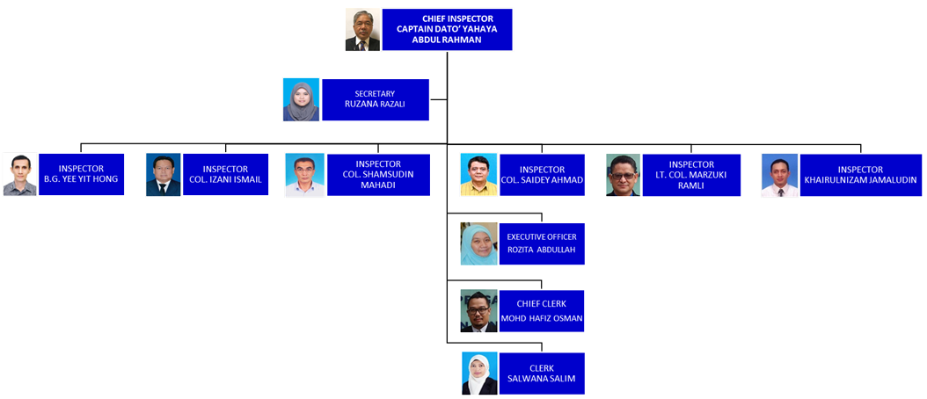
AAIB ORGANISATION
Established on 28 March 2013

Slide 10
APPOINTMENT OF INSPECTOR OF AIR ACCIDENT

Slide 11
MAJOR ACCIDENT
Definition of Major accident investigation – An investigation into an accident involving a large aircraft and usually involving fatalities.
IIC appointed from Senior investigator of the State Investigation Authority
Establish head of working groups
Members from states Accredited Representatives , experts from operators, manufacturer, powerplant and accessories

Slide 12
MAJOR AIRCRAFT ACCIDENT INVESTIGATION
INVESTIGATOR-IN-CHARGE
AIRWORTHINESS GROUP CHAIRMAN
MEDICAL/HUMAN FACTORS GROUP CHAIRMAN
OPERATIONS GROUP CHAIRMAN
MAINTENANCE & RECORDS
STRUCTURES
POWERPLANTS
SYSTEMS
SITE SURVEY
FLIGHT OPERATIONS
ATS & AIRPORTS
METEOROLOGY
WITNESSES
FLIGHT RECORDERS
PATHOLOGY
PSYCHOLOGY
SURVIVAL FACTORS
CRASHWORTHINESS
CABIN SAFETY
FIRE & RESCUE
20 Investigators/ Special Investigators

Slide 13
L TIGATOR
VOLUNTEERS FOR AAIB SPECIAL INVESTIGATORS
No. | Investigators | Identity No. | Specialization | Employer
1 | Mohd Ezwani Kadir | 790321-03-5589 | Airworthiness | UniKL MIAT
2 | Mohamad Faizal Daud | 830223-02-5081 | Maintenance & records | UniKL MIAT
3 | Fadzil Adly Ishak | 770104-10-5917 | Systems | UniKL MIAT
4 | Afiq Faizal Azman | 830101-02-5729 | Powerplant | UniKL MIAT
5 | Syed Mohd Fadzly Syed Nokman | 760717-05-5167 | Structure | UniKL MIAT
6 | Nor Aina binti Musa | 820114-14-5448 | Systems | UniKL MIAT
7 | Dato’ Ir. Kok Soo Chon | 510627-08-5045 | Engineer ( MH 370 IIC) | DCA (Retired)
8 | Mohan a/l Suppiah | 550525-0805761 | Airworthiness | MAS, AIROD
9 | Captain Abdul Wahab | 540402-0806191 | Operations | MAS
10 | Dr. Mohd Shah Mahmood | 600226-01-5037 | Pathology | HKL
11 | Prof Madya Ir. Abu Hanifah Hj Abdullah | 661105-08-5441 | Airworthiness | UniKL MIAT
12 | Amirudin Ab. Ghani | 561120-04-5677 | Airworthiness | APR AV TRG CTR

Slide 14
L TIGATOR
VOLUNTEERS FOR AAIB SPECIAL INVESTIGATORS
No. | Investigators | Identity No. | Specialization | Employer
13 | Aslam Basha Khan | 621120-08-6243 | Airworthiness
14 | Syariza Binti Ismail | 780125-07-5920 | Structure | UniKL MIAT
15 | Rohana Binti Zakaria | 800430-11-5082 | Powerplant | UniKL MIAT
16 | Anuar Bin Mustam | 780212-01-6865 | Structure | UniKL MIAT
17 | Salina Binti Mohd Thani | 860604-56-6444 | Systems | UniKL MIAT
18 | Dato’ Paduka Captain Jalil Mat Dom | 480401-08-5419 | Operations | MAS (Retired)
19 | Muhammad Imran Ismail | 760723-02-5271 | Airworthiness
20 | Norwalena Abdul Wahab | 670902-07-5566 | Cabin Safety | MAS (Retired)
21 | Kho Sim Bin @ Khaw Sim Min | 440109-01-5433 | Communictions
22 | Dr. Pathmanathan Rajadurai | 530813-10-5677 | Pathology | HUKL
23 | ACP Mohd Rafique Ramli Ariffin | 590506-08-6669 | Operations | Royal Malaysia Police
24 | Tan Huvi Vein | 560126-08-5499 | Meteorology | Met. Department (Ret)
25 | Khoo Lay See | 801221-07-5074 | Forensics | HTAA

Slide 15
VOLUNTEERS FOR AAIB SPECIAL INVESTIGATORS
No | Investigators | Identity No. | Specialization | Employer
26 | Dato’ Suarn Singh Jasmit Singh | 530812-07-5074 | Psychology | Academy of Medicine
27 | Captain Azlan Zainal Abidin | 560213105005 | Pilot wide body | Self employed
28 | Lt. Col.(R) Dr. Meer Ahmad | 550211715417 | Lecturer in medicine | MAHSA University
29 | Mariana Binti Mat Rani | 790429-11-5492 | Structure | UniKL MIAT
30 | Nur Baiti Binti Mohd Halil | 841121-10-5906 | System | UniKL MIAT
31 | Yusri Bin Dahdi | 811004-05-5455 | Powerplant | UniKL MIAT
32 | Azlina Binti Mohd Ali | 810712-10-5682 | Maintenance & records | UniKL MIAT
33 | Ahmad Hafizi bin Zuriadi | 881209-08-6363 | Fight Recorder Analysis | G-7
34 | Ameer Darwiess bin Amran | 941129-03-5349 | Fight Recorder Analysis | Sepang Aerospace Engineering (SAE)
35 | Khairol Azuan bin Ali | 740121-10-5831 | Airworthiness | AIROD Sdn Bhd
36 | Ts Liew Chee Leong | 700720-10-5925 | Airworthiness | SR Aviation Sdn Bhd
37 | Harvinder Singh | 821002-14-5421 | Power Plant | AAT Sdn Bhd

Slide 16
INVESTIGATION
PHASES
Notification / Preparation Phase
Field Investigation Phase
Documentation Phase

Slide 17
NOTIFICATION PREPARATIONPHASE
PIC/Owner/Operator or Hirer notify accident or incident immediately to AAIB - MOT Directives para 2
Notify YBM ( when necessary)
Setting up of Aircraft Accident Investigation team
Nomination of Inspector-In-Charge (IIC)
Notification of accident to state of operator, manufacturer, registry, design and etc. as per ICAO Annex 13 by IIC/CI and Invite States and Interested Parties as Accredited Representatives (AR)
Investigation planning and initial action by IIC preparation (Go Kit)

Slide 18
INVESTIGATION PHASE
Collecting factual data
Wreckage – rescue operations,security, safety at crash site
Autopsy examination (DVI) – complete autopsy for fatally injured crew and passenger
Medical examination – crew, passengers and others to determine the level of physical and psychological fitness for the flight
Coordination with judicial authorities – Possible conflict between Annex 13 investigation with Judicial investigation especially on custody of flight recorders and wreckage
Protection of investigation records – eg Voice recording, statements, radio communication transcripts. ,( A 13, 5.12)
Securing documentations – to secure operational and maintenance documents relevant to the occurrence

Slide 19
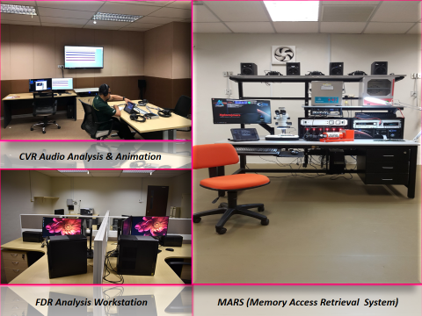
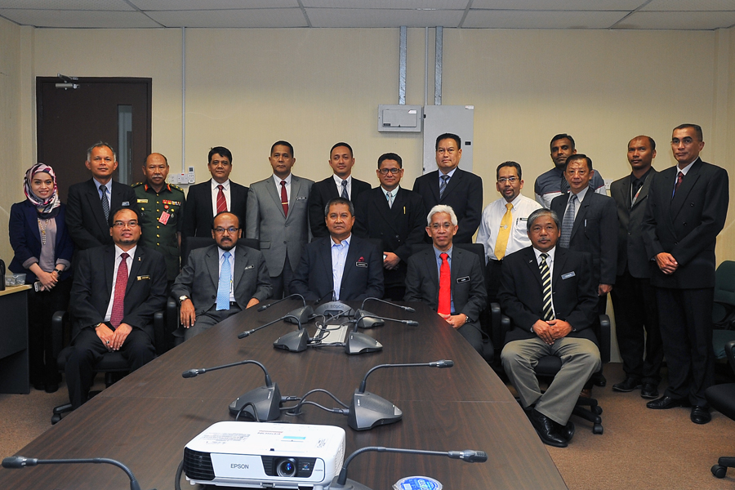
FLIGHT RECORDERS LABORATORY (STRIDE)
UNDAMAGE RECORDERS
CVR/FDR data downloading
CVR Audio Analysis and Animation
FDR Analysis workstation
Memory Access Retrieval System

Slide 20
DOCUMENTATION PHASE
Final report is the report of the IIC or Investigation Authority establish in detail what happen, how it happen, analysis, safety findings, causes and safety recommendations.
IIC on consultation with Group chairperson drafting the final report
Preliminary report within 30 days
Consultation on the draft final report to state of operator, manufacturer, registry and design
Final report send to Minister of Transport /Cabinet
Final Report send to ICAO, state of operator, manufacturer, design, and registry as per ICAO requirements
Final report make public if possible within 12 months. Failing that an interim statement on each anniversary.

Slide 21
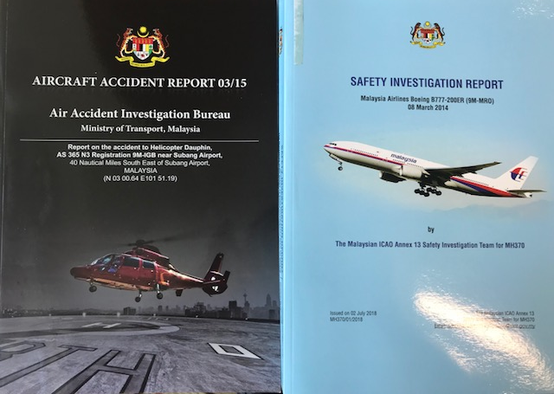
FINAL REPORT FORMAT
APPENDIX 1 – ANNEX 13
Purpose
  Convenience
  Uniformity
Format
  - Title, Synopsis
Body
  - Factual information
  - Analysis
Conclusion
  - Safety recommendation
Appendices

Slide 22
RELEASE AND DISTRIBUTION OF SAFETY RECOMMENDATIONS
At any stage of the investigation to recommend preventive measures
01
State receive recommendation, within 90 days, to respond on its preventive action taken or under consideration or reason why no action will be taken
02
In the event of any systemic deficiency probability of recurrent with potential of significant consequences, ICAO Air Navigation bureau, safety recommendation of global concern (SARG) has to be informed for further action
03

Slide 23
OCCURRENCE REPORTING METHOD AND SAFETY MEASURES
REPORTING DETAILS
FLIGHTS STATISTICS
MANDATORY OCCURRANCE REPORT DATA (MOR)
ACCIDENTS, SERIOUS INCIDENTS DATA

Slide 24
OCCURRENCES REPORTING
Accident / Serious Incident
AAIB MOT website – download accident/incident notification form. Submit the form to aaib@mot.gov.my
Incident/MOR
Sharing MOR occurrence information with CAAM
- AAIB will determine if the MOR is serious incident
Voluntary reporting
MyCair - Malaysian Confidential Accident/Incident report - www.mot.gov.my/en/aviation/mycair
if in their knowlege it was not officially reported.
Note:
AAIB also subscribes to ECCAIRS (European Co-ordination Centre for Accident And Incident Reporting System), for ADREP reporting to ICAO.
Category of occurrences can be found in Circular No 001/2017

Slide 25

COMMERCIAL AIRCRAFT DEPARTURES IN MALAYSIA (2010-2017)

Slide 26
AIR TURN BACK DUE TO TECHNICAL 2015-2017

Slide 27
TOP SIX MOR’S 2017 : JANUARY – OCTOBER

Slide 28
NUMBER OF ACCIDENTS IN MALAYSIA FROM 2000 TO 2017

Slide 29
MALAYSIA, APAC & GLOBAL RATES
(ACCIDENTS PER MILLION SCHEDULED DEPARTURES)
*Global & APAC Rate Source from ICAO Safety Report

Slide 30
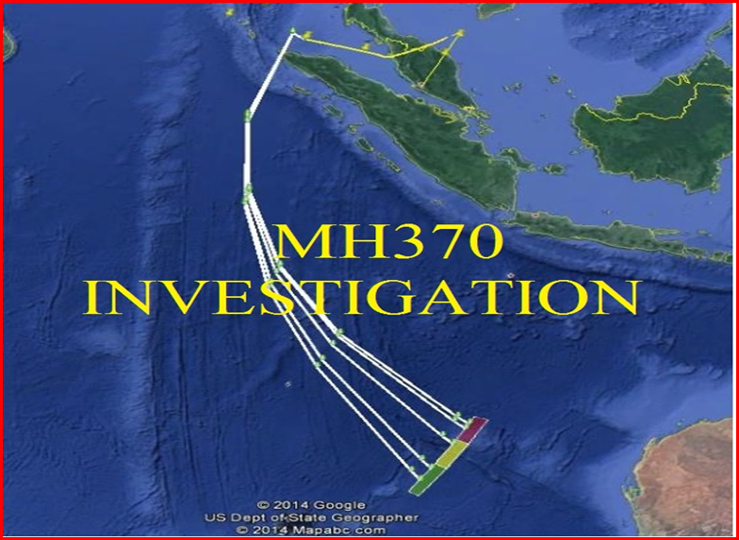
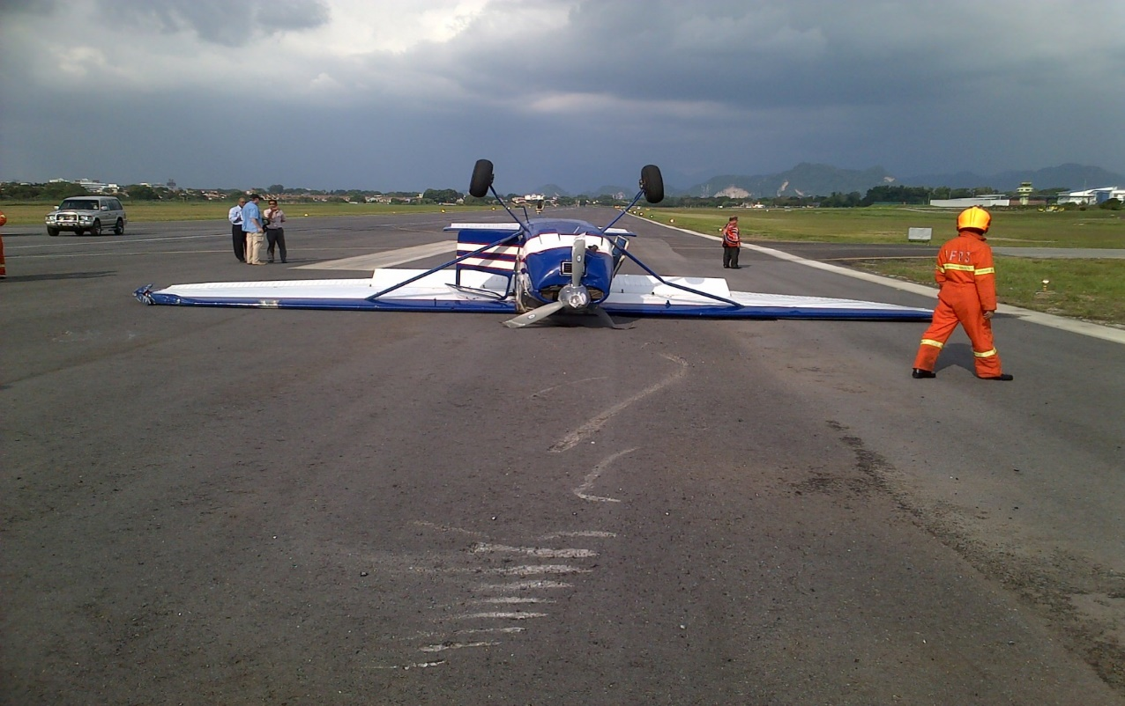
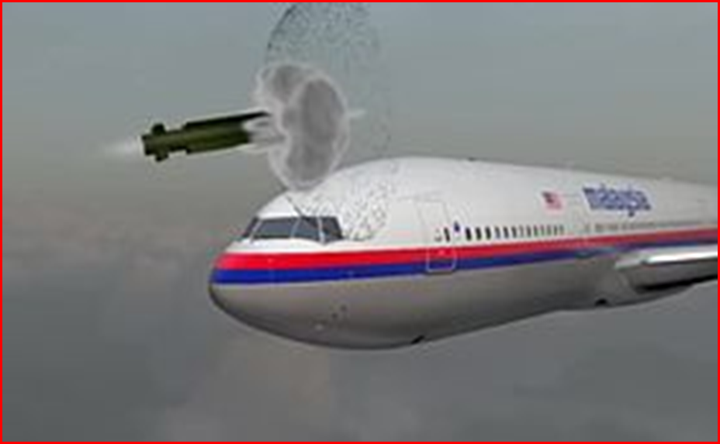
AIR ACCIDENTS IN 2014
MH 370, 9M-MRO
08/03/2014
N 7479, PA 28
02/01/2014
MH 17, 9M-MRD
17/07/2014

Slide 31
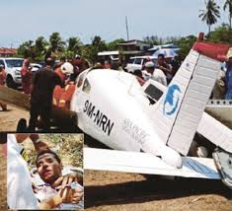
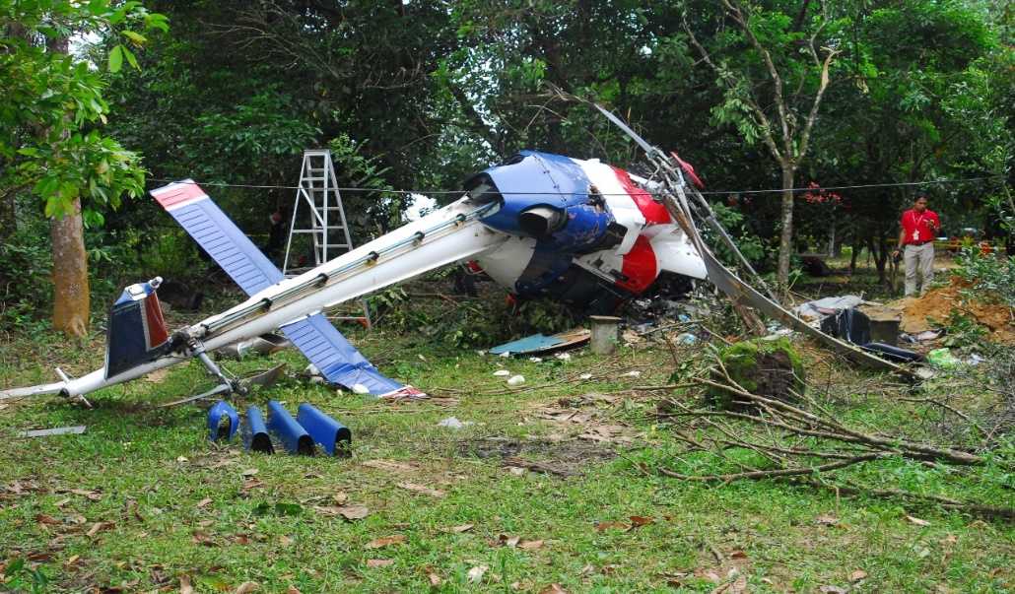
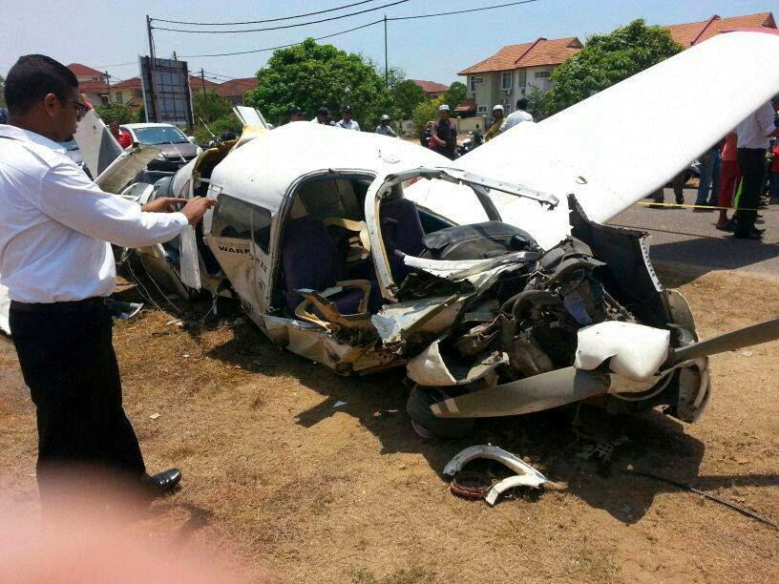
AIR ACCIDENTS IN 2014
D42,9M-NRN
01/11/2014 (RE)
AS 355, 9M PHD
31/12/14

Slide 32
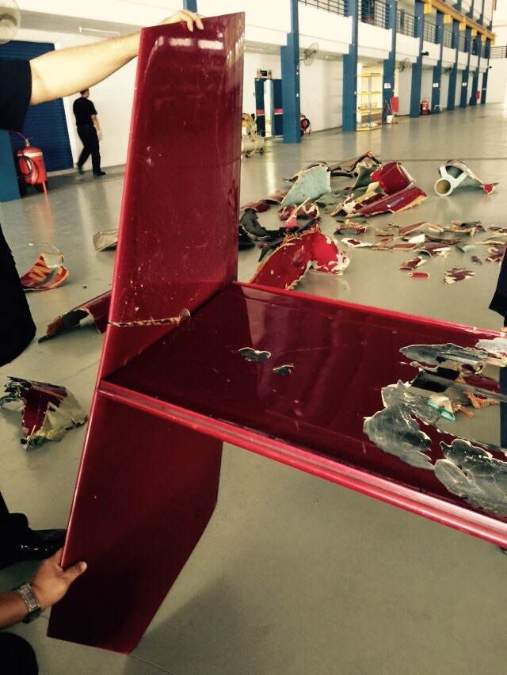
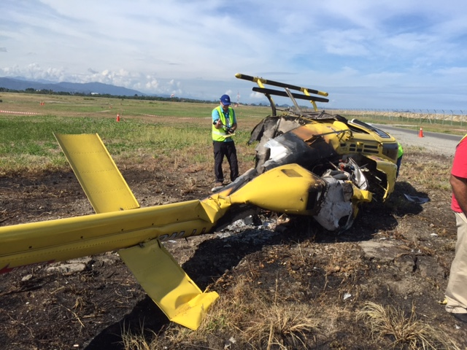
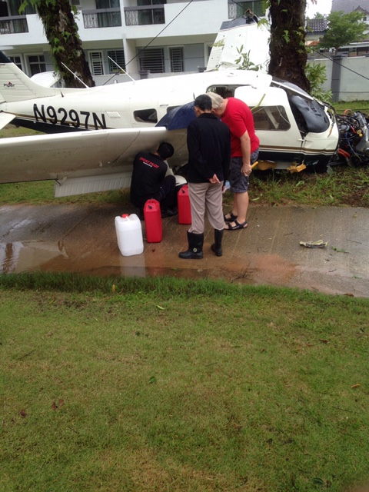
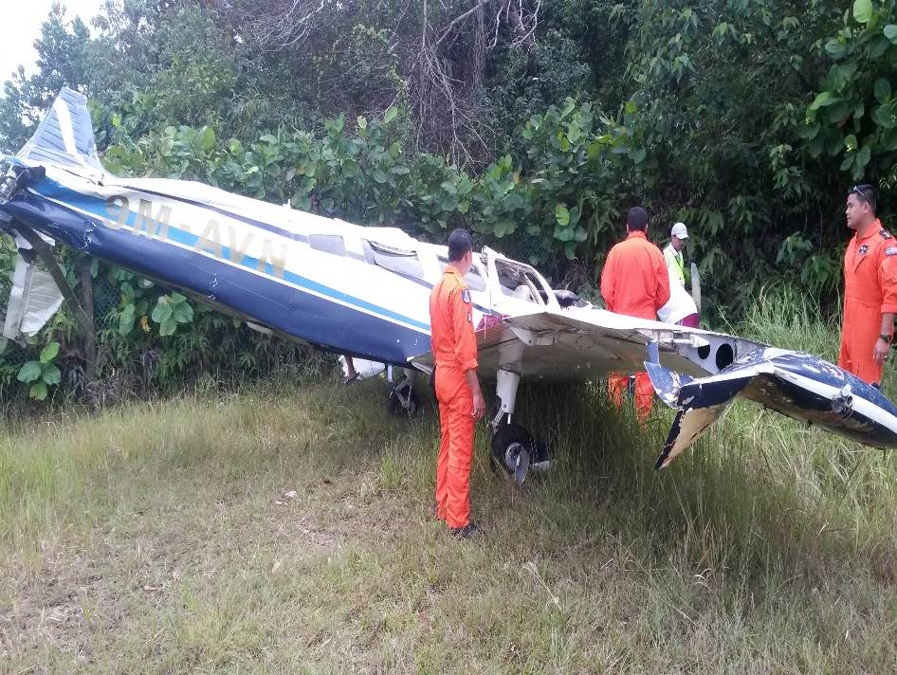
AIR ACCIDENTS IN 2015
B 206B, 9M LLM
28/05/2015 (LOC-I)
AS 365,9M-IGB
04/04/2015
(LOC-I )
PA 28,N9297N
20/11/2015 (Engine Failure)
9M-AVN,PA32
15/11/2015

Slide 33
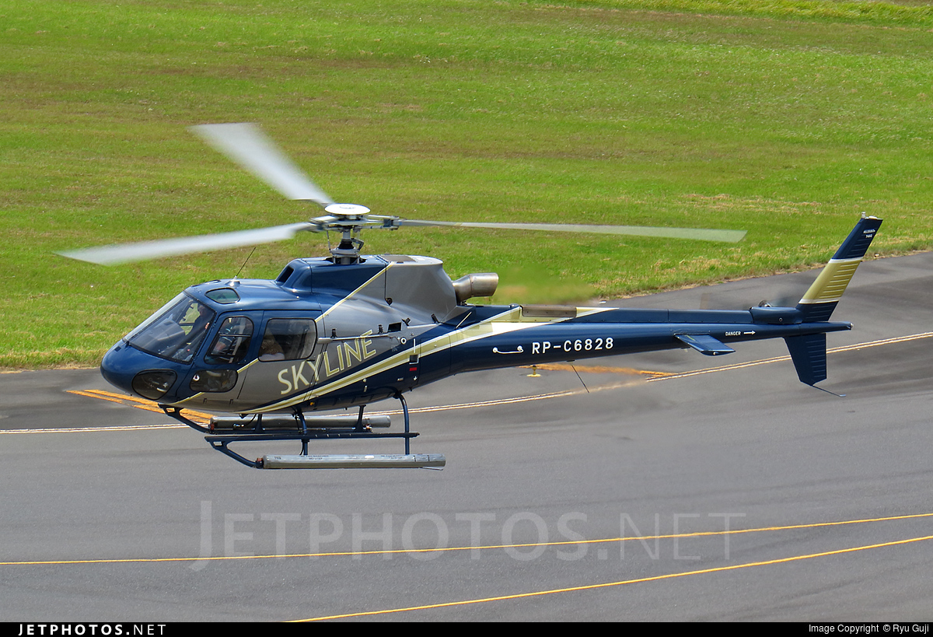
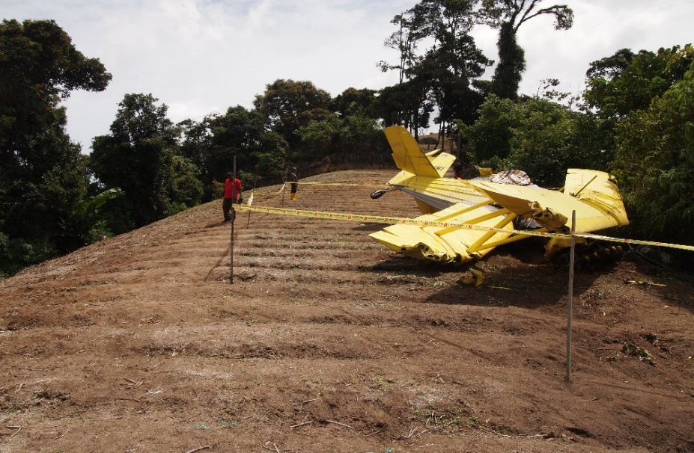
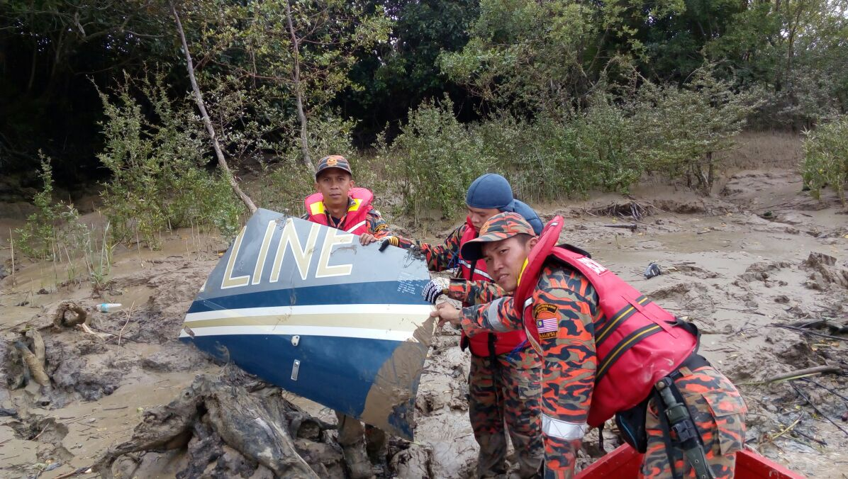
AIR ACCIDENTS IN 2016
PA34, 9M-RBI
01/01/2016,
Seletar (ARC)
AS 305B3,RP C6828, 05/05/2016
(CFIT)
Grumman,9M-IMI
22/05/2016 (FUEL)

Slide 34
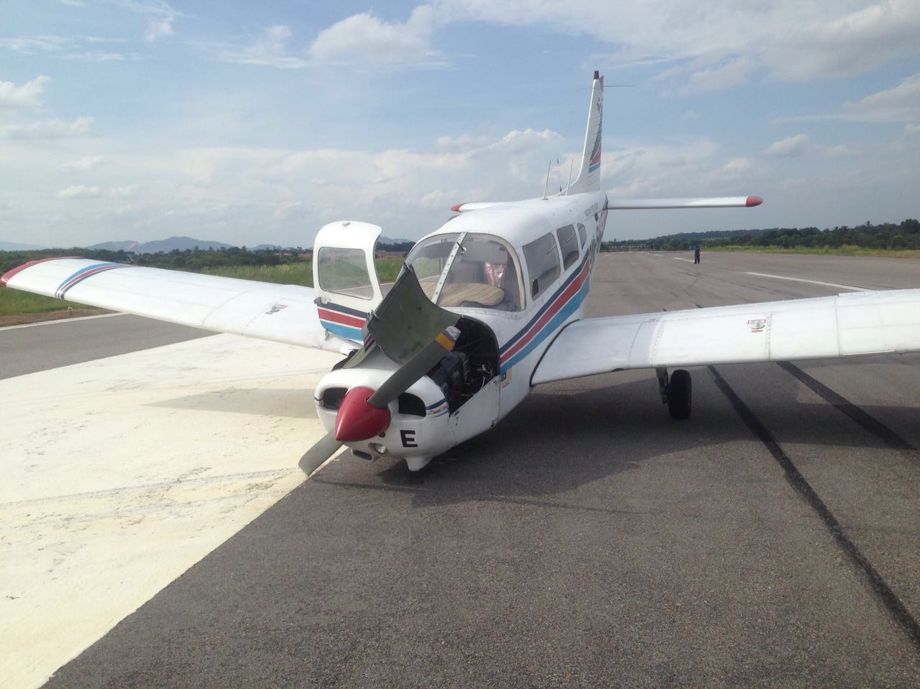
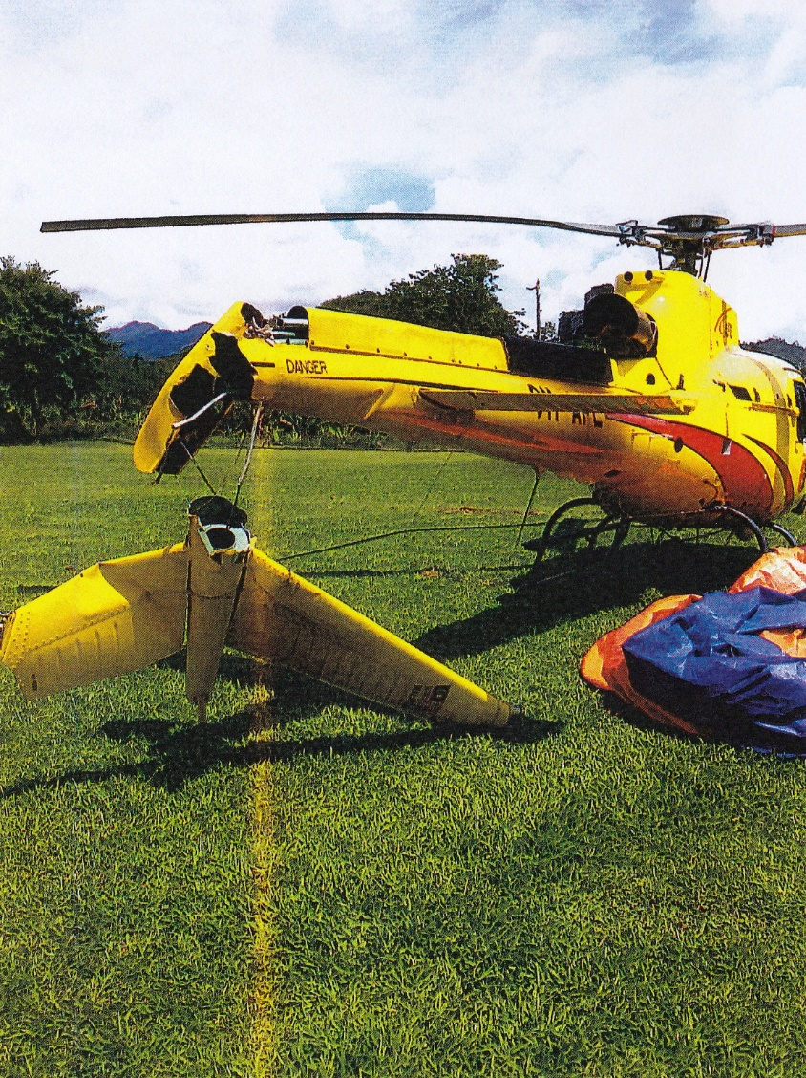
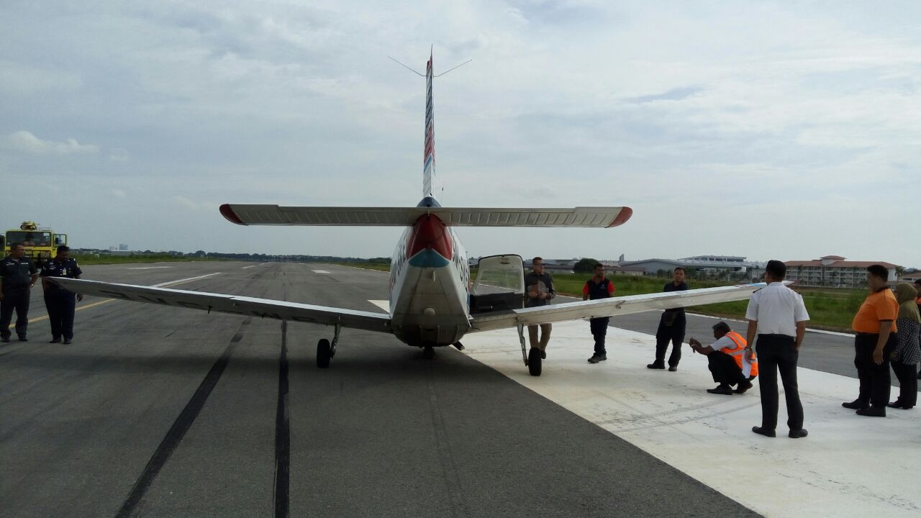
AIR ACCIDENT IN 2016
AS 350B, 9M-APL
18/11/2016 (LOC-I)
PA 28, 9M-SKE
14/07/2016( E Fire)

Slide 35
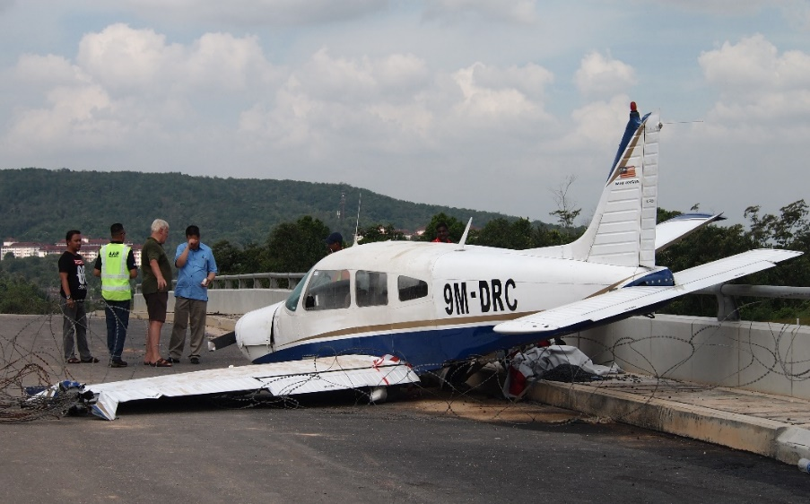
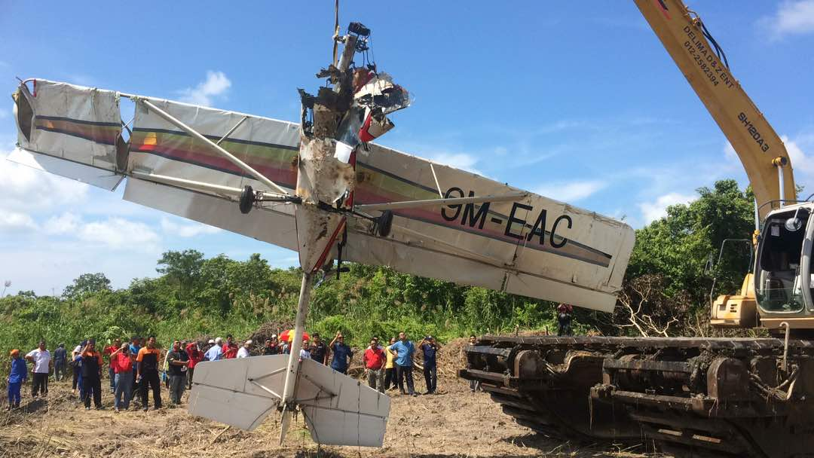
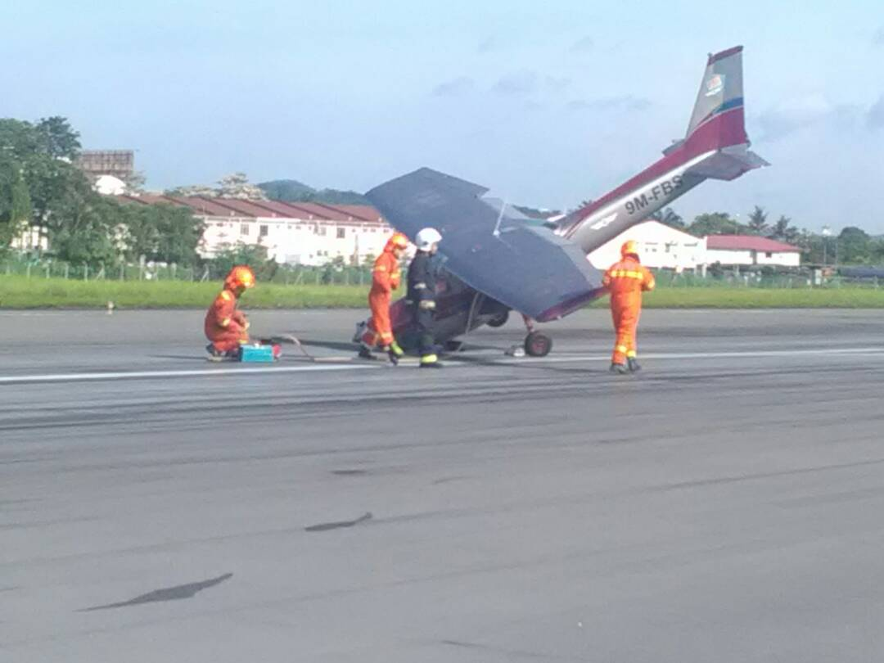
AIR ACCIDENTS IN 2017
PA 28,9M-DRC
04/06/2017, Kulai (FUEL Contaminate)
GT-500,9M-EAC, 14/10/2017, Sg. Rambai (Engine)
C 172, 9M-FBS
08/07/2017, Subang (ARC)

Slide 36
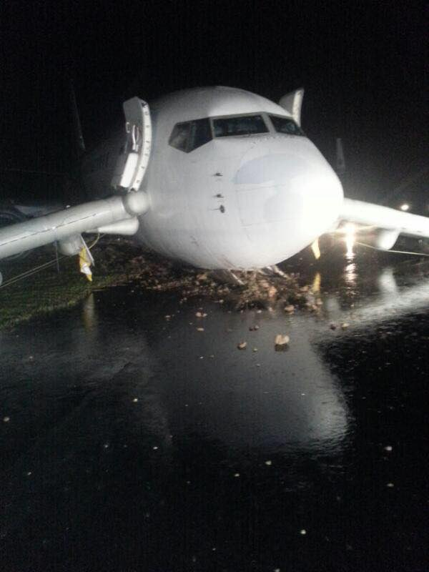
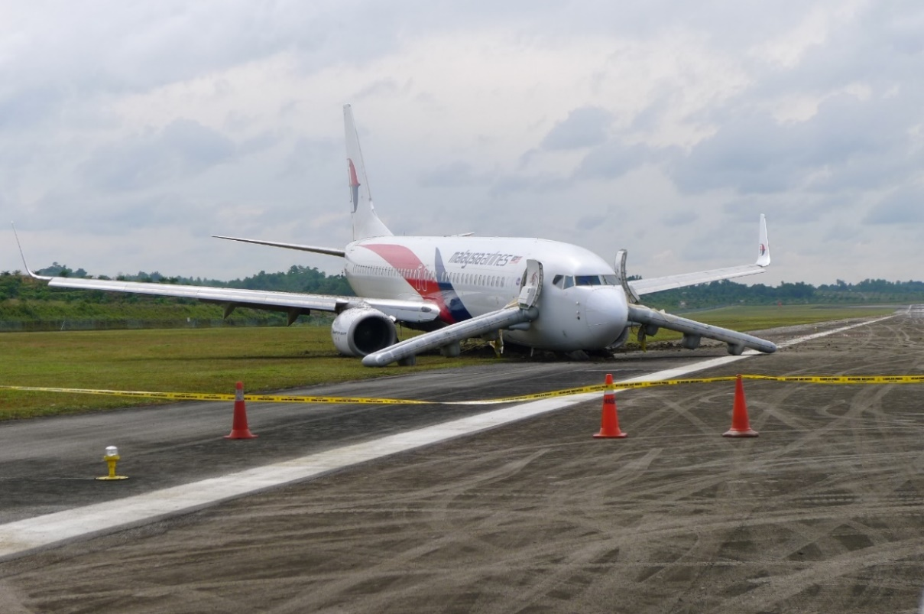
Landing at night in heavy rain,ac drifted to right side of centre line undetected by the crew causing runway excursion.
SERIOUS INCIDENT
Operator: MAB
AC Type : B 737-800
Registration : 9M-MXX
Location : Sibu Airport
Date: 08 April 2017
Time: 2217 LT

Slide 37

Enroute TPE to KUL encounter severe turbulent 5 persons injured.
Severe turbulence enroute TPE - KUL
SERIOUS INCIDENT
Operator: AAx
AC Type: A 330-343
Reg.: 9M-XXS
Location: Enroute TPE-KUL
Date; 03 May 2017
Time;1630 landed KLIA

Slide 38
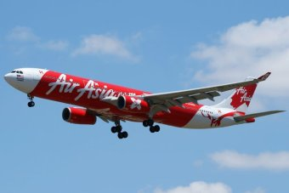
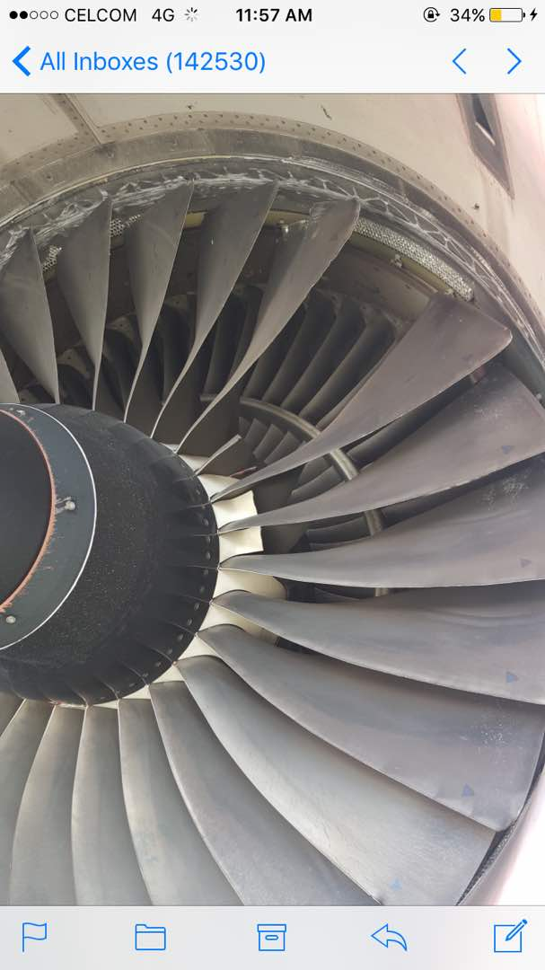
During cruise, the crew detected moderate airframe vibrations and the No. 1 engine failed. The aircraft was unable to maintain altitude and the crew conducted a return to Perth.
SERIOUS INCIDENT
Operator: AAx
AC Type: A 330-343X
Reg.: 9M-XXE
Location: Perth, Aus.
Date; 25 June 2017
Time; 0816 LT

Slide 39
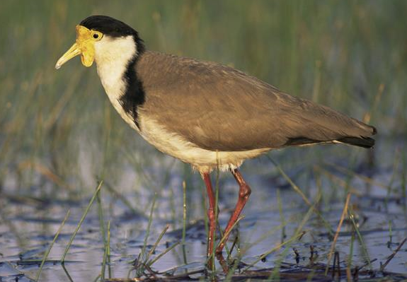
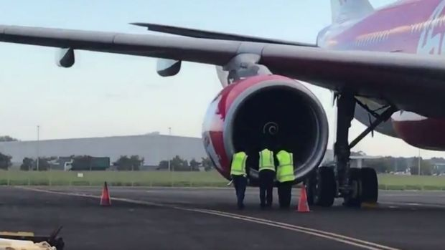
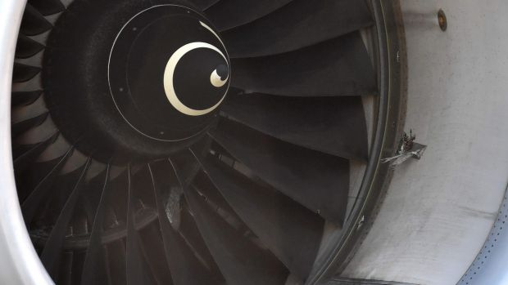
During take-off, the aircraft struck multiple lapwing plovers which were ingested into the no. 2 engine. The crew reported an engine fire to ATC and diverted the aircraft to Brisbane.
SERIOUS INCIDENT
Operator: AAx
AC Type: A 330-343
Reg.: 9M-XXT
Location: Gold Coast, Aus.
Date; 03 July 2017
Time; 1030 LT

Slide 40
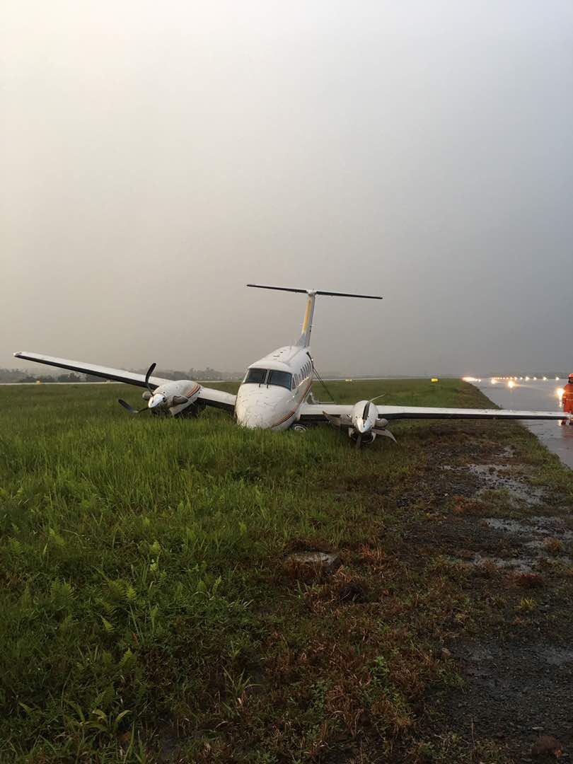
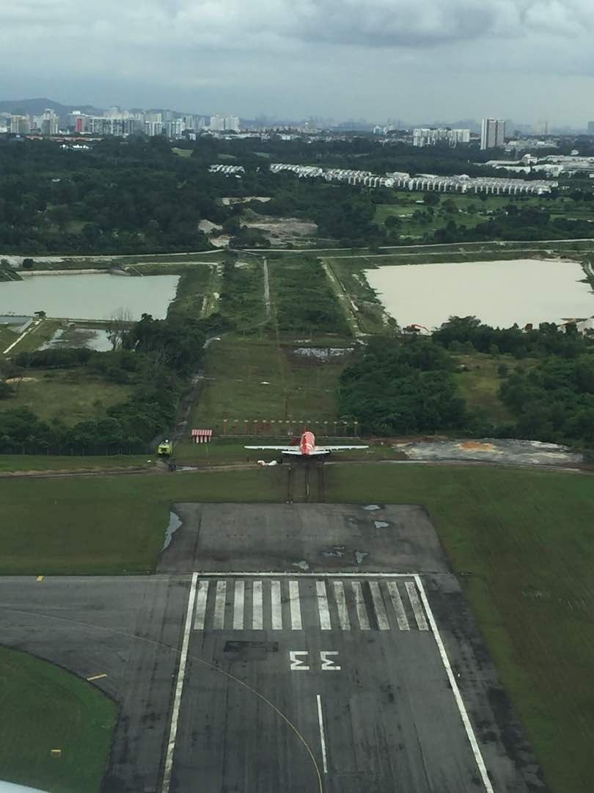
SERIOUS INCIDENTS IN 2017
Beechcraft,9M-WSK,24/08/2017, Kuching (RE)
A320,9M-AHM,
30/11/2017, Subang (RE)

Slide 41
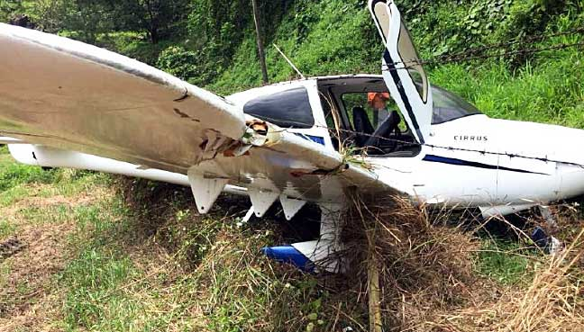
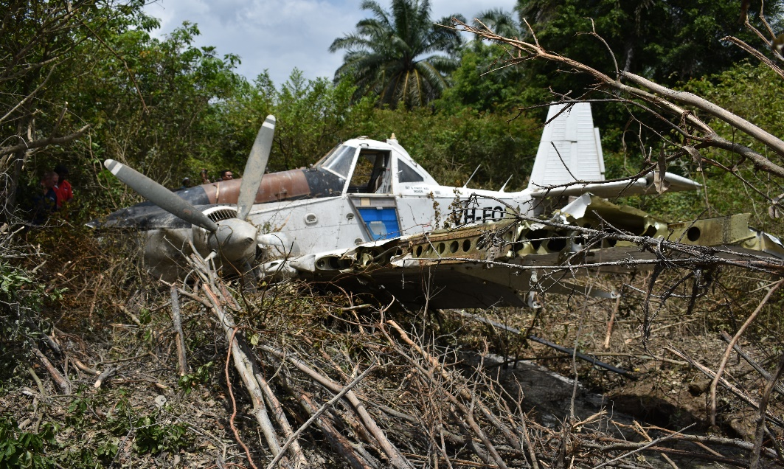
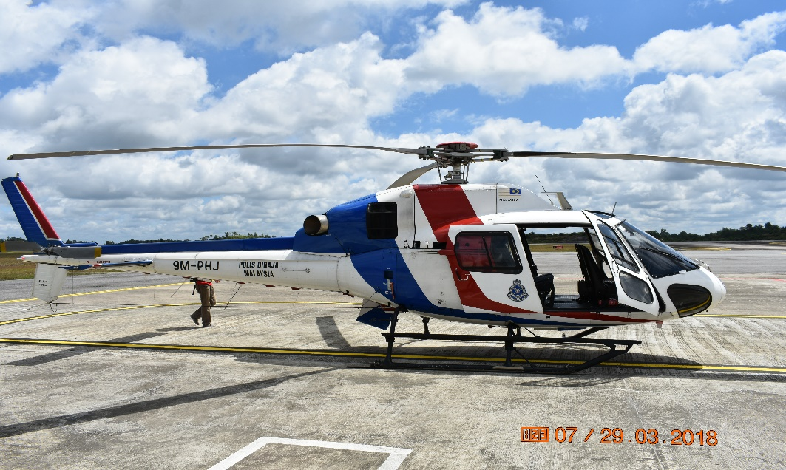
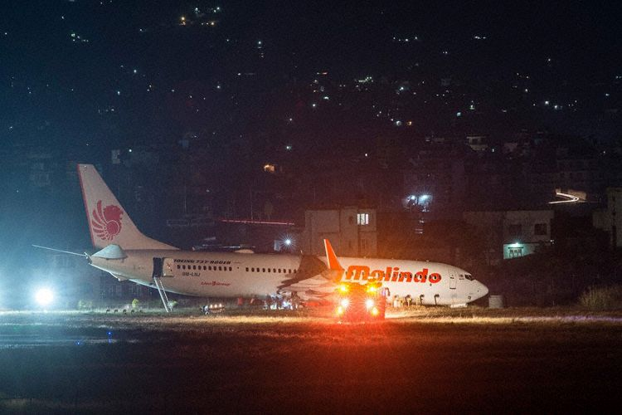
ACCIDENT/SI IN 2018
Cirrus SR20 G3,
9M-ZWR, 01/02/2018,
Tioman (RE)
Dromader,VH-FOS, 25/02/2018Keratong (Fuel)
As 355N, 9M-PHJ,13/03/2018
Sibu (Hard landing)
A330-300,9M-LNJ,19/04/2018, Katmandu (RE)

Slide 42
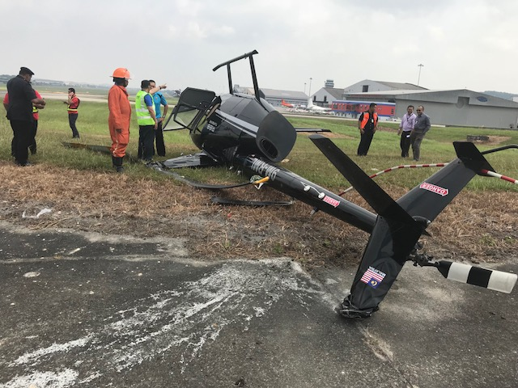
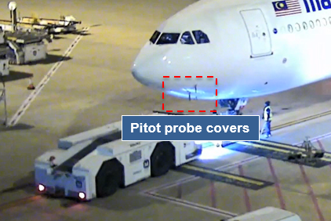
ACCIDENT /SI 2018
SERIOUS INCIDENT
9M-MTK, A330-300
18/07/2018, Brisbane
(Pitot)
ACCIDENT
R 66, 9M RML, 16/08/2018,
Subang (LOC-I)

Slide 43

AIR ACCIDENTS/SERIOUS INCIDENTS
For Year 2014 to 2018
Year | Accident | Serious Incident | Total Per Year | Fatality
2014 | 6 | 10 | 16 | 587
2015 | 5 | 11 | 16 | 6
2016 | 5 | 9 | 14 | 6
2017 | 4 | 7 | 11 | 1
2018 | 4 | 2 | 6 | 0
TOTAL | 24 | 39 | 63 | 600

Slide 44
CATEGORIES OF ACCIDENTS/SI
Categories | 2014 | 2015 | 2016 | 2017 | 2018 | Total
RE (Runway excursion) | 3 | 3 | 2 | 4 | 1 | 13*
ARC (Abnormal runway contact) | 1 | 2 | 5 | 2 | 1 | 11 (GA)
LOC-I (Loss control Inflight ) | 1 | 2 | 1 | 0 | 0 | 5
F-NI (Fire inflight) | 1 | 2 | 1 | 0 | 0 | 4
SCF-PP ( Power plant failure or malfunction) | 1 | 1 | 0 | 2 | 0 | 4
BIRD (Bird strike) | 0 | 0 | 0 | 1 | 0 | 1
TURB (Turbulence) | 0 | 0 | 0 | 1 | 0 | 1

Slide 45
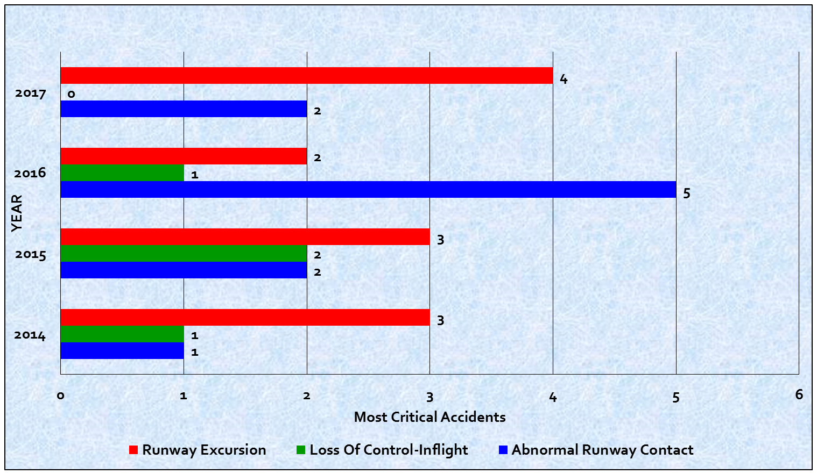
MOST CRITICAL A/SI CATEGORY : 2014-2017

Slide 46
TOP SEVEN HAZARDS IN 2017
  *Lack of crew resource management knowledge
  *Runway maintenance
  *Runway centreline markings/ lightings
  *Emergency response plan
  Instructional technique
  *Knowledge on local weather pattern
  Emergency locator transmitter activation/detection
  Note:
  Letter to DCA dated 15 January 2018
  * Runway excursion

Slide 47
HAZARDS IDENTIFIED IN 2018
s/no | File no. | Date Of Occurrence | Aircraft Type | Place Of Occurrence | Nature of occurrence | Fatality | HAZARDS See note 1
1 | A 01/18 | 01/02/18 | Cirrus SR20 9M ZWR | Tioman, Pahang | AC veered off runway | Nil | Non-compliance to local Instruction Not proficient for short runway crosswind landing
2 | A 02/18 | 25/02/18 | M18 Dromader VH FOS | Keratong, Pahang | Fuel starvation | Nil | No proper storage of refuelling equipment Technician proficiency
3 | A 03/18 | 13/03/18 | AS355N 9M PHJ | Sibu, Sarawak | Hard landing During training | Nil | Misjudged ROD during One Engine Inoperative training
4 | SI 04/18 | 19/04/18 | B737-900 9M LNJ | Kathmandu, Nepal | AC veered off runway during abort take off | Nil | Poor CRM Non conformity to take off procedure
5. | SI 05/18 | 07/07/18 | A330-300 | Maldives | Wing tip collide with horizontal stabiliser of another aircraft during taxy | Nil | Fast taxi speed Not monitoring wing watcher
6. | SI 06/18 | 18/07/18 | A330-300 | Brisbane | Pitot cover not removed | Nil | Poor communication between ground and air crew Local directive not communicated to aircrew Decision making to continue take off
7 | A 05/18 | 15/08/18 | Robinson 66 9M-RML | Subang | Crash during sloping ground take off | Nil | Improper pre- flight brief Instructor’s lack of situational awareness

Slide 48
BSKU PROMOTIONS
CO-OPERATIONS
SEMINARS/MEETINGS/SAFETY BULLETIN
TRAININGS

Slide 49
CO-OPERATION
BSKU
MOU
STRIDE
MOU
ASEAN
CAAM
MOU
AIB, KINGDOM OF SAUDI ARABIA
MOU
ARAIB, KOREA SELATAN
MOU
UniKL MIAT
PR China
COC
APAC AIG
MEETING
BOMBA
POLICE
DVI

Slide 50
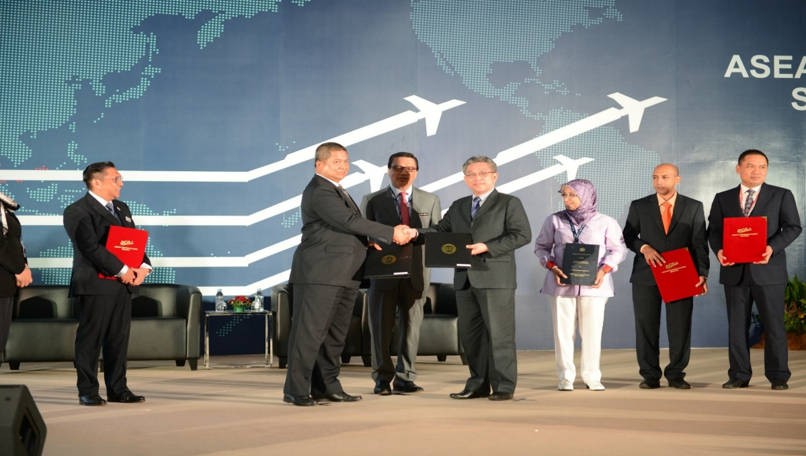
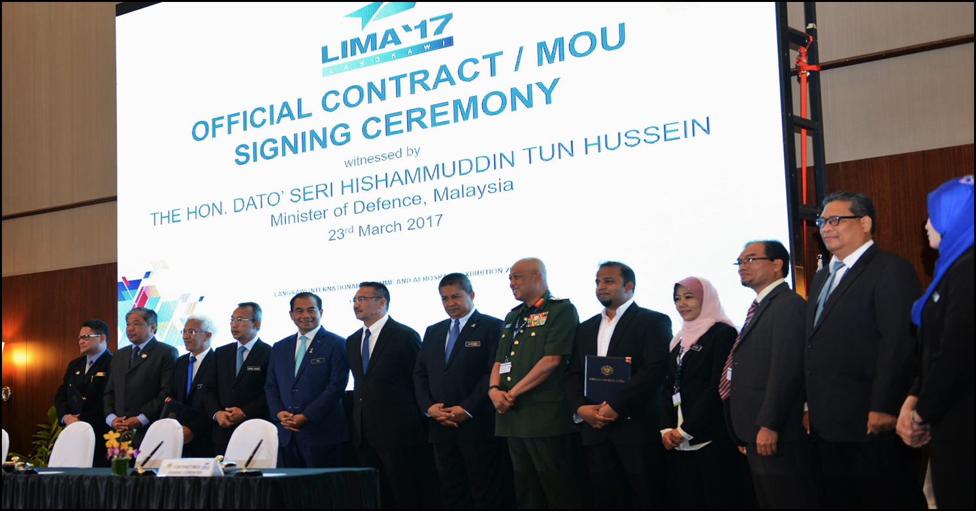
MOUs
MOU between MOT and MIAT
22/03/2017

Slide 51
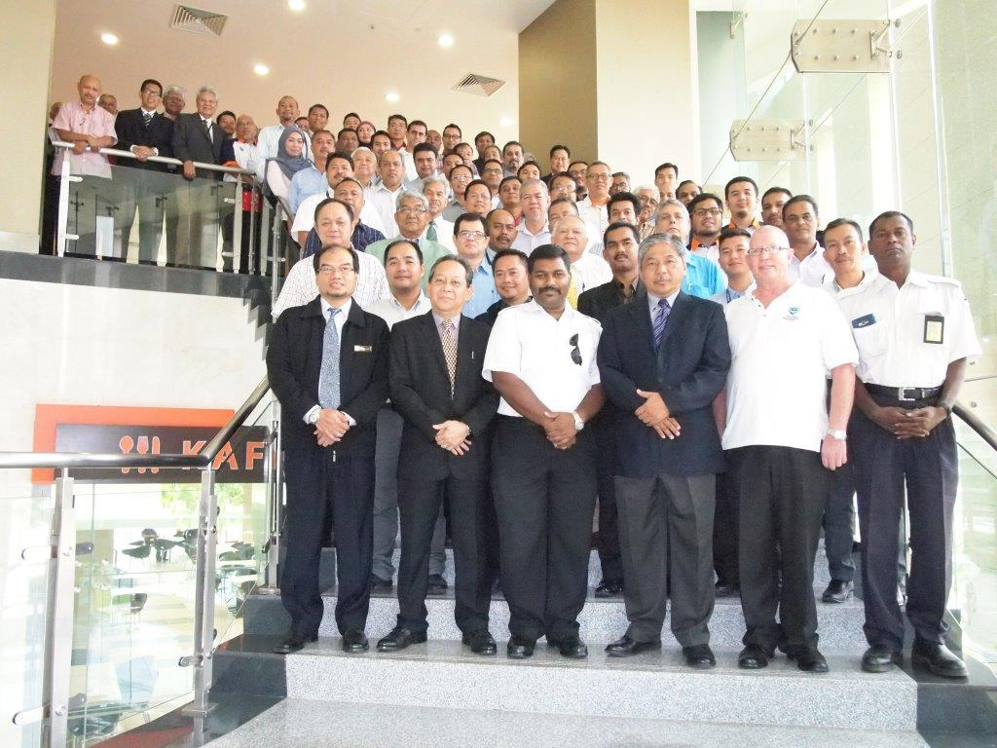
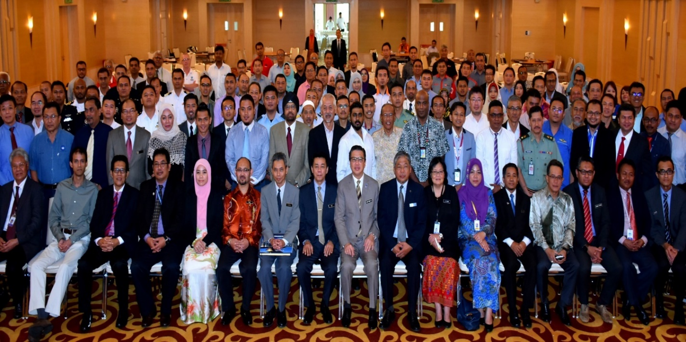
BSKU SAFETY SEMINAR SEPTEMBER 2017
BSKU safety seminar 2016
BSKU safety seminar 2017

Slide 52
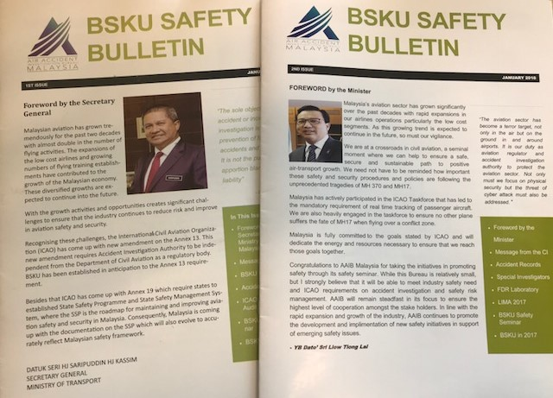
ANNUAL SAFETY BULLETIN

Slide 53
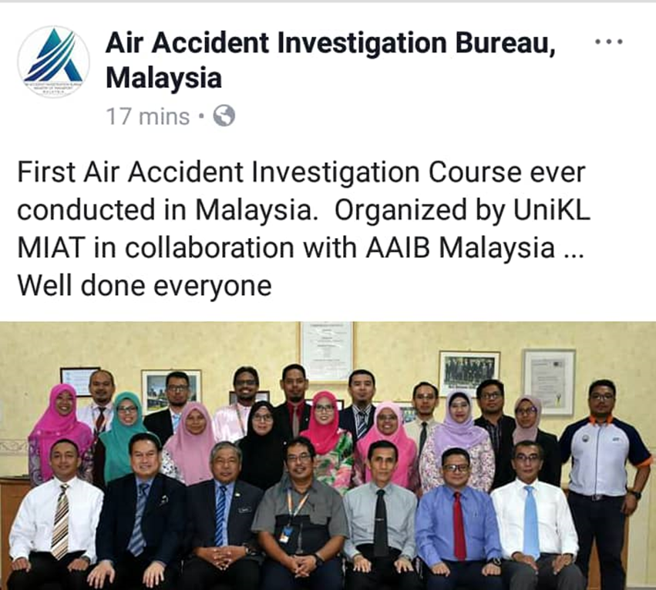
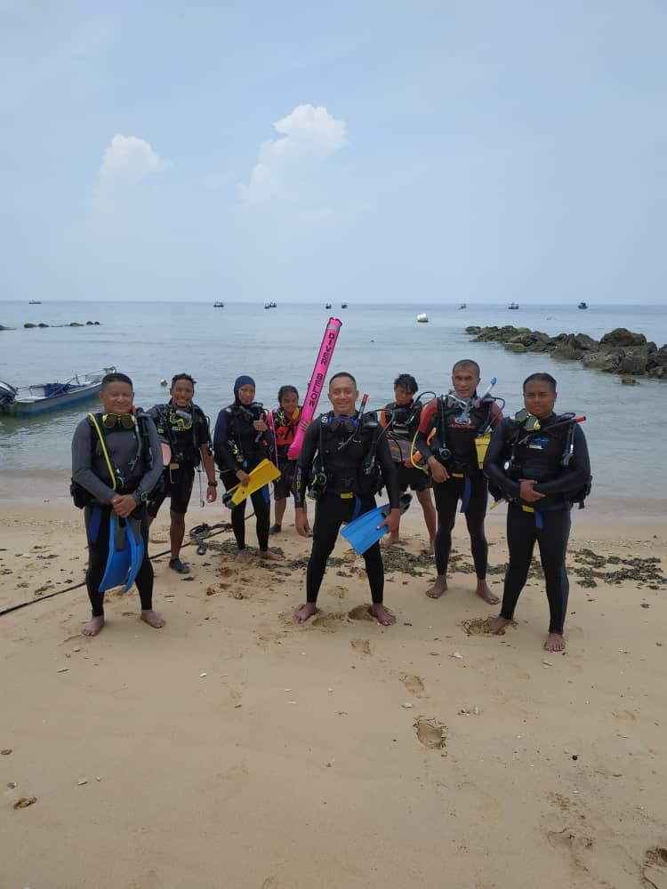
TRAINING
16 oct – 2Nov. 2018
BSKU Diving course using ULB detector at Langkawi in 1-7 October 2018

Slide 54
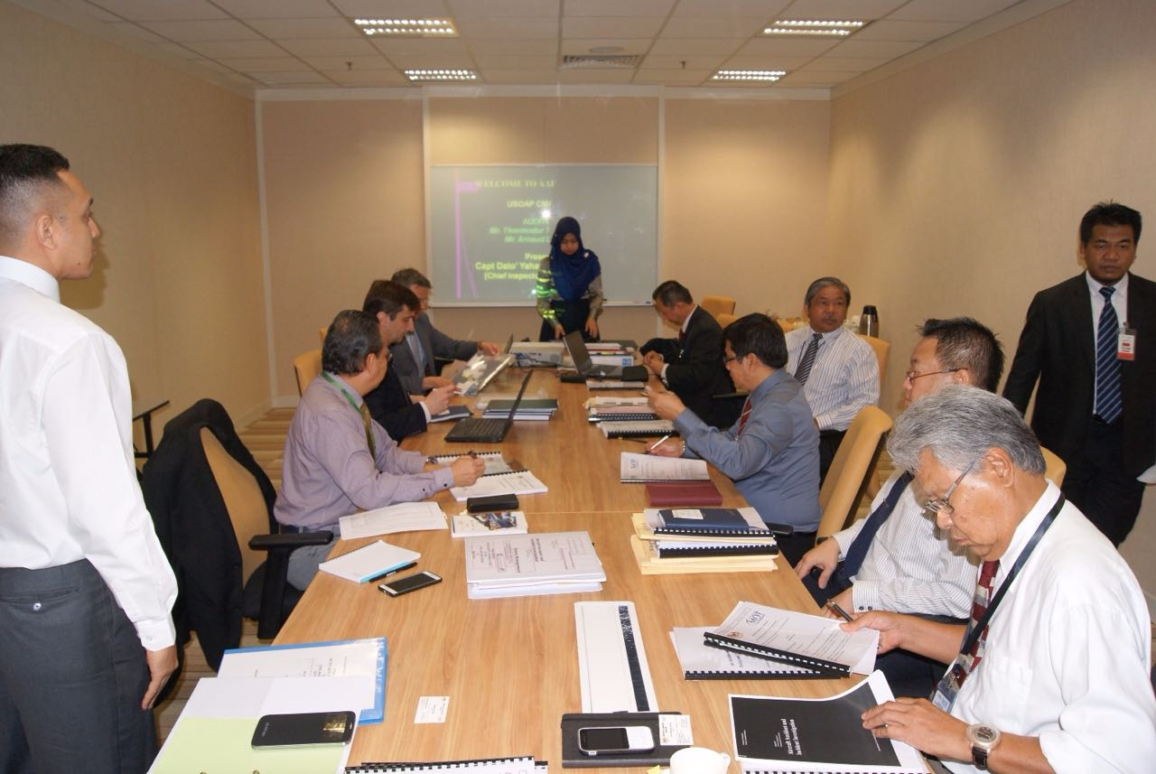
BSKU ICAO USOAP-CMA AUDIT
2nd to 12th May 2016

Slide 55
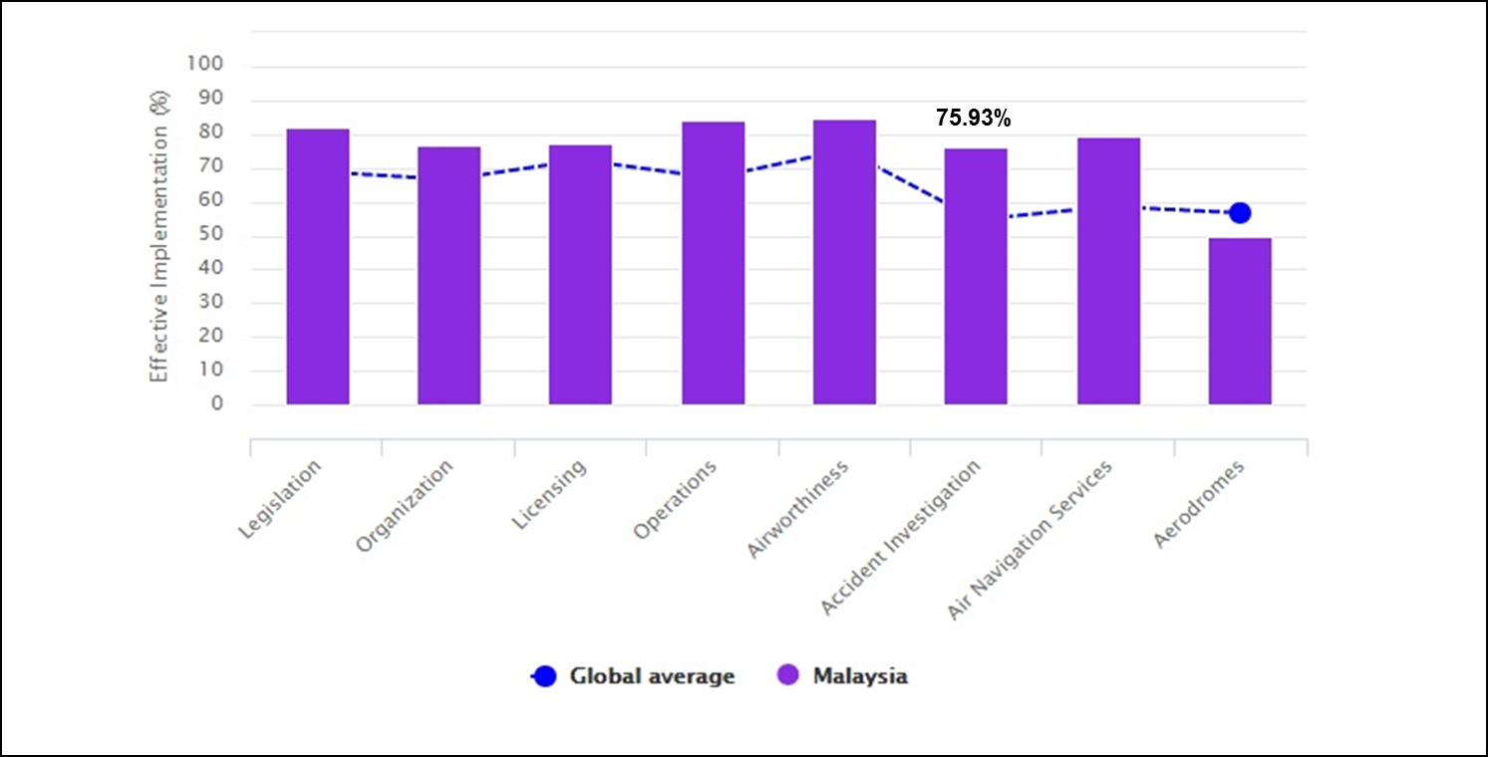
AUDIT RESULT

Slide 56
AUDIT CORRECTIVE ACTION PLAN
ICAO Universal Safety Oversight Audit Programme-Continous Monitoring Approach (USOAP- CMA)
1
Updating compliance checklist
110 protocol Questions ( 2 x Not Applicable)
27 Findings/not satisfactory
High priority;
Amend the primary aviation legislation to include provisions ensuring the non-disclosure of cockpit voice recorder for purpose of other than accident or incident investigation
2

Slide 57
CONCLUSION
HUMAN FACTOR IS THE MAIN CAUSE OF ACCIDENT. REDUCE RISK AS LOW AS REASONABLY PRACTICABLE
VOLUNTARY SPECIAL INVESTIGATORS PROGRAMME
MAXIMUM USE OF FLIGHT RECORDERS LABORATORY
MOU ON COOPERATION WITH OTHER AGENCIES
IMPLEMENTATION OF SSP AND MTSB
AWARENESS PROGRAM WITH INDUSTRY ON NEW HAZARDS
PROMOTE REPORTING CULTURE
INTERNATIONAL PARTICIPATION TO PROMOTE HARMONIZATION ON REGULATION

Slide 58
    QUESTION AND ANSWER
    SESSION
    THANK YOU
    E-mail address:
    yahaya@mot.gov.my

