Slide 1
Liberating Ownership and Control of ASEAN Airlines
The Indonesian Case
Ridha Aditya Nugraha
Kuala Lumpur, 21 December 2018
IKMAS Universiti Kebangsaan Malaysia
Air and Space Law Studies, International Business Law

Slide 2
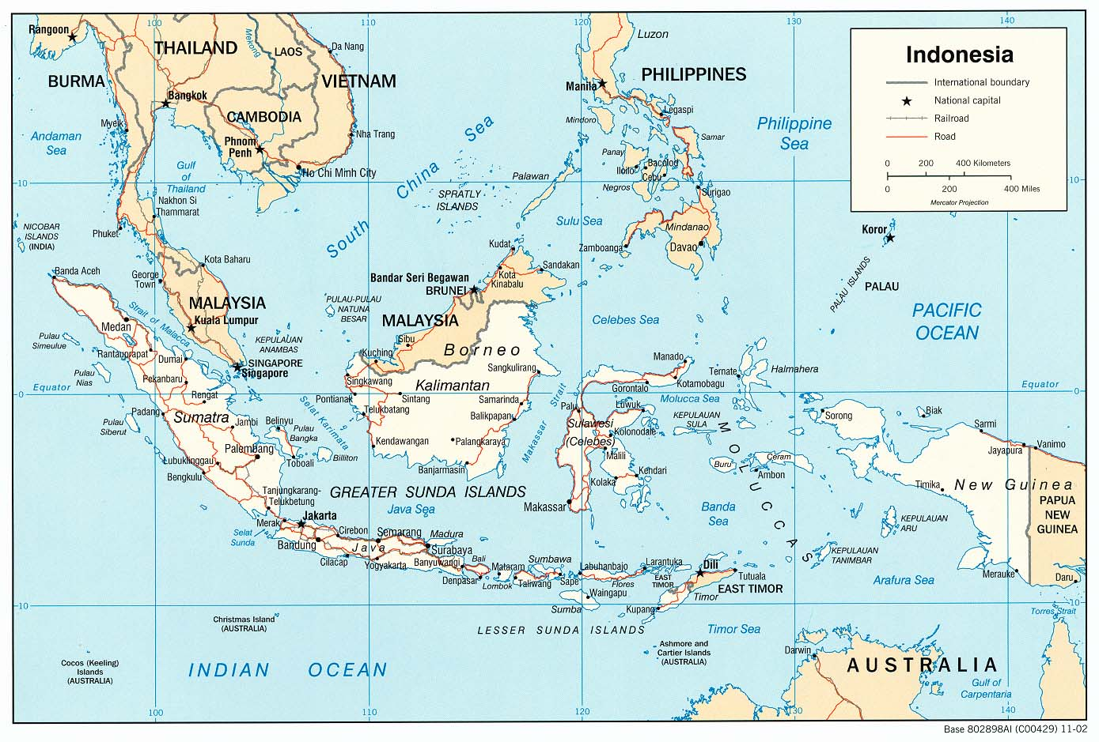
Liberating Ownership and Control of ASEAN Airlines
Ridha Aditya Nugraha - Kuala Lumpur, 21 December 2018
https://legacy.lib.utexas.edu/maps/indonesia.html

Slide 3
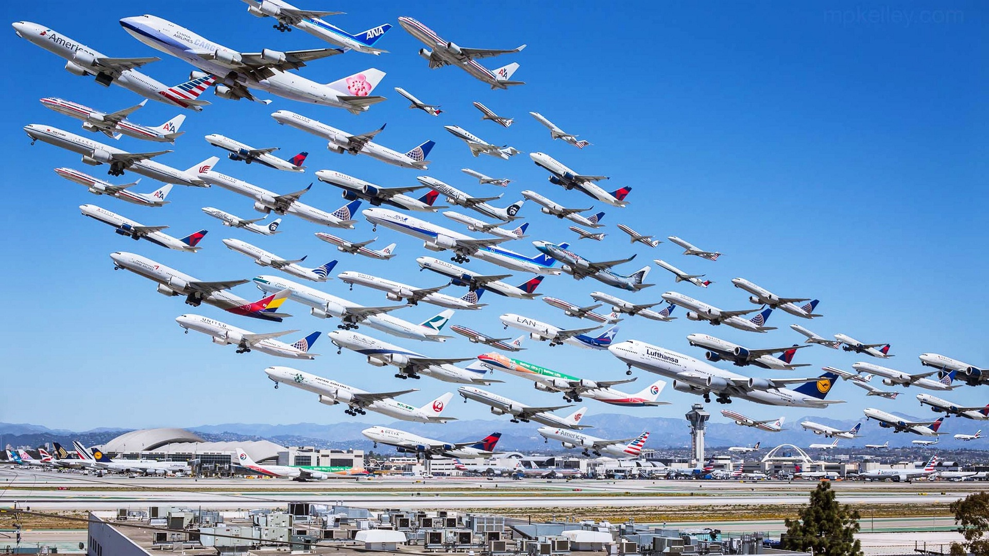
Liberating Ownership and Control of ASEAN Airlines
Ridha Aditya Nugraha - Kuala Lumpur, 21 December 2018
https://taketheleaptravel.files.wordpress.com/2015/07/many-airplanes-flying-together-amazing.jpg
Notes:
The liberalization process in ASEAN is in progress, but slow.

Slide 4
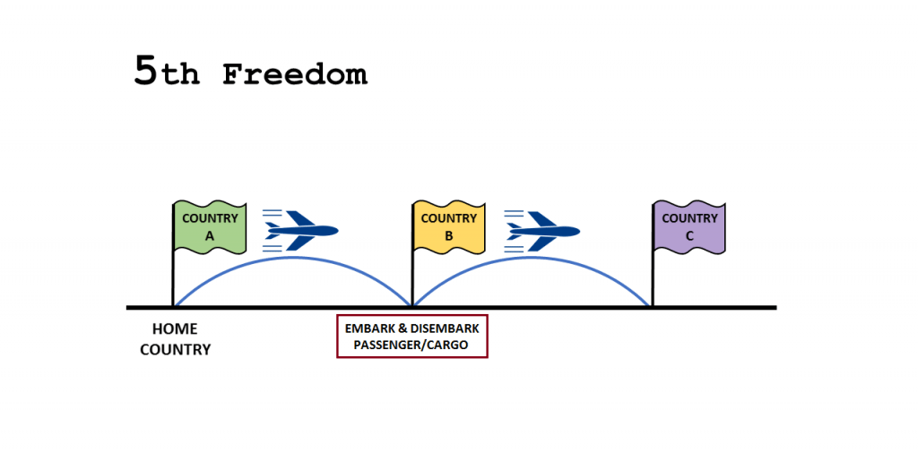
Liberating Ownership and Control of ASEAN Airlines
Ridha Aditya Nugraha - Kuala Lumpur, 21 December 2018
https://www.sametkasik.com.tr/wp-content/uploads/2017/09/5th-1024x514.png
Notes:
ASEAN Open Skies only covers up to the 5th Freedom of the Air.

Slide 5
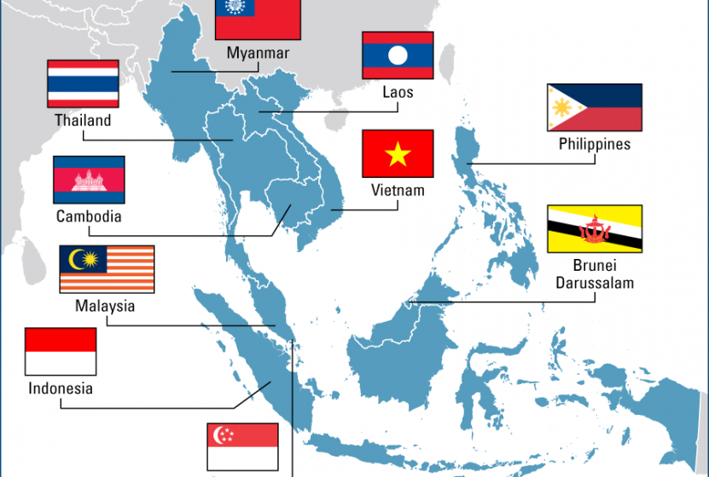
Liberating Ownership and Control of ASEAN Airlines
Ridha Aditya Nugraha - Kuala Lumpur, 21 December 2018
https://www.impresamia.com/internazionalizzazione-asean-octagona-corso-executive-su-singapore-vietnam-e-indonesia-organizzato-collaborazione-con-nibi/
Notes:
ASEAN Open Skies only covers up to the 5th Freedom of the Air.

Slide 6
Liberating Ownership and Control of ASEAN Airlines
Ridha Aditya Nugraha - Kuala Lumpur, 21 December 2018
Notes:
The best practice so far in ASEAN.

Slide 7
Liberating Ownership and Control of ASEAN Airlines
Ridha Aditya Nugraha - Kuala Lumpur, 21 December 2018
The Indonesian Aviation Law No. 1 / 2009
maximum 49% foreign ownership;
number of aircraft in possession;
bilateral agreement model.

Slide 8
Liberating Ownership and Control of ASEAN Airlines
Ridha Aditya Nugraha - Kuala Lumpur, 21 December 2018
ASEAN Open Skies
Protocol 4 - ASEAN Co-Terminal Rights
9 November 2018
open for ratification
Notes:
This is a Protocol to be ratified in addition to the 5th Freedom Traffic Rights already in place in ASEAN.
This Protocol, once ratified, will allow ASEAN-based carriers to carry out international traffic from their home base in a AMS (A) to more than one airport in another AMS (B1, B2) without the right to sell tickets or transport passengers solely from B1 to B2. It does not really constitute 7th or 8th Freedom Traffic Rights as per ICAO definitions but allows domestic connections for international traffic in another AMS.
Perhaps the new situation shall test low-fare airline or low-cost carrier business model by not only serving point-to-point destination.
Mr. John travels from Bangkok to Bali. He could buy two tickets, i.) Bangkok to Medan; and ii.) Medan to Bali or with the Protocol enforced, he could find Bangkok to Bali in a single ticket.
The new situation shall reduce passengers chance to face domestic law; in case the whole journey is issued with a single ticket. However, such protection is not yet at the maximum level considering half of ASEAN member states are still with the Warsaw regime.
Will it change the current ‘best practice’?

Slide 9
Liberating Ownership and Control of ASEAN Airlines
Ridha Aditya Nugraha - Kuala Lumpur, 21 December 2018
For example:
an ASEAN Low-Fare Airline
Vientiane → Medan → Bali
possible with one aircraft in point-to-point model
Bangkok → Jakarta → Bali
possible with one aircraft in point-to-point model
Notes:
This is a Protocol to be ratified in addition to the 5th Freedom Traffic Rights already in place in ASEAN.
This Protocol, once ratified, will allow ASEAN-based carriers to carry out international traffic from their home base in a AMS (A) to more than one airport in another AMS (B1, B2) without the right to sell tickets or transport passengers solely from B1 to B2. It does not really constitute 7th or 8th Freedom Traffic Rights as per ICAO definitions but allows domestic connections for international traffic in another AMS.
Perhaps the new situation shall test low-fare airline or low-cost carrier business model by not only serving point-to-point destination.
Mr. John travels from Bangkok to Bali. He could buy two tickets, i.) Bangkok to Medan; and ii.) Medan to Bali or with the Protocol enforcr
The new situation shall reduce passengers chance to face domestic law; in case the whole journey is issued with a single ticket. However, such protection is not yet at the maximum level considering half of ASEAN member states are still with the Warsaw regime.
Will it change the current ‘best practice’?

Slide 10
Liberating Ownership and Control of ASEAN Airlines
Ridha Aditya Nugraha - Kuala Lumpur, 21 December 2018

Slide 11
Liberating Ownership and Control of ASEAN Airlines
Ridha Aditya Nugraha - Kuala Lumpur, 21 December 2018
What are the driving force to liberate?
Tourism - international tourist
Indonesia
20 million (target by 2019)
Thailand, as a comparison
35 million (2017)

Slide 12
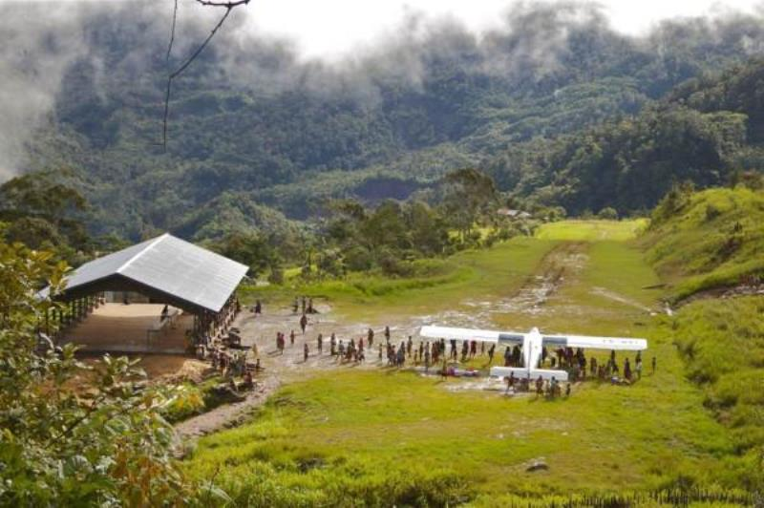
Liberating Ownership and Control of ASEAN Airlines
Ridha Aditya Nugraha - Kuala Lumpur, 21 December 2018
http://bisniswisata.co.id/subsidi-12-penerbangan-perintis-papua-alokasikan-rp80-miliar/

Slide 13
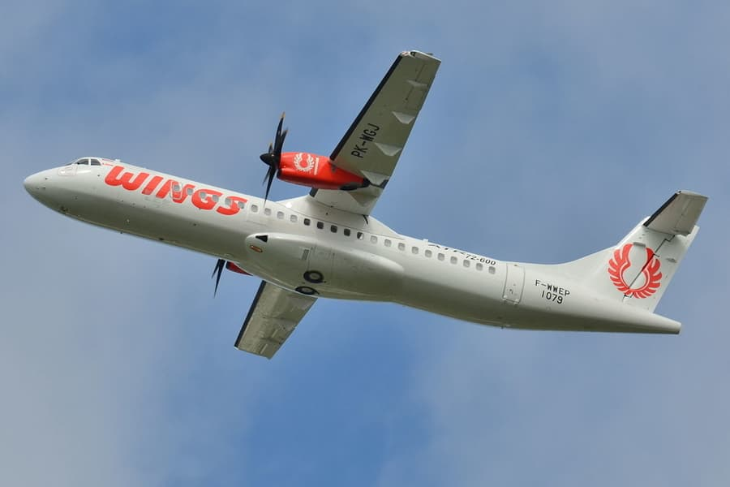
Liberating Ownership and Control of ASEAN Airlines
Ridha Aditya Nugraha - Kuala Lumpur, 21 December 2018
https://airlinerwatch.com/wings-air-receives-its-fourth-atr-72-600/

Slide 14
Liberating Ownership and Control of ASEAN Airlines
Ridha Aditya Nugraha - Kuala Lumpur, 21 December 2018
What are the driving force to liberate?
Pioneer flights (penerbangan perintis)
Essential Air Services Program (USA) or Public Service Obligation (EU)
mandated by the Indonesian Aviation Law through subsidy

Slide 15
Liberating Ownership and Control of ASEAN Airlines
Ridha Aditya Nugraha - Kuala Lumpur, 21 December 2018
The Way Forward
relaxing ownership and control in Indonesia
ASEAN nationals is allowed to own up to 70% shares
starting for airline flying isolated regional routes (pioneer routes)

Slide 16
Liberating Ownership and Control of ASEAN Airlines
Ridha Aditya Nugraha - Kuala Lumpur, 21 December 2018
Thank you for your attention!
ridha.nugraha@pmbs.ac.id

