Slide 1
ICAO UNIVERSAL SAFETY OVERSIGHT AUDIT PROGRAMME (USOAP) CONTINUOUS MONITORING APPROACH (CMA)
USOAP AIG EFFECTIVE IMPLEMENTATION(EI)
AAIB MALAYSIAN EXPERIENCE
20th December 2018

Slide 2
SUMMARY
What is ICAO USOAP CMA?
Scope and conduct of Audit
Audit areas/ Critical Elements
Audit preparation
Conduct of audit
Sharing of AAIB Malaysia Audit findings
Corrective action plan
State Safety Concern

Slide 3
USOAP CMA
The approach for USOAP audits is based on:
“…the implementation of a structured process and methodology for the planning, preparation, conduct, reporting, follow-up and evaluation of ICAO safety oversight audits, in order to determine State capability for safety oversight.”

Slide 4
AUDIT AREAS
Aircraft
Operations
Annexes 2, 6, 18, 19 &
PANS-OPS
Personnel
Licensing
Annexes 1 & 19
Airworthiness
of Aircraft
Annexes
6, 7, 8, 16 & 19
Legislation
and
Regulations
Chicago Convention
& Annexes 2 & 19
Effective State Safety Oversight System
Organization &
Safety Oversight
Functions
SAAQ
Aerodromes
Annexes 14 & 19
Accident &
Incident
Investigation
Annexes 13 & 19
Air
Navigation
Services
Annexes 2,3,4,5
10,11,12,15, 19 &
PANS-ATM

Slide 5
SCOPE/CONDUCT OF AUDIT
Based on ICAO Doc 9735 and MOU signed between Malaysia and ICAO
Covers 8 audit areas: LEG, ORG, PEL, OPS, AIR, AIG, ANS, AGA
Protocol Questions are main tools used for conduct of audit
Each PQ is linked to one of 8 critical elements (CEs) of State’s safety oversight system
Effective Implementation (EI) is indication of State’s capability for safety oversight

Slide 6
CRITICAL ELEMENTS (CEs)
CE-1
Primary aviation
legislation
CE-2
Specific operating
regulations
CE-3
State civil aviation
system & safety
oversight functions
CE-4
Technical
personnel
qualifications & training
ESTABLISH
CE-5
Technical
guidance, tools & provision of safety-critical information
IMPLEMENT
CE-6
Licensing,
certification,
authorization and/or
approval obligations
CE-7
Surveillance
obligations
CE-8
Resolution
of safety
concerns

Slide 7
AUDIT PREPARATION
Completion/updates of the State Aviation Activity Questionnaire (SAAQ):
Completion/updates of the Compliance Checklist (CCs) through the Electronic Filing of Differences (EFOD) System;
Completion/updates of the USOAP CMA protocol Questionaires

Slide 8
CONDUCT OF AUDIT: PQs
Protocol Questions (PQs)
Standardize conduct of audits to ensure transparency, quality and reliability
“Not satisfactory” PQ is reflected in LEI
Evidence-based approach:
Show me
Lack of evidence = PQ finding
Over 10,000 SARPs in the CC/EFOD database (in the 19 ICAO Annexes) (Annex 13 – 120 SARPs)
A total of 1099 PQs (AIG 109 PQs)

Slide 9
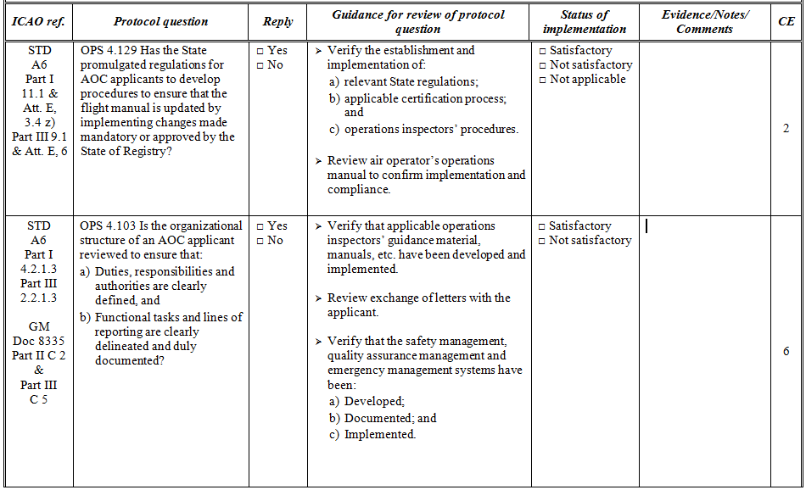
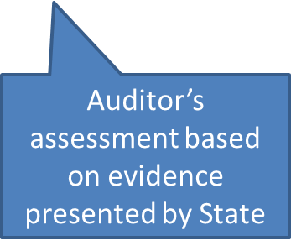
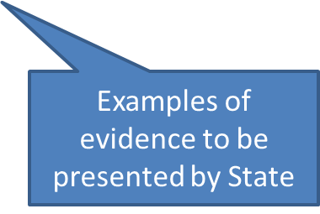
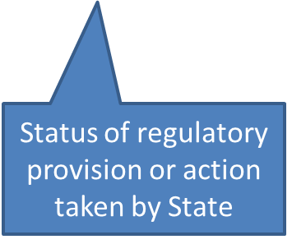
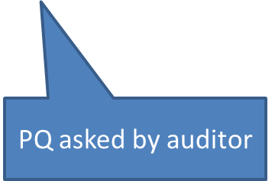
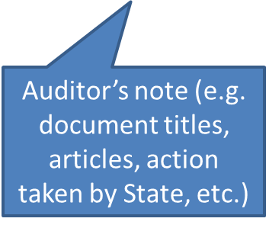
Protocol Question — Example
ICAO Reference

Slide 10
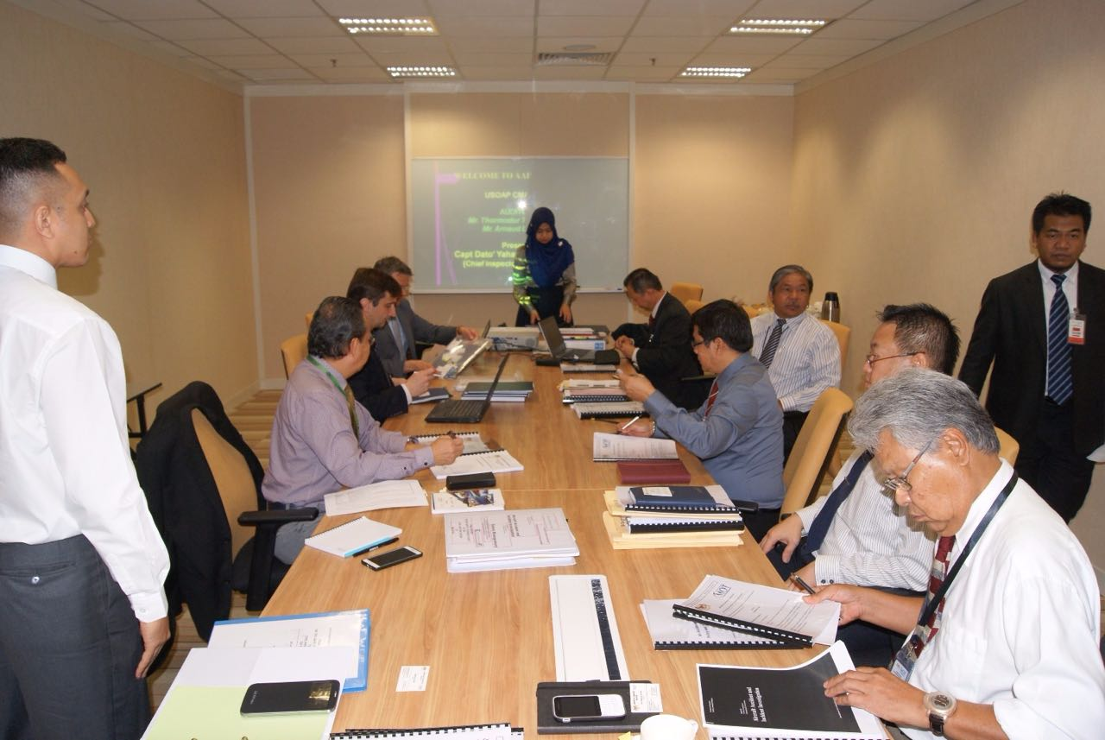
PICTURE OF AUDIT SESSION AT AAIB OFFICE 2nd to 12th May 2016

Slide 11
AUDIT RESULT – NON SAT
CE 1
Independence of the investigation, Non-disclosure of CVR information and
Non- disclosure of information other than CVR.
CE 2
To replace incident to serious incident for regulation 183 of CAR 2016 and
to include definition of serious incident at regulation186

Slide 12
AUDIT RESULT - NON SAT
CE 3
Perceived and actual conflict of interest for seconded expert to AAIB
CE 4
Training programme
IDP/OJT

Slide 13
AUDIT RESULT - NON SAT
CE 5
Sufficiency of equipment/ protective equipment and Fitness of investigators
Systematic notification to ICAO
Procedure and guidance for serious incident investigation
Responsible person for unauthorized access to draft report

Slide 14
AUDIT RESULT – NON SAT
CE 8
Establish and implement a comprehensive safety related notification on safety related incidents so that AAIB obligation to conduct serious incident investigation is full filled.
Established a state level accident and incident database

Slide 15
Audit Results based on PQs for Effective Implementation
Critical Element | Total PQs | Non Sat. PQs | Area of concern (Non Satisfactory) | Remarks
CE 1 | 10 | 3 | Independence of the investigation, Non-disclosure of CVR information and Non- disclosure of information other than CVR. | To be incorporated into primary legislation, Malaysia is filing differences .
CE 2 | 15 | 1 | To replace incident to serious incident for regulation 183 of CAR 2016 and to include definition of serious incident at regulation186 | Agree with audit finding
CE 3 | 14 | 2 | Perceived and actual conflict of interest for seconded expert to AAIB | Agree with audit finding
CE 4 | 7 | 3 | Training programme IDP/OJT | Agree with audit finding
CE 5 | 49 | 8 | Sufficient equipment/ protective equipment/Fitness of investigators Systematic notification to ICAO Procedure and guidance for serious incident investigation Responsible person for unauthorized access to draft report | Agree with audit finding
CE 6 | 0 | 0
CE 7 | 0 | 0
CE 8 | 14 | 10 | Establish and implement a comprehensive safety related notification on safety related incidents so that AAIB obligation to conduct serious incident investigation is full filled. Established a state level accident and incident database | Agree with audit finding
Total CE | 109 | 27
Note;
There were no PQs on CE 6 and 7

Slide 16
DRAFT REPORT
The Draft Report is the first ICAO “official” report of the audit.
It is submitted to the State within 90 calendar days after the audit closing meeting.
The State has 45 days to comment on the draft report.

Slide 17
FINAL REPORT
The Final Report is the official report of the audit. It supersedes the Draft Report that has been distributed earlier.
It is sent to the State within 30 calendar days after the State has submitted to ICAO its comments on the draft audit report.

Slide 18
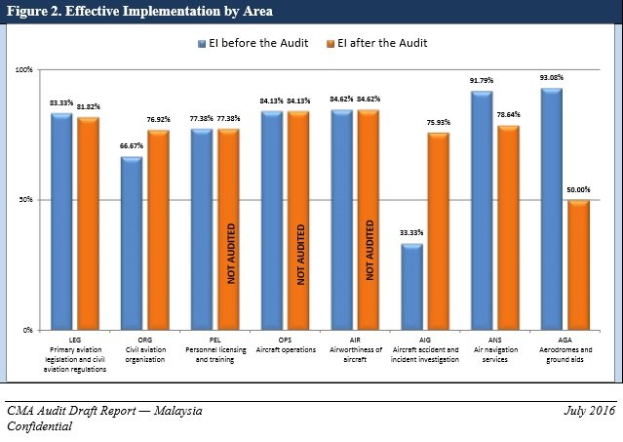
EFFECTIVE IMPLEMENTATION BY AREA

Slide 19
CORRECTIVE ACTION PLAN
Should address ALL the findings contained in the final Audit Report.
Provide specific actions and time-lines for the resolution of each of the findings.
Indicate the officer responsible for each action.
States are encouraged to use the State Corrective Action Plan Template developed and provided by ICAO for this purpose.

Slide 20
STATE SAFETY CONCERN
“A significant safety concern occurs when the audited State allows the holder of an authorization or approval to exercise the privileges attached to it, although the minimum requirements established by the State and by the Standards set forth in the Annexes to the Chicago Convention are not met, resulting in an immediate safety risk to international civil aviation.”
Implications to States with SSC !

Slide 21
AAIB CHALLENGES
Qualified Technical Personnels
Legislations/Regulations
Budget for training and equipment
State level accident and incident database.

Slide 22
THANK YOU ANY QUESTION...

