Slide 1



ACADEMIC QUALIFICATION
MSc in Engineering Business Management
Certificate of Aircraft Maintenance Technology
(FAR Part 65 Airframe & Powerplant Maintenance Program
BSc in Electrical Engineering
WORKING EXPERIENCE
Specialist UniKL MIAT (2001 – present)
Section Heads CHAMPS - Center of Helicopter and Aircraft
Maintenance Professional (UniKL MIAT :2013 – 2016)
Training Manager for EASA Part 147 Direct Approval
(UniKL MIAT : 2012 – 2016)
Training Manager representative Part 147 Outpost Airbus Helicopter
(UniKL MIAT: 2012 – 2016)
Training Manager representative Part 147 Extended Workbench
Aerobildung GmbH. (UniKL MIAT: 2008 – 2016)
Section Head Airframe & Powerplant (UniKL MIAT : 2003 – 2006)
ZULKEFLI BIN HJ HARUN
UniKL MIAT

Slide 2

Aircraft Airworthiness and Challenges in
Ensuring Commonality of Regulations within ASEAN
Aircraft Continuing Airworthiness
Aircraft Maintenance Training (Part 147/66)
(AIRCRAFT MAINTENANCE LICENCE)

Slide 3

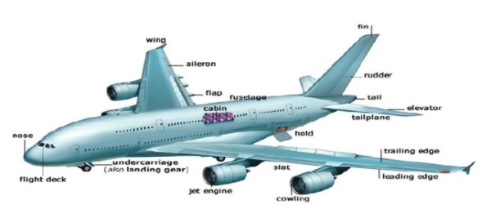
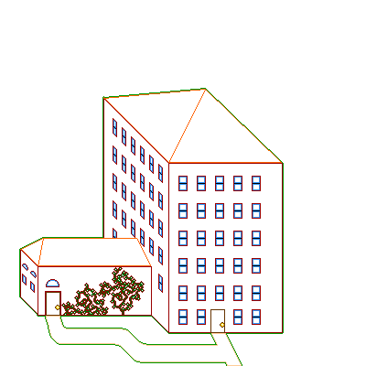


Initial Airworthiness
C S
+ AMC
+ GM
Requirement
Certification
Specification
iR 748/2012
CAw
STC
TC
e.g:
FAA/CS 25
CERTIFICATION
NAA
Design Data
*
DO
Design
*
Cert. test
*
Customer. test
A/C Design
*
*
ICT. test
DOA
Part 21.J
*
Lab. test
Syst. Design
*
*
Integration. test
Approved DATA
Approved DATA
Comp. Design
*
*
Comp. test
Production
Phase
Soft.W Design
*
*
Soft.W. test
Form
52
Form
53
Delivery to owner
Approved
DATA
Form
1
Part 21.G
DO
Part 21.O
NAA
PO
C of Conform
CTS’s

Slide 4


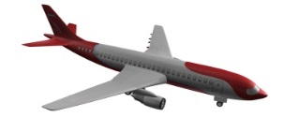


CAR 2016 Reg:30
Continuing
Airworthiness
Initial
Airworthiness
N 7101
AOC
W & B
iR 1321/2014
Aircraft Registration
C.A.T
ETOPS
N 8301
C of A
TC
Operation
OPERATOR
15b
NAA
15a
Maintenance
Annex 6
MEL
SRM
FCOM
SB
AMP
PiREPS
15b
Approved Data
N 6102
ARC
CRS
AML
+
145
Airworthiness
Review
15b
AMM
IPC
WDM
*CMM
COSL
CAMO
15a
N 6501
AMO
Part M
Part 145
SHOP
NDT (D)
LINE
MRO
*CMM
C1 C2
STORE
BASE
OMP
TC
Form 1
NAA
CAME
Part 147
(AN1201)
MOE
Certifying staff
CAT A
CAT B1 , CAT B2
Part 66
(AN 1101)
Unskilled
Worker
MTOE
Practical
Training
+
Assessment
ATO
Skilled
Worker

Slide 5
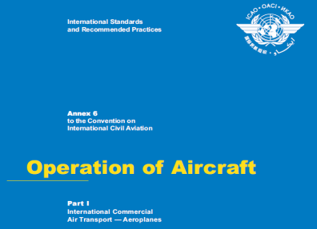
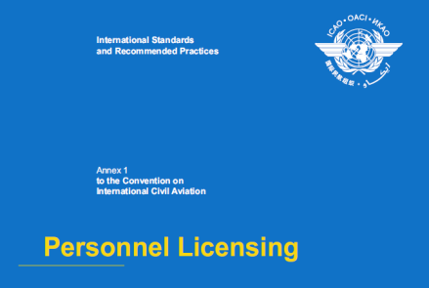
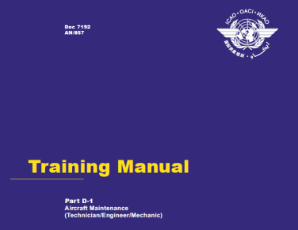
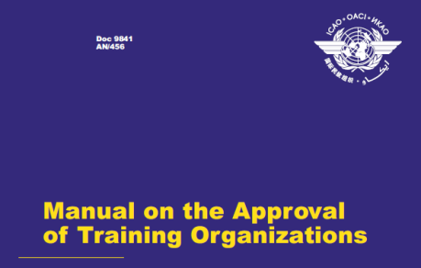

ADOPTION OF INTERNATIONAL
STANDARDS AND RECOMMENDED PRACTICES
(SARPs) - ANNEXES
CONCLUDED
CONVENTION &
ARTICLES
MANDATING
COMPLIANCE
OVERSIGHT
CONTRACTING STATES
DEVELOP
IMPLEMENTATION
LAWS
CONTRACTING STATES
NATIONAL AVIATION
AUTHORITY (NAA)
REGULATIONS
REQUIREMENTS
GUIDANCE MATERIALS

Slide 6
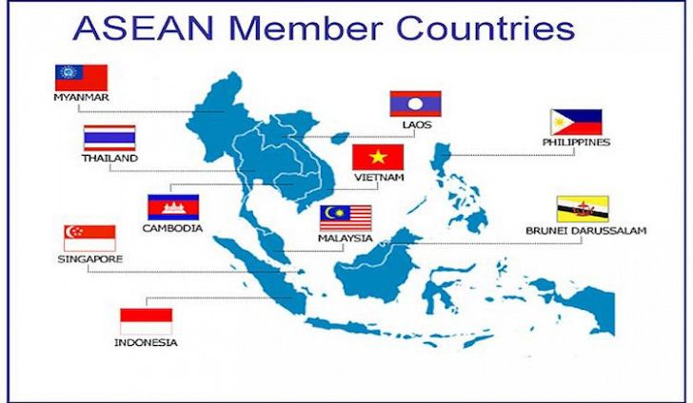
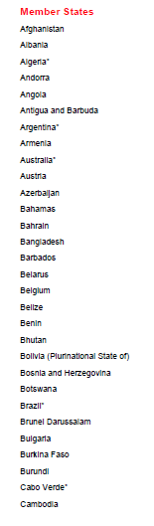
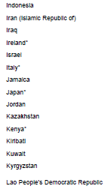
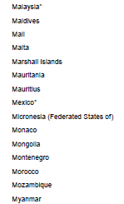
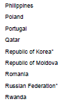



ICAO Member States

Slide 7
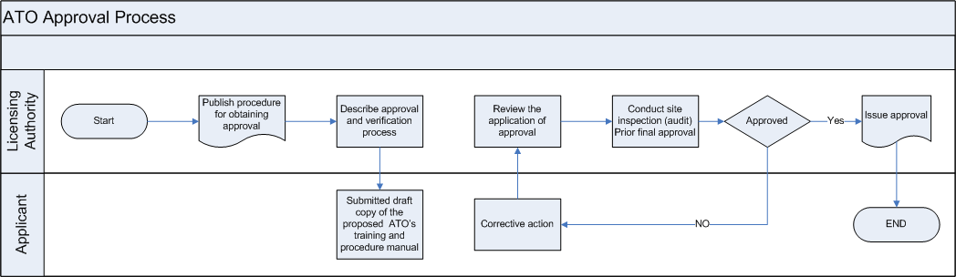
ATO Approval Process
Continuing Airworthiness

Slide 8
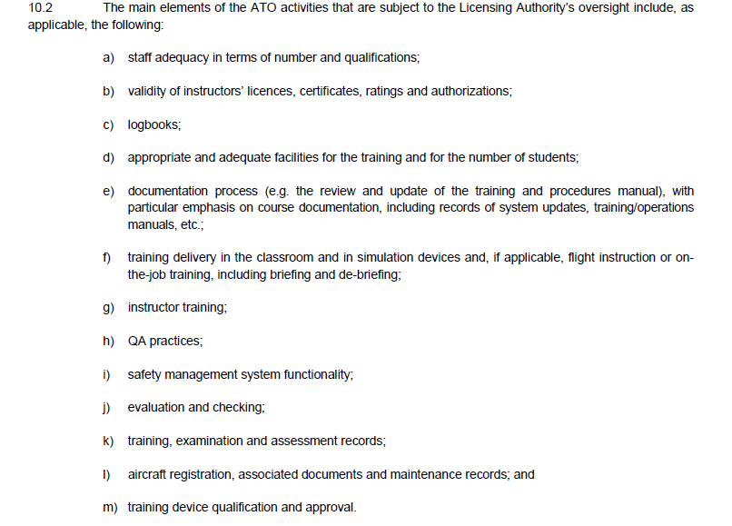
ATO: Continuing Airworthiness
Part 147
Part 66

Slide 9


Annex 1:- Personal Licensing
Doc 9841:- Manual on approval of a training organization
Part 147
Aviation Maintenance Technicians School
Part 147
Maintenance Training Organization Approvals
Part 65 –
Certification: Airmen Other
Than Flight Crewmembers
Part 66 –
Certifying Staff

Slide 10
Part 147 - Comparison
FAR Part 147 |  |  |  |  |  | EASA Part 147
Subpart A : General |  |  |  |  |  | SECTION A Technical Requirements
 |  |  |  |  |  | Subpart A - General
147.1 | Applicability |  |  |  |  | 147.A.05 | Scope
147.3 | Certificate required |  |  |  |  | 147.A.10 | General
147.5 | Application and issue |  |  |  |  | 147.A.15 | Application
147.7 | Duration of certificates
147.8 | Employmwnt of former FAA employees
Subpart B - Certification Requirments |  |  |  |  |  | Subpart B- Organisational Requirements
147.11 | Rating |  |  |  |  | 147.A.100 | Facility requirements
147.13 | Facilities, equipments, and material |  |  |  |  | 147.A.105 | Personnel requirements
 | requirements |  |  |  |  | 147.A.110 | Records of instructors, examiners
147.15 | Space requirements |  |  |  |  |  | and assessors
147.17 | Instructional equipments requirements |  |  |  |  | 147.A.115 | Instructional equipment
147.19 | Materials, Special tools, shop |  |  |  |  | 147.A.120 | Maintenance Training Materials
 | equipment requirements |  |  |  |  | 147.A.125 | Records
147.21 | General curriculum requirements |  |  |  |  | 147.A.130 | Training procedure and quality
147.23 | Instructor requirements |  |  |  |  |  | system
 |  |  |  |  |  | 147.A.135 | Examination

Slide 11
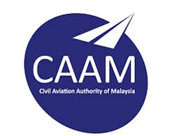
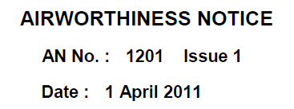
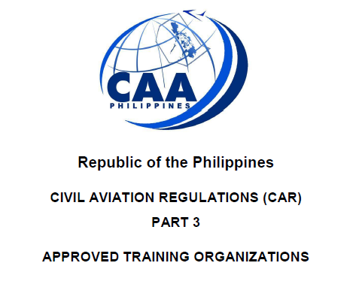

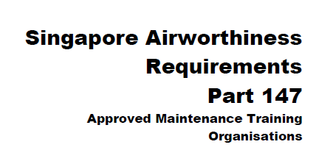

Slide 12

 | CAAM -AN 1201
1.0 | Introduction
2.0 | Scope and Rating
3.0 | Definitions
4.0 | Application
5.0 | Organizational Requirement
6.0 | Approved Basic Training Course
7.0 | Aircraft Type/Task Training
8.0 | Miscellaneous
Part 147 Similarities
/Differences
 | SAR - 147
Sub-part B - Organisational Requirements
147.100 | Facility requirements
147.105 | Personned requirements
147.110 | Records of instructors, Examiners and
 | Assessors
147.115 | Instructional Equipments
147.120 | Maintenance Training Manual
147.125 | Recprds
147.130 | Training Procedures and internal Quality
 | Assurance systen
147.135 | Examintion
PCAR - Part 3
3.4 AMT Training course
3.4.1 | Applicability
3.4.2 | AMT trining course
3.4.3 | General Curriculum requirements
3.4.4 | AMT training program providers
3.4.5 | Instructor requirements
3.4.6 | Attendance and credit for prior
 | instruction or experience
Supported by IS : Implementing Standard

Slide 13


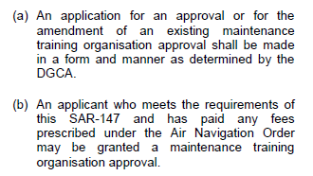
AN 1201 : - 2.0 Scope and ratings
Authority
PCAR Part 3 : - Application for Issuance or amendment of ATO Certificate
SAR - 147 : - Application and Issue
Do training provider need
to apply approval from all
countries for training program
to be recognized?

Slide 14
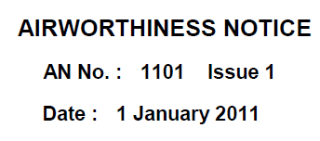
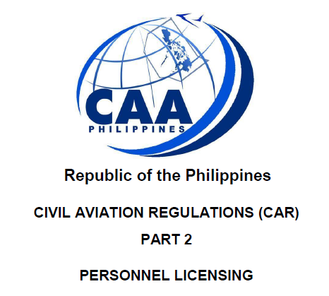
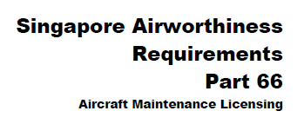

Slide 15
Part 66 Similarities
/Differences
 | CAAM -AN 1101
1.0 | Introduction
2.0 | Effecrive date
3.0 | Definitions
4.0 | Aeroplanes and Helicopers
5.0 | Aircraft Other than Aeroplanes and Helicopters
6.0 | Components
7.0 | Applications for Aircraft Maintenance Licence
8.0 | Transitions
 | SAR - 66
66.1 | General
66.3 | Effectivity
66.5 | Definitions
66.10 | Application and issue
66.20 | Privileges
66.25 | Basic Knowledge requirements
66.30 | Experience requirements
66.40 | Continuity of the aircraft maintenance Licence
66.45 | Type/task training and ratings
66.50 | Medical fitness
66.55 | Evidence of qualifications
66.60 | Equivalent safety case
66.65 | Revocation, Suspension or limitation of the SAR 66
 | aicraft maintenance licence
66.70 | Conversion provisions
PCAR - Part 2
2.6 Aviation Maintenance Licensing
2.6.1 | General
2.6.2 | Aviation Maintenance Technician (AMT)
2.6.3 | Aviation Maintenance Specialist (AMS)

Slide 16



AN 1101 : - 7.0 Application for Aircraft Maintenance Licence
PCAR Part 2 : - Eligibility requirement (applicant for AMT)
How do we recognize /accept
the English level ?
Do we have alternative
means of compliance
for each countries?
SAR - 66 : - Application and Issue

Slide 17
Other challenges to have mutual agreements
among ASEAN countries?
To conduct study we needs to access the information related to aviation rules and
Regulations? How many ASEAN countries willing to share the information?
Each ASEAN countries have their own aviation legislative framework.
Level of implementing rules different among the countries. Accessibility to the
information are limited.
Aviation Legislation Standardization. How do we formulate to have standardization
in aviation legislation among the ASEAN countries?
Differences in Licence category of Aircraft Maintenance licence : (Philippines /Malaysia )
Do we have conversion provision of licensing among the ASEAN countries?

Slide 18
THE END
THANK YOU VERY MUCH FOR YOUR ATTENTION..

