Slide 1

ECONOMIC IMPACT ON DOWNGRADE
Tamat Sarmidi and Rizal Palil
Faculty of Economics and Management
University Kebangsaan Malaysia

Slide 2
Organization
Background
Assessing current scenario
Problems
Objectives
Economic effect to downgrade
Data and methodology
Results
Conclusions

Slide 3
Background of Study
In 2015, the Federal Aviation Administration has downgrade Thailand to Tier 2 because Thailand does not comply with international aviation standards.
Category 2 means that the country does not comply to the minimum international flight standards (FAA Press Release December 1, 2015).
The International Civil Aviation Organization (ICAO) which provides Standard and Recommended Practices (SARPs) is a platform or benchmark for airlines industry.
In general, every industry aviation worldwide, in particular the member countries (192 states) is constantly monitored and assessed to ensure that each airline complies with international standards and practices to ensure the safety of the aviation sector to carry out operations worldwide.
Thai Airways was banned by China, Japan, Korea, U.S to fly to their country.

Slide 4
Background of Study
According to aviation industry experts, Malaysia is in a very uncertain position and is likely to be downgraded by ICAO's as has happened to Thailand.
This concern is due to the issue of the delinquency of the Aviation Legislation Act and the responsible authority in the aviation sector.
Although each country has its own flight authority and legislative body, it is very important to recognize and certify that the airline is eligible to fly or not based on international standards.
Getting worst with the missing of MH17 and incident of MH370. Both incidents pose biggest threats to the aviation industry in Malaysia.
The incidents show that aircraft safety and flight management systems are still not managed satisfactorily, and quick action are needed to fix the problems.

Slide 5
Two ratings for the status of countries
Category 1, Does Comply with ICAO Standards: A country's civil aviation authority has been assessed by FAA inspectors and has been found to license and oversee air carriers in accordance with ICAO aviation safety standards.
Category 2, Does Not Comply with ICAO Standards: The Federal Aviation Administration assessed this country's civil aviation authority (CAA) and determined that it does not provide safety oversight of its air carrier operators in accordance with the minimum safety oversight standards established by the International Civil Aviation Organization (ICAO).
Country
1.Malaysia
2. Singapore
3. Nigeria
4. India
Category 2
Category 1
1. Bangladesh
2. Ghana
3. Thailand

Slide 6
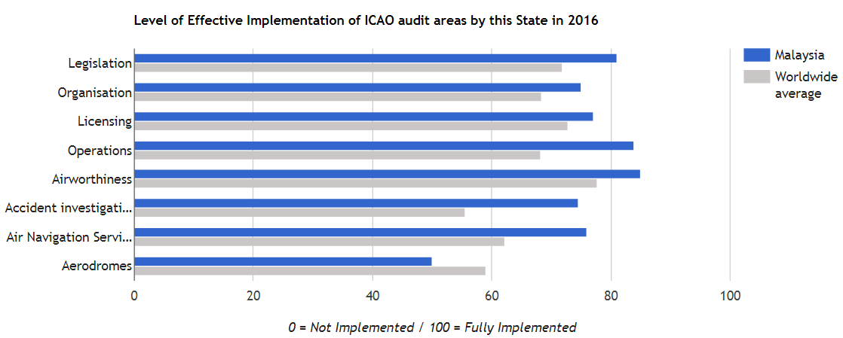
ICAO AUDIT in 2016 (MALAYSIA)
Source : Aviation Safety Network - https://aviation-safety.net/database/country/country.php?id=9M

Slide 7
Problem Statement
Therefore, the improvement of the aviation law needs to be done to ensure no threats can lead to downgrades.
Researchers are of the view that if the aviation industry in Malaysia is to be categorized as unsafe or to be downgraded, it has a very crucial impact on the economy, tourism and also the aviation industry in Malaysia.
If Malaysia is downgraded, it will indirectly impact international trade such as trade, import and export relations.
The tourism sector is expected to affected most.
This study, seeking expert opinion including from airlines and aviation authority bodies such as the Civil Aviation Authority of Malaysia (CAAM) and MAVCOM to uphold better service quality and meet international standards.
Additionally, this study is very important to determine weaknesses in aviation industry in Malaysia and then to improve Malaysia's national aviation system.
The findings of this study can also help the respected parties to be prepared when ICAO-appointed auditors and assessors to audit Malaysia’s aviation industry.

Slide 8
Objective of study
General Objective
Analyze the impact on the Malaysian economy if Malaysia's aviation industry is downgraded to category 2
Specific objective
To analyze the impact of aviation operations on GDP, wages, and jobs
To analyze the impact of aviation on tourism (number of business, tourist and resident passengers transported by air
To measured the total impact in Malaysia (sums the operational and tourism benefits, and compares them to Malaysia GDP)
To analyze the international and domestic connectivity effects (describes the wider contribution made by aviation to the economy in Malaysia)

Slide 9
Assessing Tier 2 to Aviation Potential
Thailand is one of the most well-known and most visited countries in the world. In 2015, Thailand was shocked by the bad news by the International Airline (ICAO) that the Thai aviation industry did not meet the international standards adequately. The news has caused China, Japan and Korea to blacklist Thai airlines to fly and launch new routes to the country. Even the launch of the TAX flight service to Sapporo, Japan and NokScoot Flight to Incheon, Korea was also canceled (Dennis, 2015).
This has also occurred in several countries such as India in 2014 due to lack of security supervision, Indonesia in 2007 following a series of accidents and the Philippines in 2008 for failing to comply with minimum international safety standards.

Slide 10
Assessing Tier 2 to Stock Market
Tripathy (2014), when the US Federal Aviation Administration (FAA) issues a warning against India's flight that they did not meet the aviation standards has caused aviation stock market share in Mumbai market to close 3.7% lower. This suggests that the impact of the rating to the stock market for Indian airlines.
In addition, India is not allowed to add new routes to the United States until completion of the assessment.
According to sources from Reuters site (2015), shares for national airline Thai Airways International dropped 6.3% to six-year low.
Asia Aviation, a major shareholder in Thai AirAsia and Bangkok Airways companies, also dropped more than 3 %.

Slide 11
Assessing Current Situation
A study by O'Connell and Vanoverbeke (2015) report that the downgrade of the security has caused Philippine Airlines has limitation to grow internationally. The fact is that the lack of domestic networks and no feeder traffic from partner airlines has prevented new routes to the Middle East and Europe.
Meanwhile, the European Union also banned all airlines from the Philippines to operate in the European airspace.
This has significantly restricting networking and tourism potential of Philippine Airlines.

Slide 12
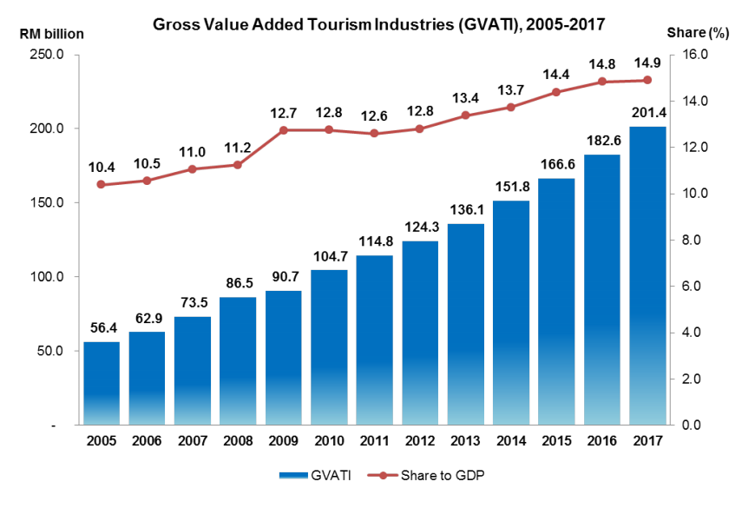
Assessing Current Situation: the Potential Impact

Slide 13
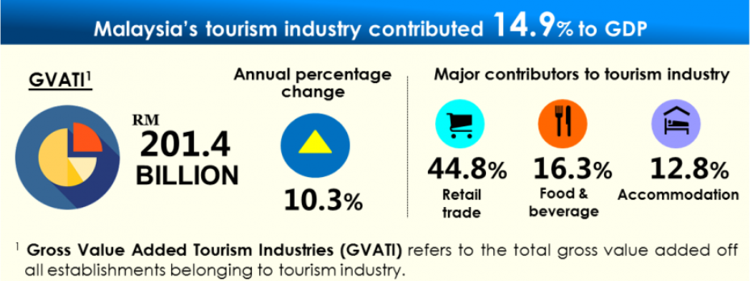
Assessing Current Situation: the Potential Impact

Slide 14
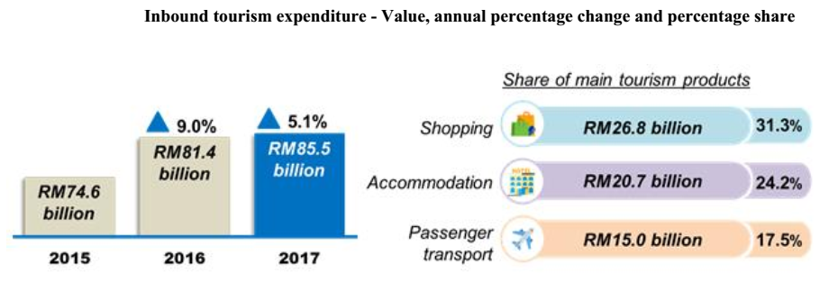
Assessing Current Situation: the Potential Impact

Slide 15
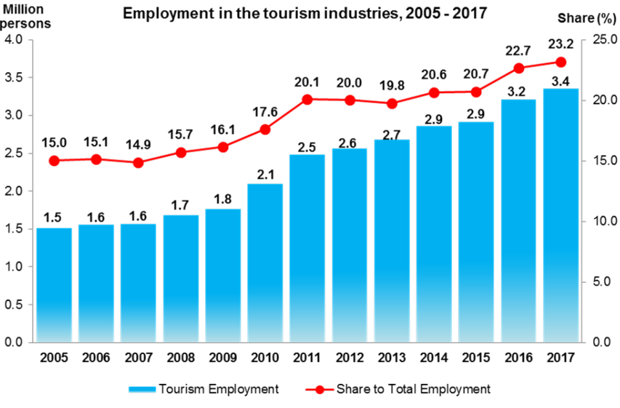
Assessing Current Situation: the Potential Impact

Slide 16
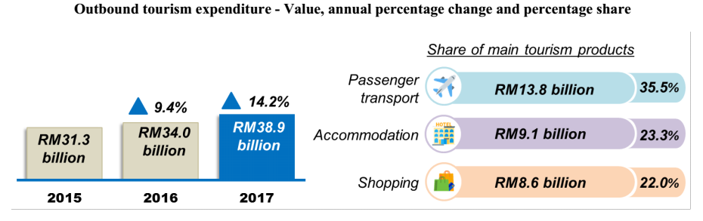
Assessing Current Situation: the Potential Impact

Slide 17
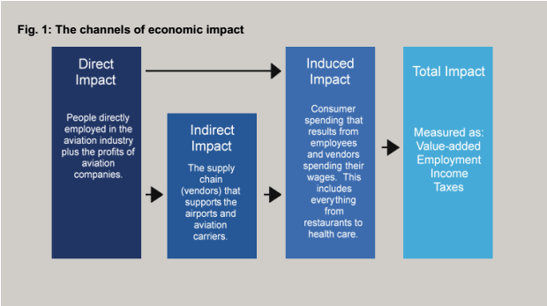
Impact Channels

Slide 18
Data
The data have been collected from World Development Indicators (WDI) of World Bank.
This study uses panel data.
The time series data covers the period 1990 until 2017.
The panel data consisting of 7 countries -Malaysia, Singapore, Nigeria, India, Bangladesh, Ghana and Thailand.
Tier 2 are Bangladesh, Ghana and Thailand

Slide 19
Methodology
Panel data setup is used for 7 countries which divided into 2 groups
First category include countries with Tier 1 and Second group consist of Tier 2
The effect of Tier two category is estimated using Difference-In-Difference (DID) methodology
DID is used in observational settings where exchangeability cannot be assumed between the treatment and control groups.
DID relies on a less strict exchangeability assumption, i.e., in absence of treatment, the unobserved differences between treatment and control groups are the same overtime.

Slide 20
Methodology
DID requires data from treatment/control or pre-/post-intervention, such as cohort or panel data (individual level data over time) or repeated cross-sectional data (individual or group level).
The approach removes biases in post-intervention period comparisons between the treatment and control group that could be the result from permanent differences between those groups, as well as biases from comparisons over time in the treatment group that could be the result of trends due to other causes of the outcome.

Slide 21
Methodology
Estimating DID as an interaction term between variable under study and treatment group dummy variables in a regression model.
Passenger_{it}= β₀ + β₁*[Variable_{it}] + β₂*[Tier2_{it}] + β₃*[Variable_{it}*Tier2_{it}] + β₄*[Covariates_{it}]+ε_{it}
Passenger = Air transport passenger
Variable = 1. tourist, 2. freight, 3. carrier
Tier2 = Dummy for country classified as Tier 2
Covariates = Growth
i = Cross section
t = time series 1990 to 2017

Slide 22
Methodology
Panel data estimation without country specific effect because we control by labor force in the country
Tourist arrival is mediating variable
Interaction term can be interpreted as moderating effect to air pessanger (+sign) or effect (-sign)
The turning point/threshold can be found using standard differentiation technique of d[Passenger]/d[Tier2]
Robustness checking using;
econometric tools to have robust standard error
Variables Carrier and Freight to avoid co-incident

Slide 23
Relationship Between Tourist Arrival, Air Passenger and Economy Size in 1990

Slide 24
Relationship Between Tourist Arrival, Air Passenger and Economy Size in 2015

Slide 25
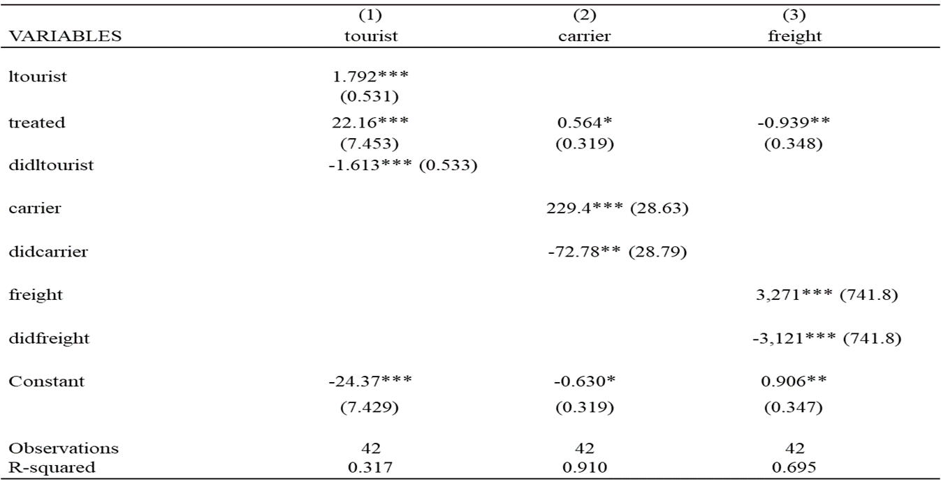
Impact of Tier-2 Status to Air Passenger 1990-2017

Slide 26
Results
Tourist has mediating positive impact on number of air passenger
Tier 2 moderates air passenger activities
Tier 2 classification significantly reduces number of air passenger by -1.6 or about 41 person/labor force
To nullify the negative effect of Tier 2, at least country need to have 13.85 number of tourist
The model 31.7% explained the variation in the number of air passenger

Slide 27
Policy Implication
Loosely based on assuming that previous study holds, tourism has direct effect to economy
Tier 2 has moderating effect to Malaysia economy
Avoiding for downgrade to Tier 2 is utmost priority

Slide 28
Thank you

