Slide 1
ICAO
Universal Safety Oversight Audit Programme (USOAP)
- Malaysia Experience
Dato Sri Azharuddin A Rahman

Slide 2
ICAO Universal Safety Oversight Audit Program (USOAP)
  Audits are carried out by ICAO to determine Member States’ safety capabilities and the status of States’ implementation of all safety-relevant ICAO Standards and Recommended Practices, associated procedures, guidance material, and best safety practices.
  ICAO Doc 9735

Slide 3

The Perspective of International Aviation Legislation
CONCLUDED
CONVENTION &
ARTICLES
MANDATING
ADOPTION OF INTERNATIONAL
STANDARDS AND RECOMMENDED PRACTICES
(SARPs) - ANNEXES
OVERSIGHT
COMPLIANCE
CONTRACTING STATES
DEVELOP
IMPLEMENTATION
LAWS
CONTRACTING STATES
NATIONAL AVIATION
AUTHORITY (NAA)
REGULATIONS
REQUIREMENTS
GUIDANCE MATERIALS

Slide 4
Original
  7th December 1944
Current
  9th edition 2006
Articles
  96 articles
States
  Initial - 52 States
  Currently - 192 states
  Malaysia joined 7 April 1958

Slide 5
Notable Article
Article 12:
  Each state shall keep its own rules of the air as uniform as possible with those established under the convention, the duty to ensure compliance with these rules rests with the contracting state.

Slide 6
Notable Article pertaining to airworthiness of aircraft
Article 33:
  (Recognition of Certificates and Licences) Certificates of Airworthiness, certificates of competency and licences issued or validated by the state in which the aircraft is registered, shall be recognised as valid by other states.
  The requirements for issue of those Certificates or Airworthiness, certificates of competency or licences must be equal to or above the minimum standards established by the Convention.

Slide 7
Notable Article pertaining to
Adoption of International Standards and Procedures
Article 37
Each contracting State undertakes to collaborate international uniformity in regulations, standards, procedures, and organization in relation to aircraft , personnel, airways and auxiliary services in all matters in which such uniformity will facilitate and improve air navigation.
To this end the International Civil Aviation Organization shall adopt and amend from time to time, as may be necessary, international. standards and recommended practices and procedures dealing with:
(a) Communications systems and air navigation aids, including ground marking;
(b) Characteristics of airports and landing areas;
(c) Rules of the air and air traffic control practice;
(d) Licensing of operating and mechanical personnel;
(e) Airworthiness of aircraft;

Slide 8
Notable Article pertaining to International Standards and Recommended Practices
… cont..Chapter VI Article 37 : Adoption of International Standards and Procedures
(f) Registration and identification of aircraft ;
(g) Collection and exchange of meteorological Information;
(h) Log book;
(i) Aeronautical maps and charts;
(j) Customs and immigration procedures;
(k) Aircraft in distress and investigation of accidents;
and each other matters concerned with the safety, regularity, and efficiency of air navigation as may from time to time appear appropriate.

Slide 9
ICAO Universal Safety Oversight Audit Programme (USOAP)
- Malaysia Experience
Areas audited - 8
Primary Aviation Legislation and associated civil aviation regulations (LEG)
Civil Aviation Organisation structure (ORG)
Personnel Licensing activities (PEL)
Aircraft Operations (OPS)
Airworthiness of civil aircraft (AIR)
Accident and serious incident investigation (AIG)
Air Navigation Services (ANS)
Aerodromes (AGA)

Slide 10
ICAO Universal Safety Oversight Audit Programme (USOAP)
- Malaysia Experience
Audit on 8 Critical Elements (CE)
CE 1 – Primary aviation legislation
CE 2 – Specific operating regulations
CE 3 – State civil aviation system and safety oversight functions
CE 4 – Technical personnel qualification and training
CE 5 – Technical guidance, tools and the provision of safety-critical information
CE 6 – Licensing, certification, authorization and approval obligations*
CE 7 – Surveillance obligations*
CE 8 – Resolution of Safety concerns*
* have direct implications on service providers

Slide 11
ICAO Universal Safety Oversight Audit Programme (USOAP)
- Malaysia Experience
2005 - All areas
2016 – LEG, ORG, AIG, ANS, AGA
… 2020 – PEL, OPS, AIR and possibly LEG, ORG
… 2019 – Universal Security Audit Programme (USAP)
… from 2020 – State Safety Programme (SSP) Audit

Slide 12
ICAO Universal Safety Oversight Audit Programme (USOAP)
- Malaysia Experience
USOAP timelines
ICAO notify State – 12 months before audit
ICAO and State to sign MOA on the audit *
*Mutually agree on the dates and timelines
Audit 10 working days, including site visits
Closing meeting – Preliminary audit results
90 days after closing meeting – Draft report
State to comment on draft report – 45 days
Final report – 30 days after receipt of State comments

Slide 13
ICAO Universal Safety Oversight Audit Programme (USOAP)
- Malaysia Experience
Preparation
Inform relevant service providers (airlines, airport operators, training schools)
Submit a completed and updated
State Aviation Activity Questionnaire (SAAQ)*
Corrective Action Plans (CAP)*
Protocol Questions (PQ)*, (total 1016 in 2016 audit)
Compliance Checklists (CC)*
* Continuous Monitoring Assessment (CMA)

Slide 14
ICAO Universal Safety Oversight Audit Programme (USOAP)
- Malaysia Experience
… cont… Preparation
… submit a completed and updated
Results of last USOAP
Relevant State legislation
Operating regulations
Prepare relevant records ;
license / certificates issued, audits, surveillance, personnel,
training and any other relevant records

Slide 15
Aviation eco-systems
ICAO
NAA
MANUFACTURERS
AIRLINES
AIRPORTS
MRO

Slide 16
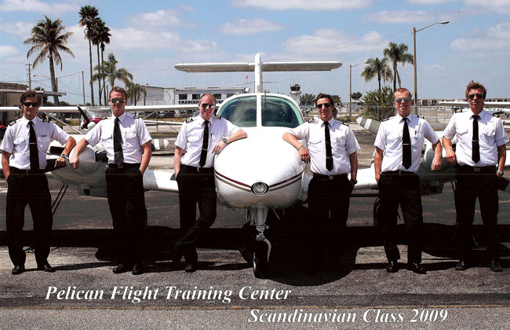
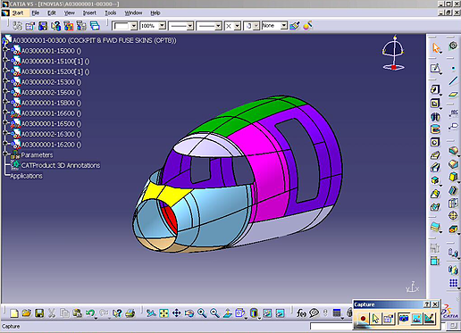
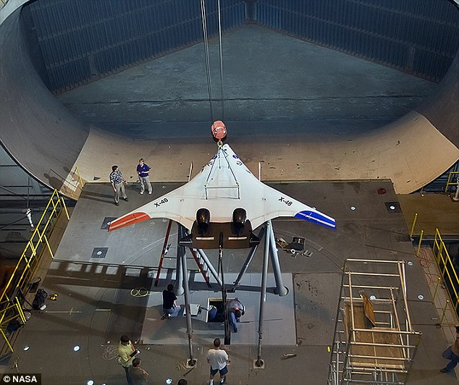
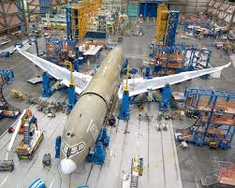
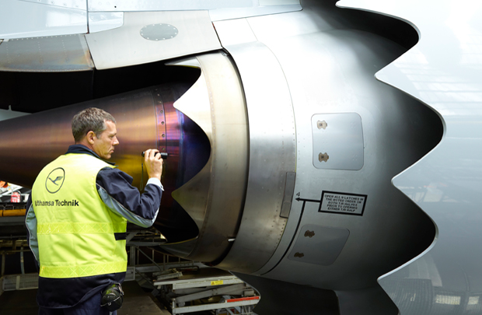
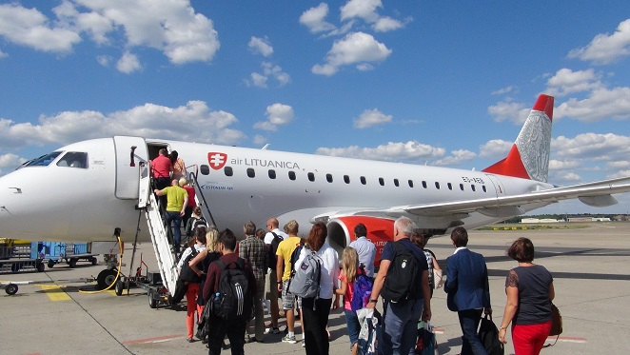
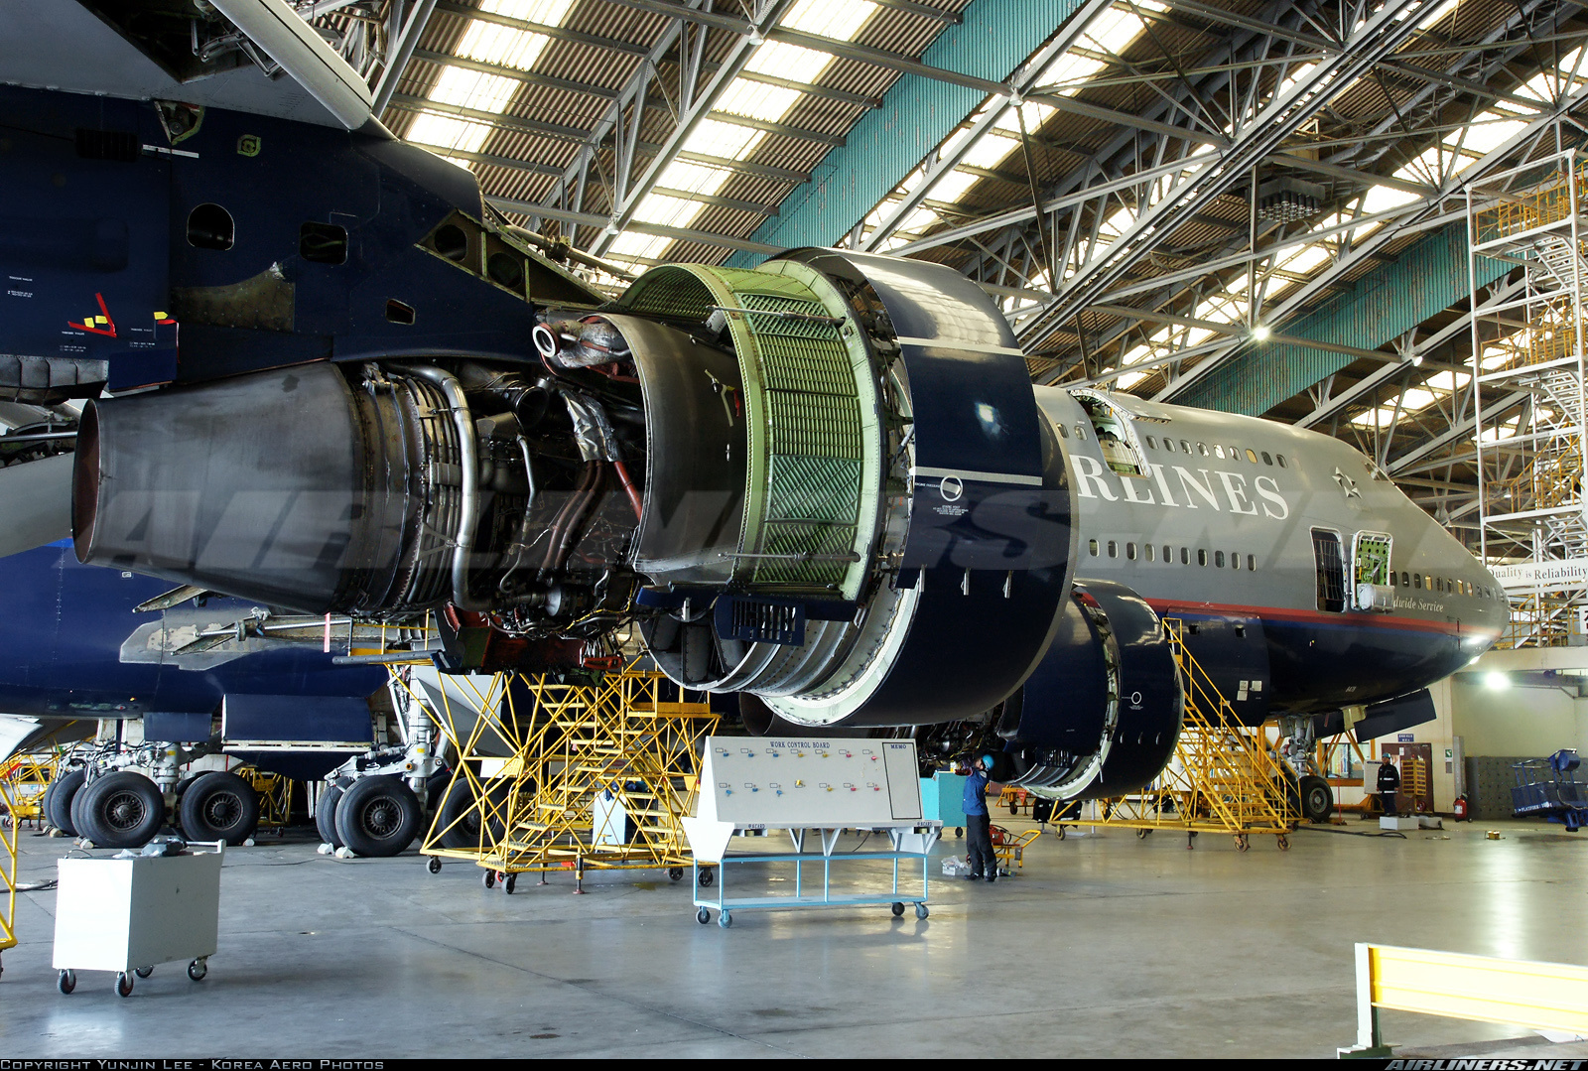
ATO
Design
Certification
Production
Operation
Maintenance
Training and
Airworthiness Management
DOA
POA
AOC
CAMO
MRO
Aviation Industry Segments

Slide 17
ICAO Universal Safety Oversight Audit Programme (USOAP)
- Preparation, Malaysia Civil Aviation Data
AOC – 26
ASL – 6 [272 aircraft]
Total aircraft reg. – 878
Intl Airports – 6
Aerodromes - 415
FIR – 2
MRO – 61 (dom) / 122 (intl)
DOA - 6
ATPL – 5412
LAME – 4499
ATCO – 1147
F TO – 5
AME TO – 14
ATC TO - 1

Slide 18
ICAO Universal Safety Oversight Audit Programme (USOAP)
- Malaysia Experience
Preparation
… Inform relevant service providers (airlines, airport operators, training schools) …
Air Operators’ Certificate (AOC) – 26
Air Service Licence (ASL) – 6 [no of aircraft – 272] {total aircraft reg – 878}
International Airports – 6
Flight Information Regions (FIR) – 2
MRO - 163
ATPL – 5412 / LAE – 4499 / ATCO – 1147

Slide 19
Malaysia Air Legislation Framework
Guidance Materials
ICAO (SARPs)
Civil Aviation Act
Civil Aviation Regulations
Notices, Circulars, Directives, Information, Requirements

Slide 20
Civil Aviation Act 1969

Slide 21
Civil Aviation Act 1969 Part II, Section 3

Slide 22
Malaysia Civil Aviation Regulations 2016

Slide 23
Matter in question :
The regulations are not sufficient for showing compliance,
therefore the Authority publishes
notices, circulars, directives and information
to detail the requirements.

Slide 24
Design Organisation Approval (DOA)
Regulation 21 – Certification of Approval for design, manufacture and construction of aeronautical products.
Requirements – Airworthiness Notice No. 96
          Design Organisation Approval

Slide 25
Production Organisation Approval (POA)
Regulation 21 – Certification of Approval for design, manufacture and construction of aeronautical products.
Requirements – Airworthiness Notice No. 8201
          Production Organisation Approval

Slide 26
Maintenance Repair Overhaul (MRO)
Organisation Approval
Regulation 31 – Approval for person or organization to engage in continuing airworthiness management, maintenance of aeronautical products and maintenance training.
Requirements – Airworthiness Notice No. 6501
          Maintenance Organisation Approval (DCAM Part 145)
          – Airworthiness Notice No. 6502
          Limited Maintenance Organisation Approval
          (DCAM Part M Subpart G)

Slide 27
What is the status of the Notices?
Power given under the Civil Aviation Act 196 and Amendments

Slide 29
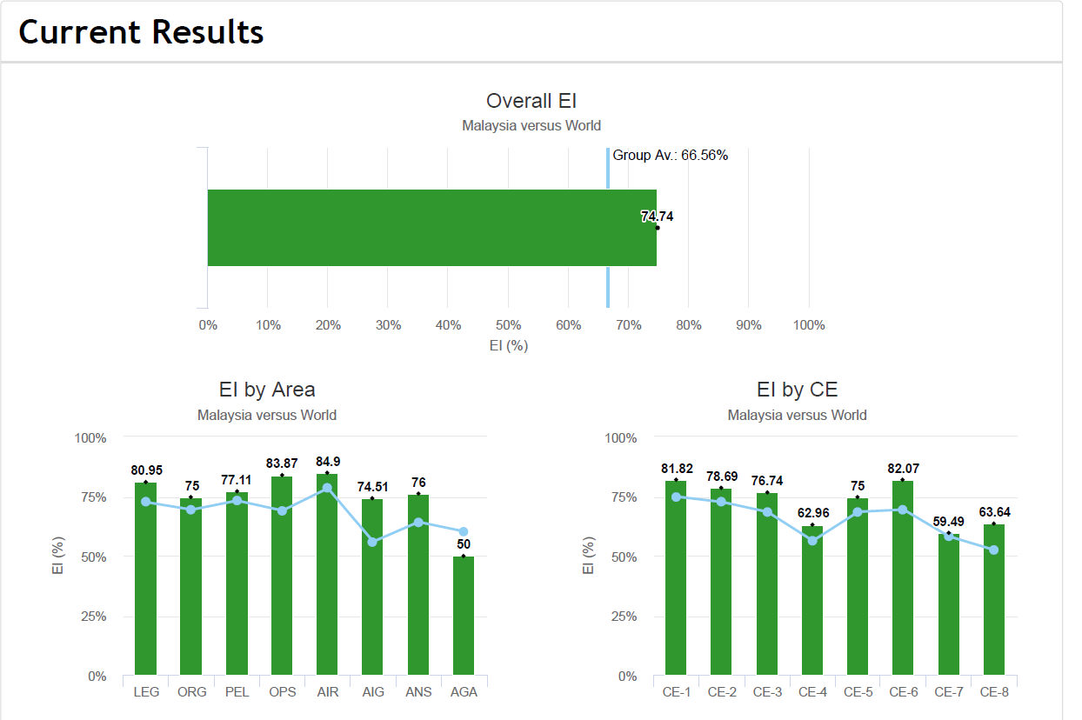
ICAO Universal Safety Oversight Audit Programme (USOAP)
- Malaysia @ 2016

Slide 30
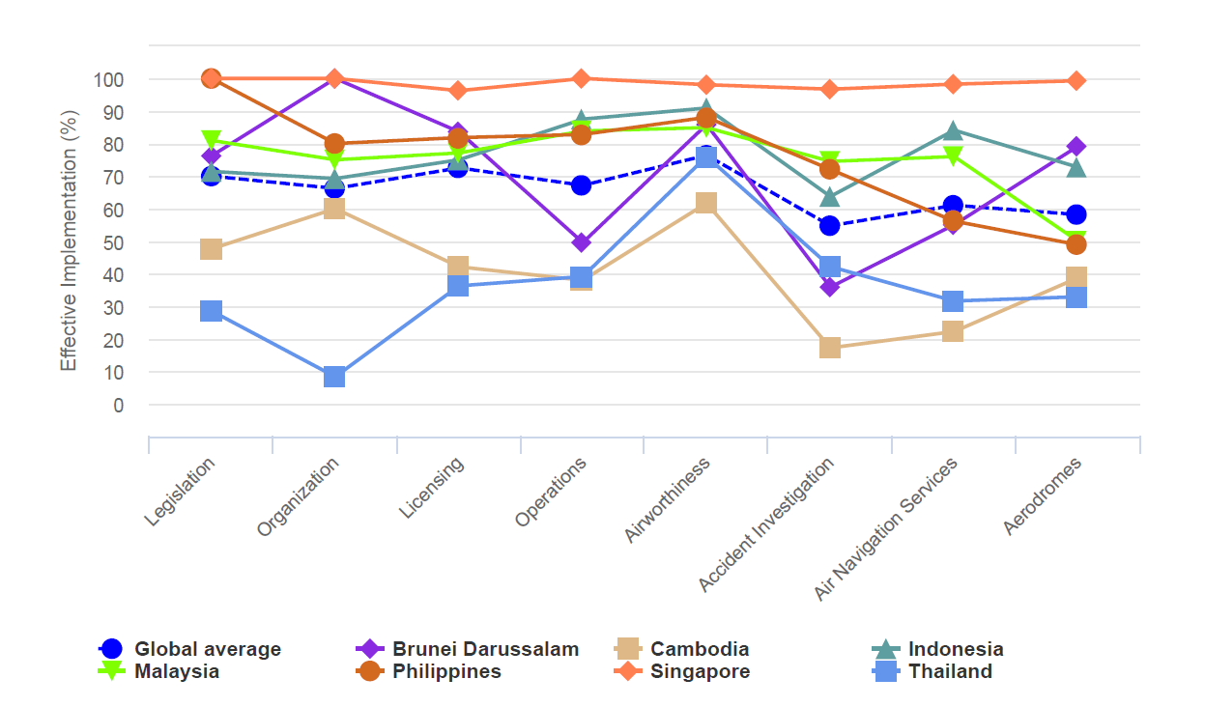
ICAO Universal Safety Oversight Audit Programme (USOAP)
- Malaysia vs global average and vs 6 ASEAN states

Slide 31
Non-compliance to USOAP
Downgrade by ICAO under USOAP to Category 2
  State Safety Concern (SSC)
  Name and shame on the State
  Restrictions on operations to the SSC civil aviation industry.
Downgrade by the FAA International Aviation Safety Assessment (IASA)
  Restrictions on the SSC air carriers to operate, or seek to operate, into the US, or codeshare with a US air carrier.
The EU may place the SSC into the EU Air Safety List
  The SSC airlines;
    may be banned from operating in Europe.
    may be restricted from operating under certain conditions in Europe.

Slide 32
Conclusion
  Malaysia was audited twice (2005 & 2016) by ICAO in the USOAP-CMA programme.
  At each audit, Malaysia performance was above the global average and also above most states in the APAC/ASEAN region.
  Notable CAPs have resulted improvements in Malaysia civil aviation eco-system, notably the setting up of CAAM and AAIB, and the revision of the MCAR 2016.
  A bad performance in USOAP will result in SSC, which all civil aviation stakeholders must understand the SSC implications. Therefore, compliance to the SARPs and state aviation legislation is upmost important.
  Preparation for the next USOAP in 2020 (and the USAP in 2019) should start from now, which includes submission of various documents to ICAO in the CMA programme.

Slide 33
ICAO Universal Safety Oversight Audit Programme (USOAP)
- Next Audits
… 2020 – PEL, OPS, AIR and possibly LEG, ORG
… 2019 – Universal Security Audit Programme (USAP)
… from 2020 – State Safety Programme (SSP) Audit

Slide 34
thank you
Dato Sri Azharuddin A Rahman

