Slide 1
GUIDELINES FOR REFLECTION SESSION
FOR TEACHERS
YOUR LANGUAGE MY CULTURE (YLMC) WEBSITE
www.ylmc.info

Slide 2

registration

Slide 3
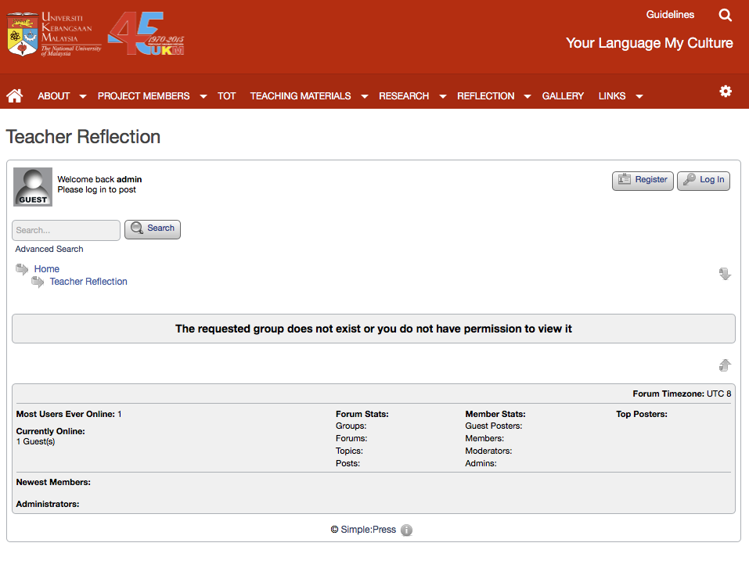
registration

Slide 4
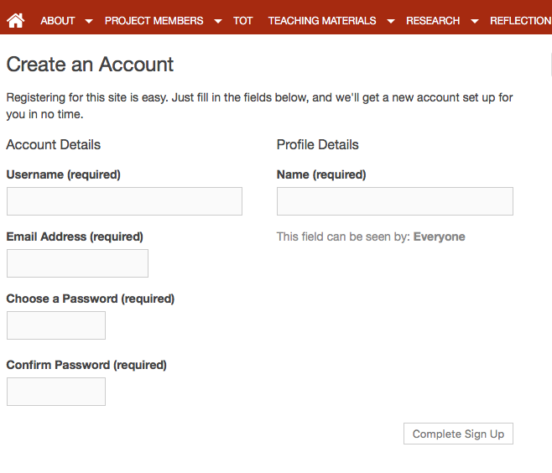
Fill up forms
Click to submit after complete form

Slide 5
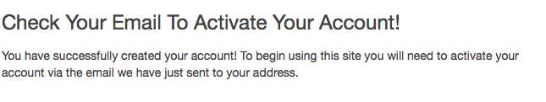
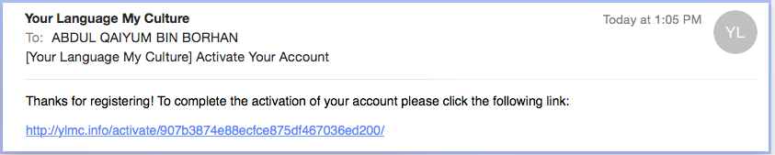
Check email to activate
Click the given link in your
e-mail inbox for activation

Slide 6
LOGIN

Slide 7
LOGIN

Slide 8
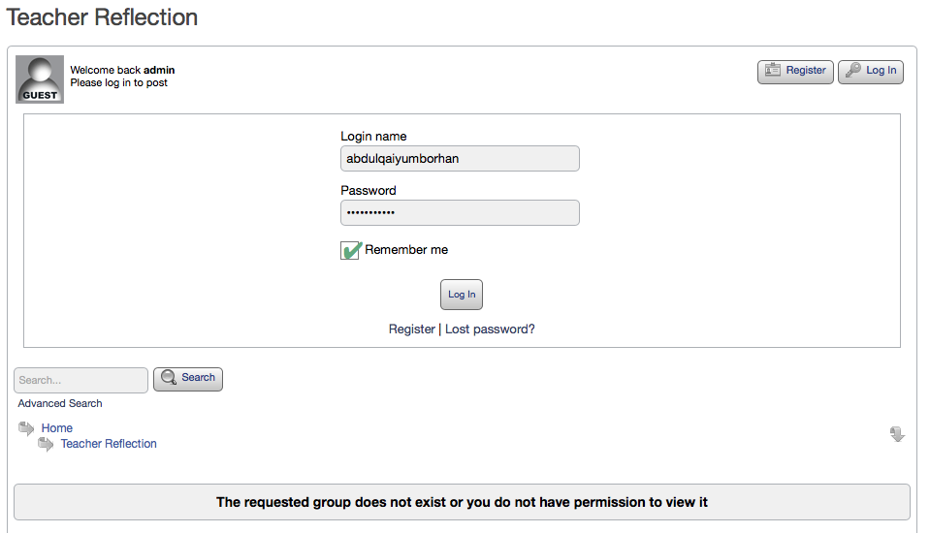
Log in

Slide 9
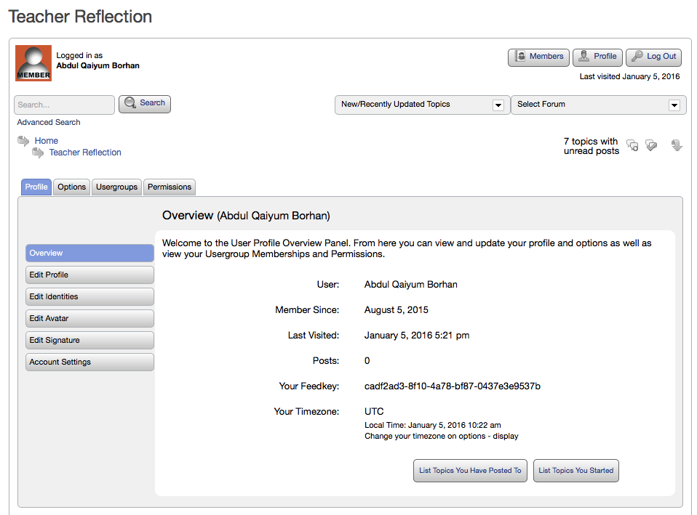
CLICK ON THE TEACHER REFLECTION’S LINK

Slide 10
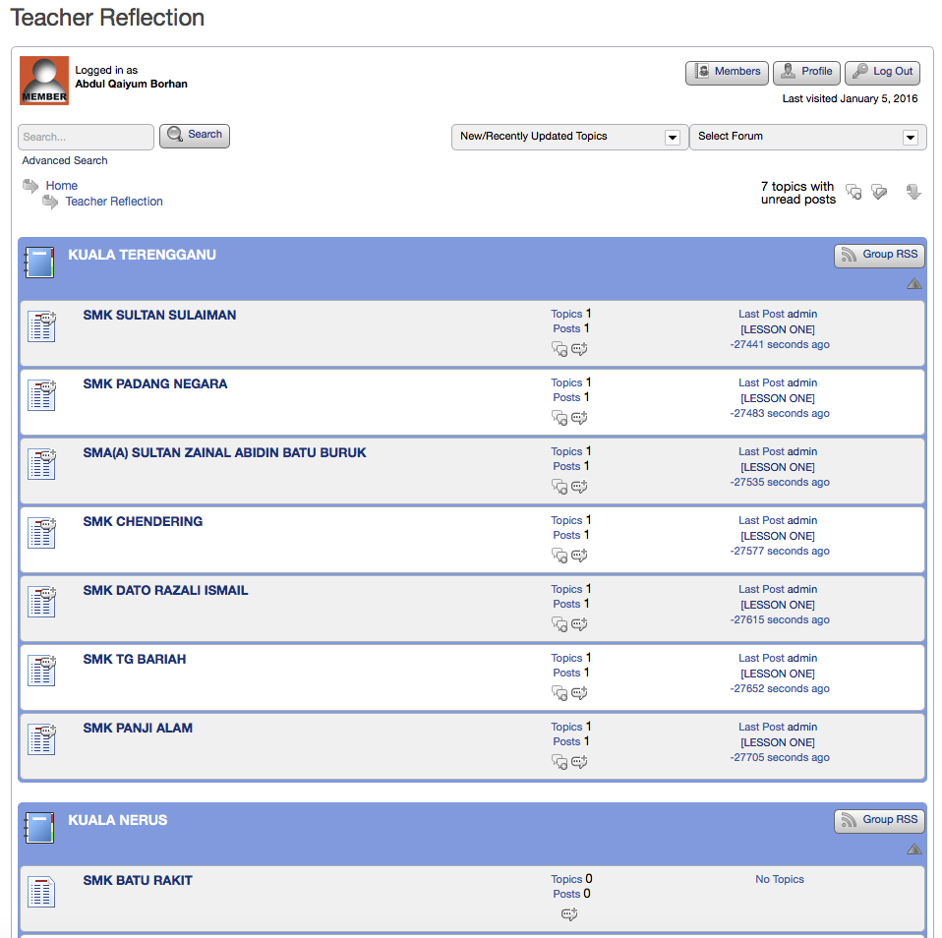
Choose
School

Slide 11
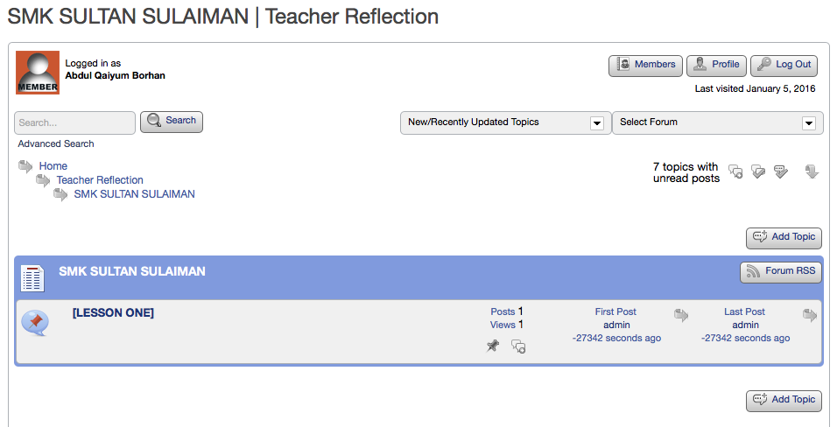
Choose Reflection Topic to start answering questions

Slide 12
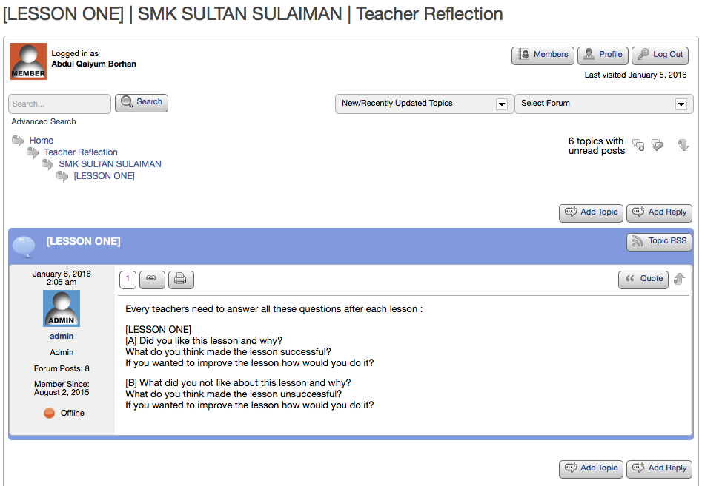
Click on
‘Add Reply’

Slide 13
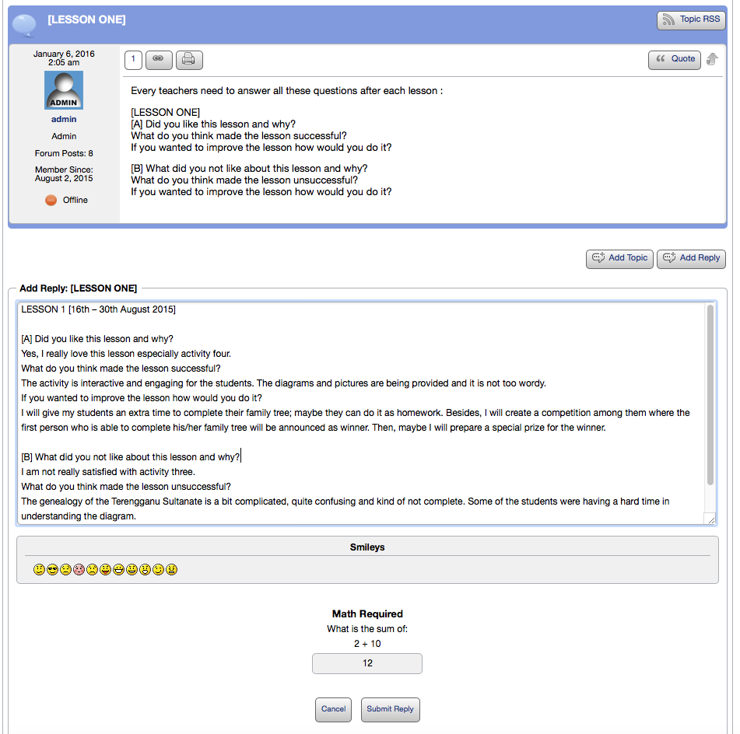
Reply in
this textbox
area
Answer some
security question
and ‘Submit’

Slide 14
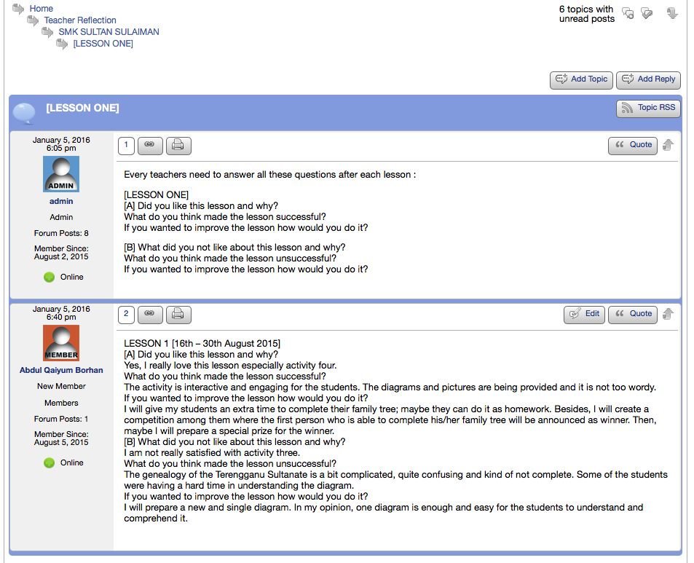
Your reply will appear here

