Slide 1
LaTeX Gaya UKM
Ir. Dr. Zambri Harun
Dr. Mohamad Rasidi Rasani
Dr. M. Asyraf Zulkifley

Slide 2
Introduction
What is LaTeX?
LaTeX is a document preparation system for high-quality typesetting often used for medium-to-large technical or scientific documents.

Slide 3
Objective
To introduce participants to general LaTeX writing skills.

Slide 4
Outcomes
It is expected that by the end of the course, participants are able to start using LaTeX for their thesis and developing their own documents and are able to continue learning LaTeX for more advanced applications.
Participants are able to use support from online resources or forum in the Internet.
Participants are able to troubleshoot errors arising from different types of compilers.
Participants should be comfortable in choosing LaTeX if there are options in publisher’s recommendation/guidelines.
Participant starts using Gaya UKM

Slide 5
Identifying System
For windows XP
Go to ‘Start’
Click ‘Run’ (command window)
Type: msinfo32.exe
Will show System Type: X86
X86 or X32 mean 32 bits, X64 means 64 bits

Slide 6
Schedule
Module 1: Time: 9.00pm: 12.30pm
Introduction to LaTeX
Installing Miktek
Installing different text editors
Module 2: 2.00-5:00pm
Typical manuscript requirement, figures, tables, bibliography,
referencing etc.

Slide 7
Example
Thesis
Articles

Slide 8
Module I
Installing Miktek
Installing WinEdt
Installing TeXnicCenter

Slide 9
Search Miktek in google
http://miktex.org/2.9/setup
Create a folder Miktek (or Miktek 2.9) in your c (or other) drive

Slide 10
Download to ‘C:\Program Files\Miktek’
ASK if not sure!
Make sure 32 bits or 64 bits

Slide 11
Downloading Miktek from the Internet
Will jam LAN, therefore download from:
‘\\jkmb-cae\Notes & Exercise\LaTeX Training’
Choose ‘basic-miktex-2.9.4521.exe’ 157 MB
So please STOP downloading now! And let the guys with 64 bits system download

Slide 12
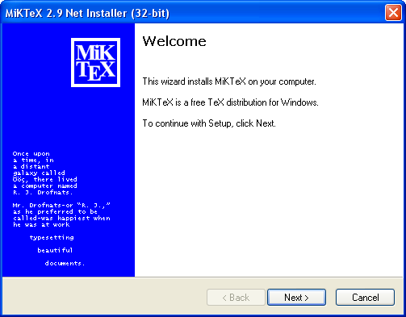
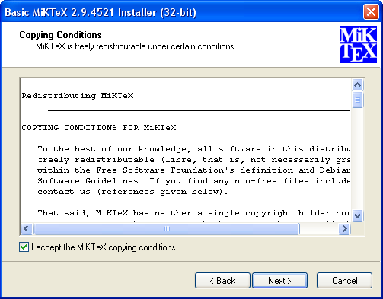
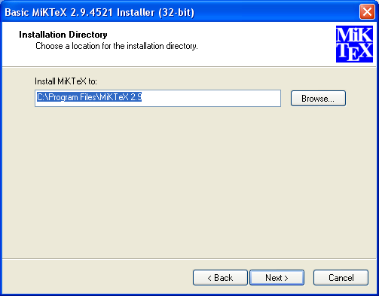
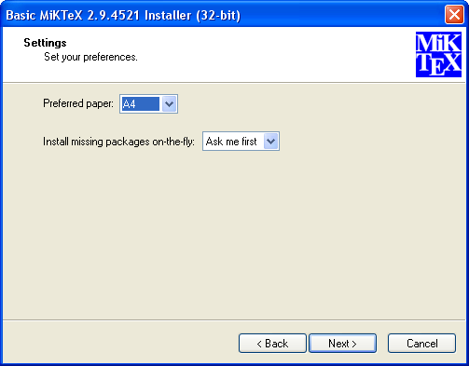
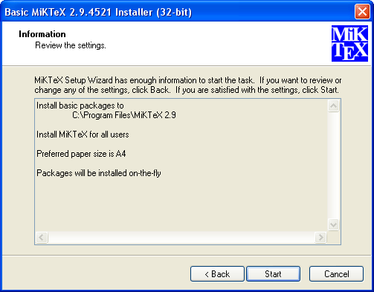
Steps in Installing Miktek
Welcome
I accept
Anyone
Install Miktek to …
a4 paper, on the fly
Start

Slide 13
Downloading & Installing WinEdt and TeXnicCenter
Install WinEdit by double clicking winedt55.exe
This is a 32bit installer

Slide 14
WinEdt
Miktek
Miktek

Slide 16
Installing TeXnicCenter

Slide 17
Installing TeXnicCenter

Slide 18
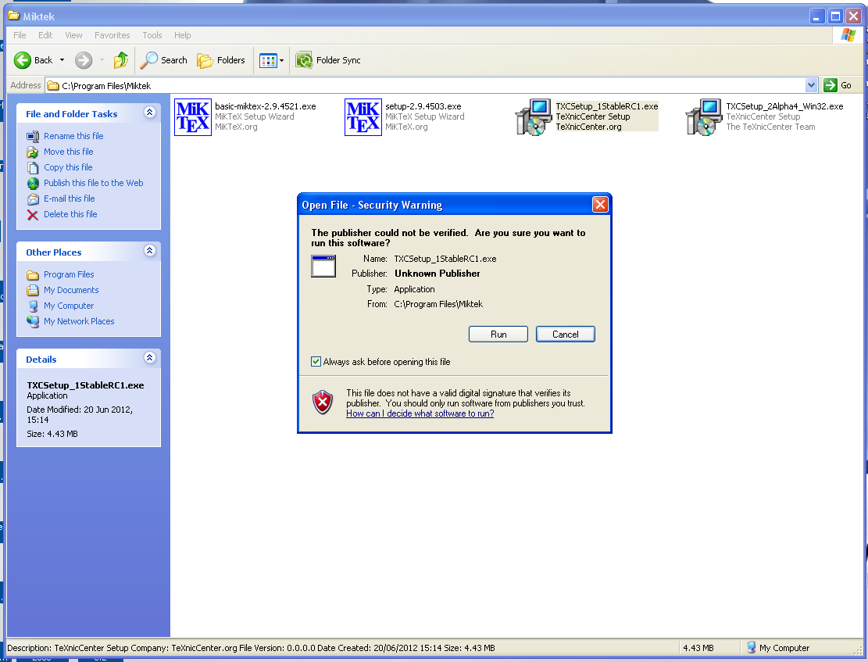
Installing TeXnicCenter

Slide 19
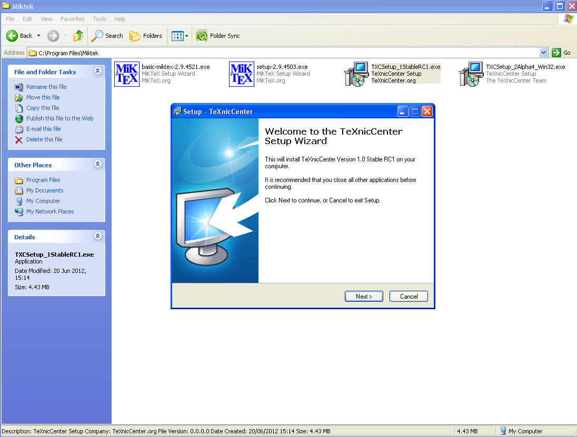
Installing TeXnicCenter

Slide 20
Installing TeXnicCenter

Slide 21
Installing TeXnicCenter

Slide 22
Installing TeXnicCenter

Slide 23
Installing TeXnicCenter

Slide 24
Installing TeXnicCenter

Slide 25
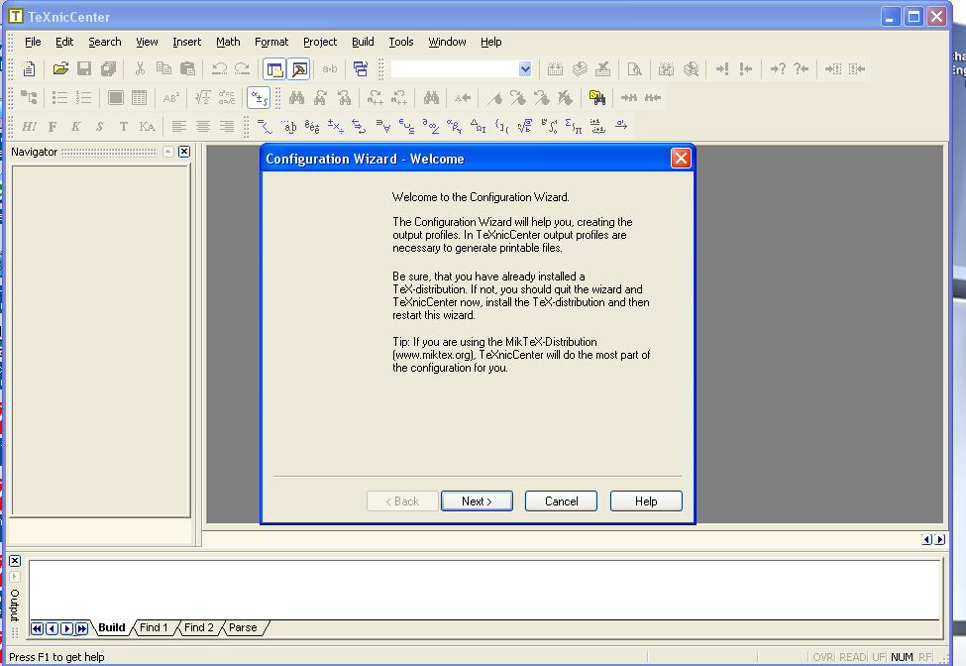
Configuring TeXnicCenter
Double click on TeXnicCenter icon, and after some ‘Tip’, a configuration wizard window should appear

Slide 26
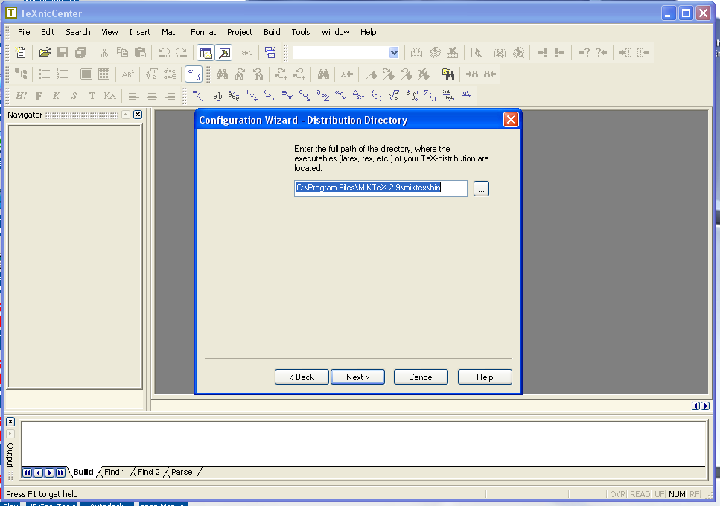
Configuring TeXnicCenter

Slide 27
Configuring TeXnicCenter

Slide 28
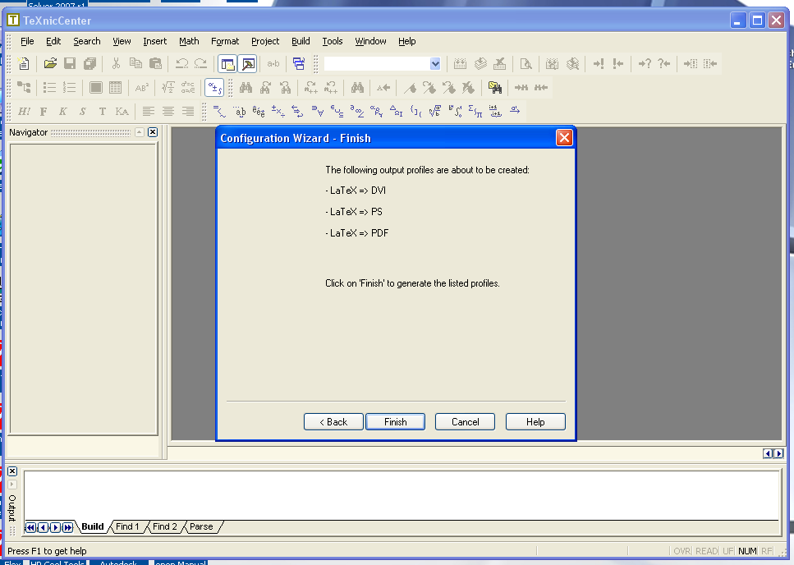
Configuring TeXnicCenter

Slide 29
Module II
Typical manuscript requirement, figures, tables, bibliography,
referencing etc.

Slide 30
Installing JabRef
Double click ‘JabRef-2.6-setup.exe’

Slide 31
Module III
Working with eps figures with added features and much increased quality
Intro
Installing ghost script
psfrag
Output from Matlab
My first manuscript in LaTeX

Slide 32
PostScript
PostScript (PS) is a dynamically typed concatenative programming language created by John Warnock and Charles Geschke in 1982. It is best known for its use as a page description language in the electronic and desktop publishing areas.
The concepts of the PostScript language were seeded in 1976 when John Warnock was working at Evans & Sutherland, a computer graphics company. At that time John Warnock was developing an interpreter for a large three-dimensional graphics database of New York harbor. Warnock conceived the Design System language to process the graphics. – source wikipedia.

Slide 33
eps
eps means Encapsulated PostScript
eps is a DSC-conforming PostScript document with additional restrictions which is intended to be usable as a graphics file format. In other words, EPS files are more or less self-contained, reasonably predictable PostScript documents that describe an image or drawing and can be placed within another PostScript document.
Document Structuring Conventions, or DSC, is a set of standards for PostScript, based on the use of comments, which primarily specifies a way to structure a PostScript file and a way to expose that structure in a machine-readable way. A PostScript file that conforms to DSC is called a conforming document. – source wikipedia.

Slide 34
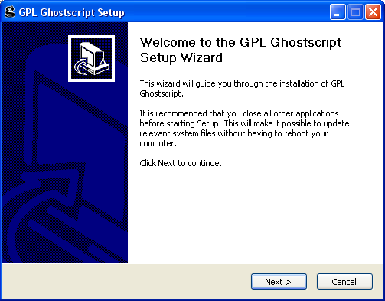
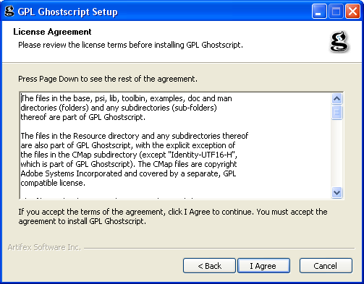
Installing Ghostcript
Double click on ‘gs905w32.exe’. What does 32 mean?

Slide 35
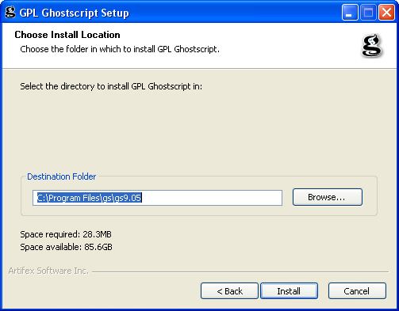
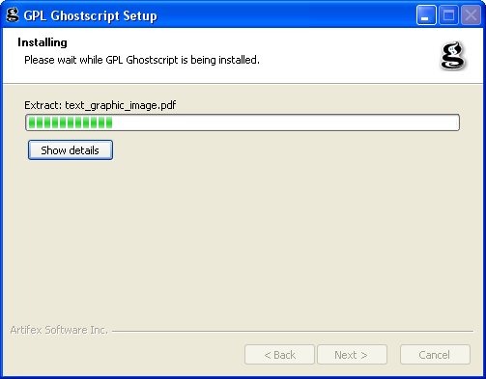
Installing ghostcript
Cont..

Slide 36
What is Ghostscript?
Ghostscript is an interpreter for PostScript™ and Portable Document Format (PDF) files. It is available both under the GNU GPL license and for commercial licensing from Artifex. It has been under active development for over 20 years and has been ported to many different systems during this time.
Ghostscript consists of a PostScript interpreter layer, and a graphics library. Sometimes the Ghostscript graphics library is confusingly also referred to simply as Ghostscript.
Binaries for Ghostscript for various systems can be downloaded from www.ghostscript.com/download. The source code is included in both the Ghostscript and GhostPDL downloads from the same site.
Source - http://sourceforge.net/projects/ghostscript/?source=recommended

Slide 38
Check WinEdt

Slide 39
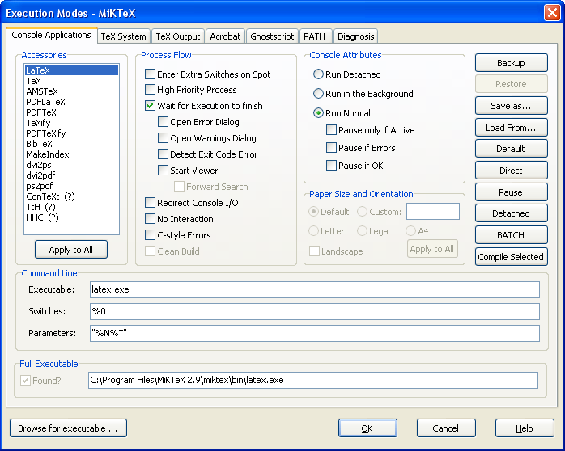
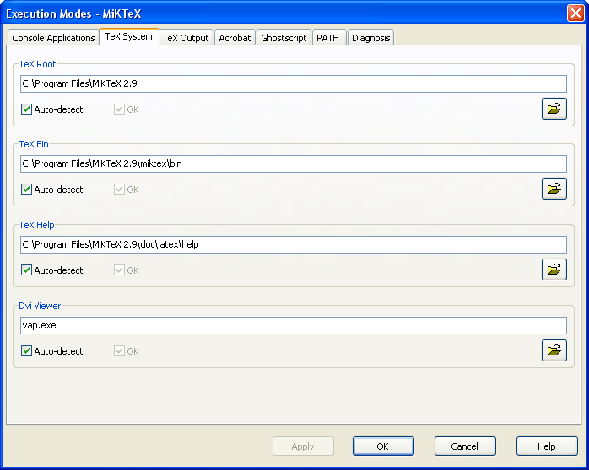
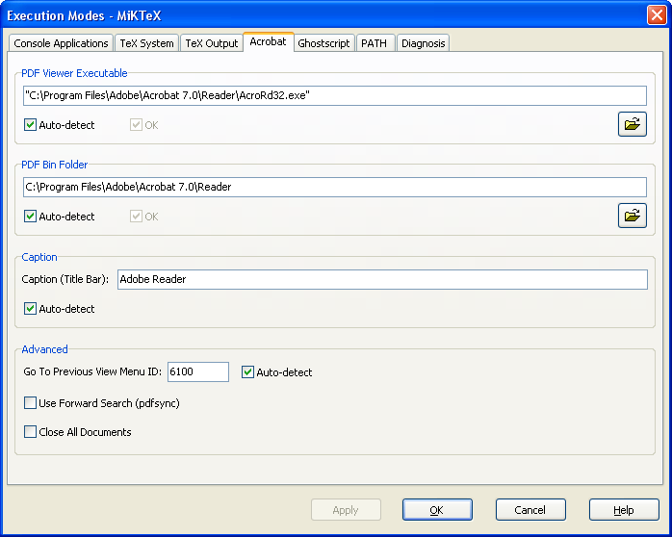
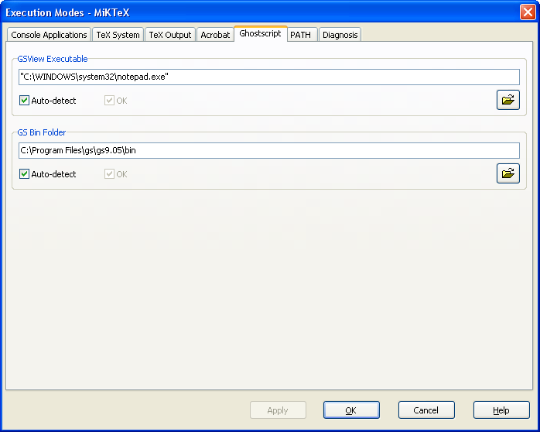

Slide 40
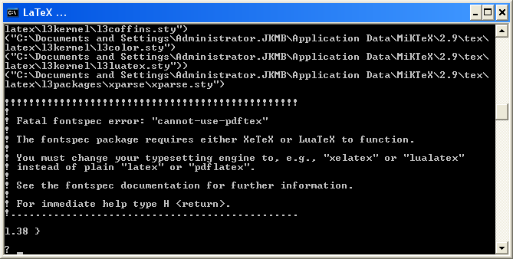
Use TextWorks
Cannot run using LaTeX
Use others e.g. XeLaTeX

Slide 41
Cont
Using eps

